Slide 1
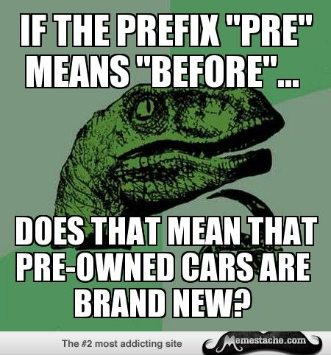
Home Learning: English
Thursday: Spelling
What is a prefix?

Slide 2
A group of letters that is added to the beginning
of a word to change its meaning.
It's similar to a suffix, which is added to the
end of a word.
E.g. the verb 'take' can be made into 'mistake'
with a prefix and 'taking' with a suffix.

Slide 3
Meaning: to take away or reduce.
Examples: deactivate, defuse and deface.
de
Unfortunately, the street sign had been defaced..
Can you write your own “de-” word to show your understanding of this prefix?

Slide 4
Meaning: to remove, reverse or not to have
Examples: disconnect, disagree, discomfort.
dis
I had to disconnect
my printer from my
computer.
Can you write your own “dis-” word to show your understanding of this prefix?

Slide 5
Meaning: to happen again and to back away
Examples: reread, return and retreat
re
I had to re-read the story because I didn’t
understand it at first.
Can you write your own “re-” word to show your understanding of this prefix?

Slide 6
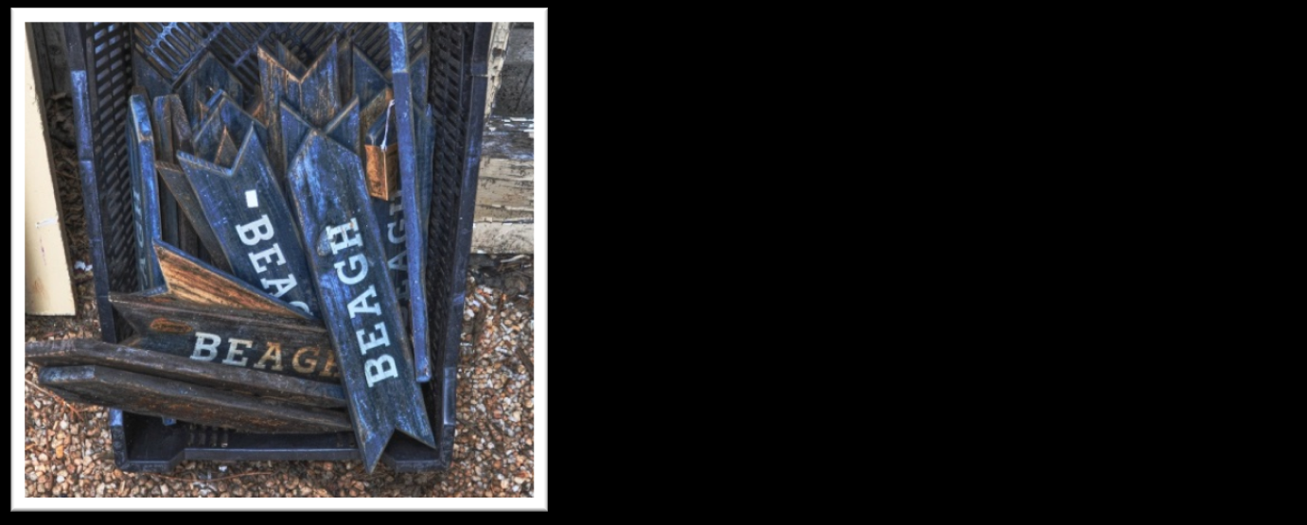
Meaning: wrongly, badly or unsuitably
Examples: misinform, mismanage, misspell.
mis
The signs couldn’t be used because “beach” had been misspelt.
Can you write your own “mis-” word to show your understanding of this prefix?

Slide 7
Meaning: too much and something that is over or on the outside. Examples: overreact, overtake and overfill.
over
The black racing car tried to overtake his opponent.
Can you write your own “over-” word to show your understanding of this prefix?

Slide 8
Match the prefix
to the definition
and think of as many
words as possible.
Use a dictionary if you need help!
re dis over mis de
too much and something that is
over or on the outside.
wrongly, badly or unsuitably
to remove, reverse or not to have
to take away or reduce.
to happen again and to back away

Slide 9
Match the prefix
to the definition
and think of as many
words as possible.
Use a dictionary if you need help!
re dis over mis de
too much and something that is
over or on the outside.
wrongly, badly or unsuitably
to remove, reverse or not to have
to take away or reduce.
to happen again and to back away

Slide 10
The Year 5 and 6 Spelling Words

Slide 11
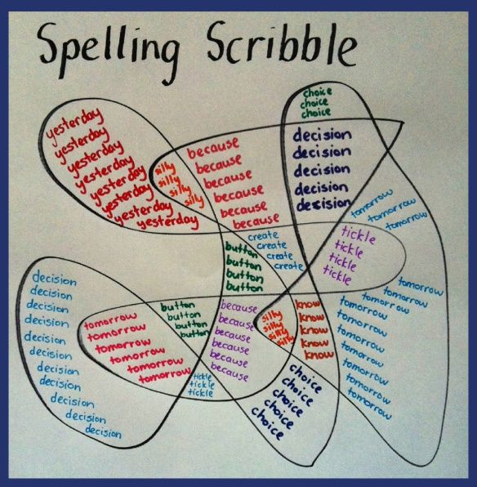
Spelling Rule: The Year 5 and 6 Spelling Words
Draw a spelling squiggle for the “b” and “c” Year 5 and 6 words!

