Slide 1

Home Learning: English
Wednesday: Writing

Slide 2
Instructional Writing
Today, we will revisit how to write a set of instructions linked to Skellig. You have two instructions to chose from for your writing:
Option 1
Difficulty Level **
Purpose: To write instructions on how to make a meal that would truly delight Skellig, using what we know about his eating habits. You will need to persuade Skellig that the meal you are instructing him to make will be the tastiest meal he has ever had.
Audience: Skellig
Option 2
Difficulty Level ***
Purpose: To plan the perfect meal which will convince Skellig to eat it, instead of eating the people living inside the house.
Audience: The people (adults or children) living inside the house. They will make the meal for Skellig so they need to be convinced that this meal will persuade Skellig to it, instead of them.

Slide 3
Things To Consider
Skellig is half bird (owl), half angel
Skellig has so far survived on a diet of spiders and flies
Skellig suffers from a bone condition called arthritis
Fish, olive oil garlic, ginger, broccoli, walnuts, berries, spinach and grapes are apparently the 9 best foods to eat if you have arthritis
When Michael asks him what he would like, he replies with ‘27 and 53’, which Michael realises is off of a Chinese takeaway menu
Skellig appears to be rather grumpy and negative, moaning wherever possible

Slide 4

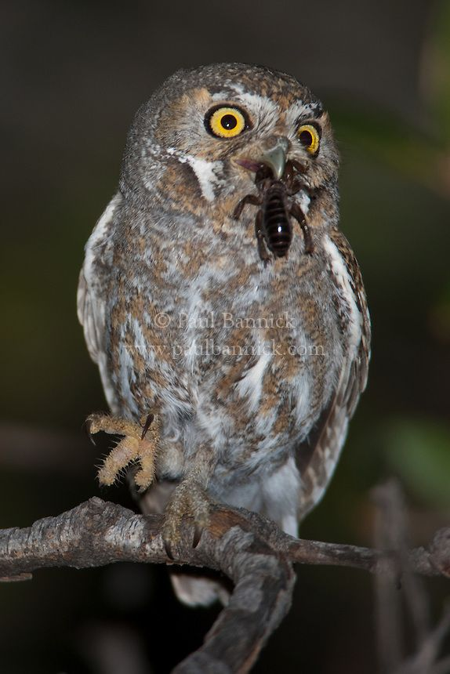
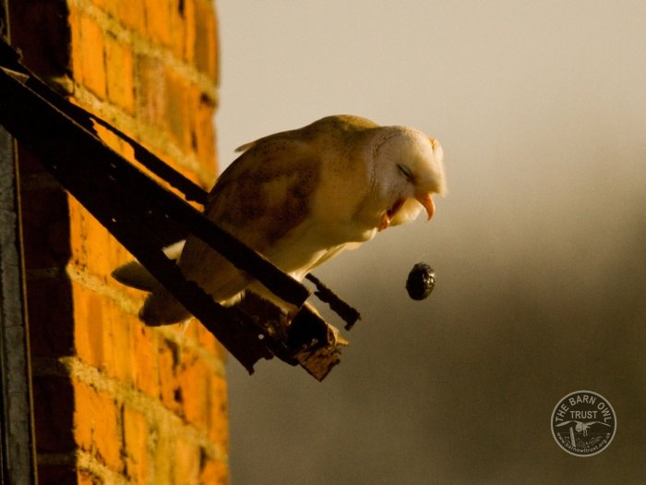
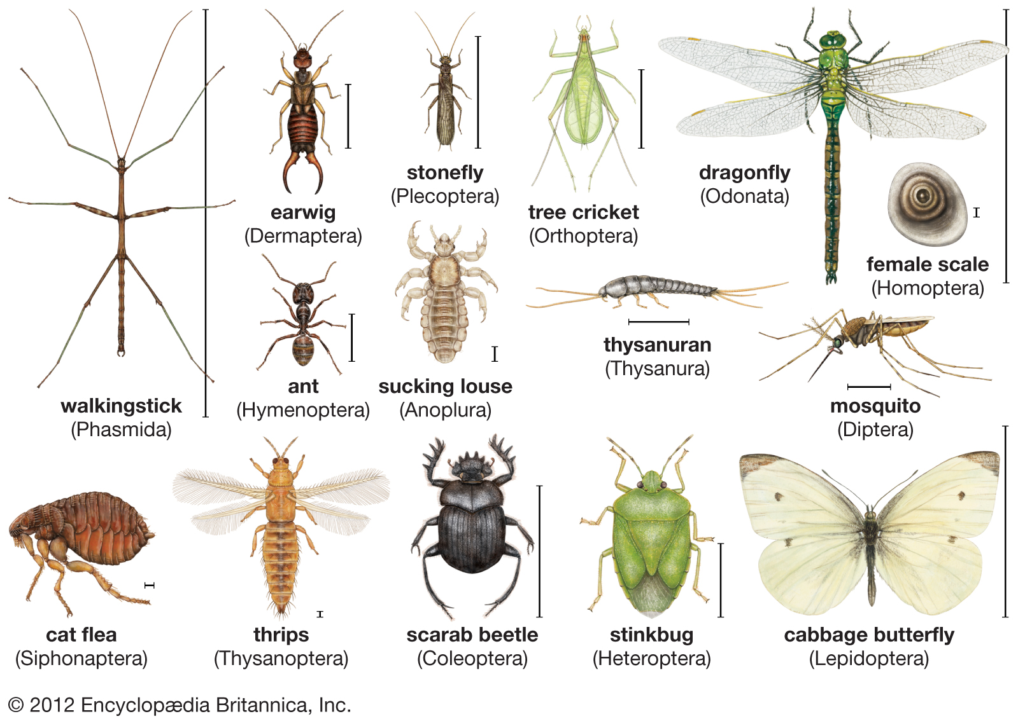


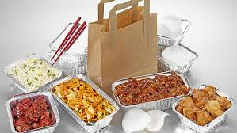
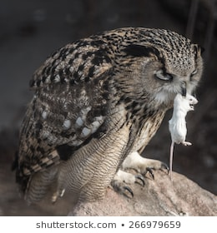
Yep, that’s an owl pellet
‘27 and 53’

Slide 5
Planning: Shoulds
Planning is a personal process and you will by now have developed a planning format which you prefer for e.g. I like to use mind maps for non-fiction texts, where I use different coloured pens to make my Year 6 grammar stand out.
What your planning should include:
Introduction
Equipment list
Method
Concluding paragraph
Language Toolkit (see next slide)
Varied year 6 punctuation ; : - () ,

Slide 6
Planning: Shoulds
Instructions Language Toolkit
Remember to…
Use imperative verbs (e.g. Put seats into the upright position)
Use the present tense or third person for instructions
Use some time conjunctions (e.g. first, next)
Use accurate descriptions in order to make the instructions clear (e.g. Fold the smaller piece of paper in half)
Use technical language related to the subject (emergency exit, aisle)
Where relevant extend the instruction to provide extra advice and explanation (e.g. Insert the metal tab into the buckle)

Slide 7
Planning: Coulds
Below are some examples of ways in which you could plan your instructions. Remember, these are only ideas so take ownership and plan your instructions in the format that you prefer.
 | Language Toolkit | Varied Year 6 Punctuation
Introduction
Equipment List
Method
Concluding Paragraph
Remember to include sentence examples in your plan

Slide 8
Planning: Coulds
Below are some examples of ways in which you could plan your instructions. Remember, these are only ideas so take ownership and plan your instructions in the format that you prefer.
Write clear instructions using relevant language
Direct your ending to the reader
State your purpose

Slide 9
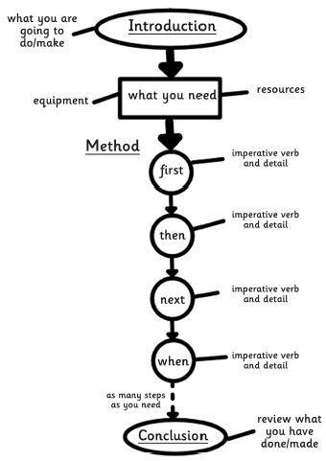
Planning: Coulds
Below are some examples of ways in which you could plan your instructions. Remember, these are only ideas so take ownership and plan your instructions in the format that you prefer.

Slide 10
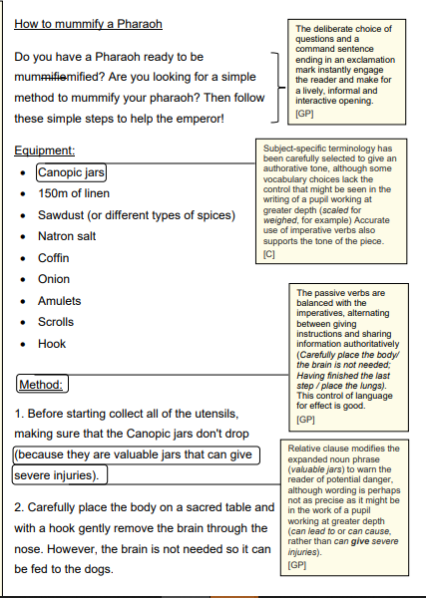
WAGOLL Instructions
This child is working at the expected standard for Year 6. After a visit linked to their Egyptian topic, they wrote a set of instructions on how to mummify a Pharaoh.

Slide 11
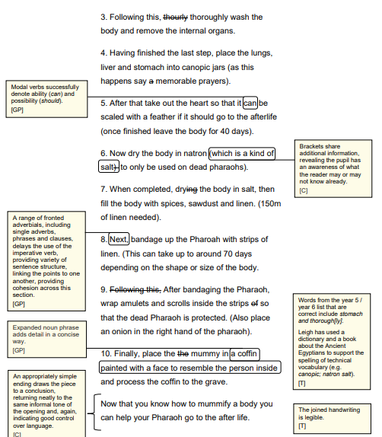
WAGOLL Instructions

Slide 12
WAGOLL Instructions: Introduction
Are you afraid at night of something terrible living in your garage? Do you fear you will be Skellig’s next meal? Well don’t despair, just follow these instructions to help you create the perfect meal.

