Slide 1
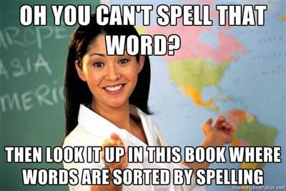
Home Learning: English
Wednesday: Spelling

Slide 2
Can you guess the spelling rule?
presented
beginning
listener
forgotten
transferring
beginner
listened
upsetting
gardening
preferred

Slide 3
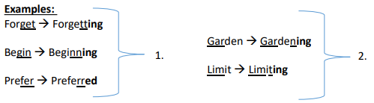
Spelling Rule: If the last syllable of a word is stressed and ends with one consonant letter which has just one vowel letter before it, the final consonant letter is doubled before any ending beginning with a vowel letter is added. The consonant letter is not doubled if the syllable is unstressed.

Slide 4

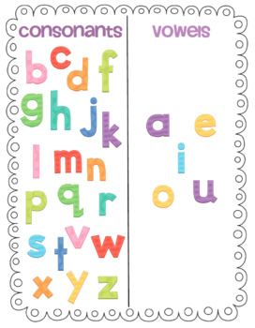

Spelling Rule: If the last syllable of a word is stressed and ends with one consonant letter which has just one vowel letter before it, the final consonant letter is doubled before any ending beginning with a vowel letter is added. The consonant letter is not doubled if the syllable is unstressed.
A syllable sounds like a beat in a word. Syllables have at least one vowel (a, e, i, o, u), and possibly one or more consonants.
Can you sort the words below into words with one syllable or more than one syllable?
One Syllable
More Than One Syllable
begin
shine
forget
rain
garden

Slide 5
Spelling Rule: If the last syllable of a word is stressed and ends with one consonant letter which has just one vowel letter before it, the final consonant letter is doubled before any ending beginning with a vowel letter is added. The consonant letter is not doubled if the syllable is unstressed.
Watch:
https://www.bbc.co.uk/teach/class-clips-video/english-ks2-wonderful-words-suffixes-part-1/zdnd7nb
Read:
https://connect.collins.co.uk/CLPPrimary/TreasureHouseY3_Sample/contents/TH_INF_Spelling_U1.html
Play:
https://spellingframe.co.uk/spelling-rule/8/1-Adding-suffixes-beginning-with-vowel-letters-to-words-of-more-than-one-syllable
https://www.spellzone.com/word_lists/games-4910.htm

