Slide 1
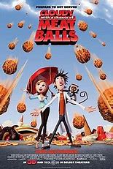
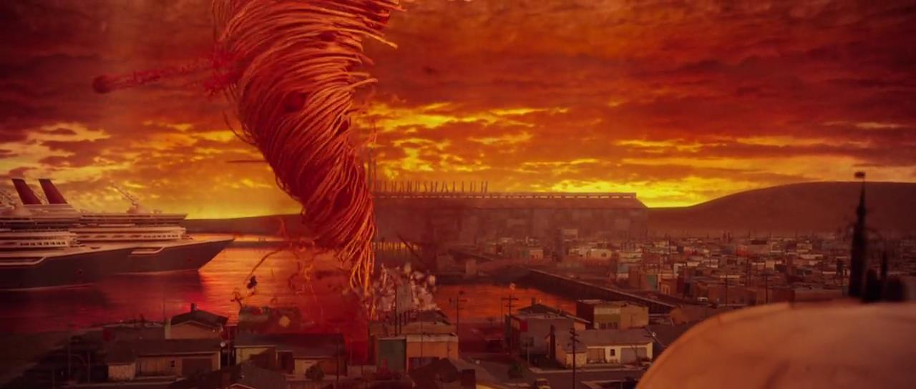
Home Learning: English
Wednesday: Writing

Slide 2
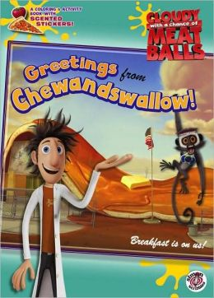
Imagine if food fell from the sky like rain…wouldn’t it be great? Or would it? This is what happened in the tiny town of Chewandswallow.

Slide 3
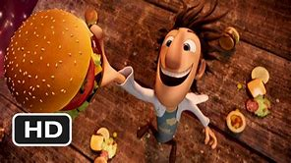
In many ways it was much the same as any other small town, except for the weather…which came three times a day, at breakfast, lunch and dinner.

Slide 4
Sometimes it rained soup and juice, or snowed mashed potatoes, once or twice it even blew up a storm of hamburgers.

Slide 5

Life was pretty delicious in Chewandswallow…until the weather took a turn for the worse!

Slide 6
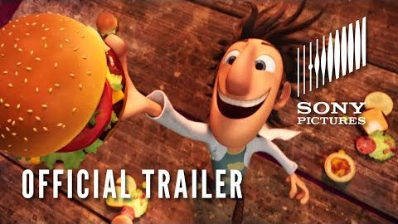
Lets find out about what happened in Chewandswallow.
https://www.youtube.com/watch?time_continue=8&v=pUaKcFI4BZY&feature=emb_logo

Slide 7
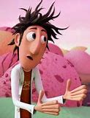

Flint Lockwood / Chewandswallow
Aspiring scientist
Made many inventions
(mostly bad – “Ratbirds” and “Remote control TV”)
Lived in Chewandswallow
Found out how to turn water into food (best invention yet)

Slide 8
Newspaper article writing
Today we are going to write a newspaper article about what happened in Chewandswallow.
Let’s first look at what a newspaper article should look like.

Slide 9
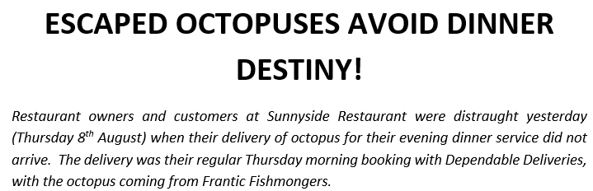
An introductory paragraph must tell the reader what the article is going to be about. It tells us the 5 Ws: Who? What? Why? Where? When?
A short, catchy headline must grab the reader’s attention. It can be in capital letters or bold to stand out.

Slide 10
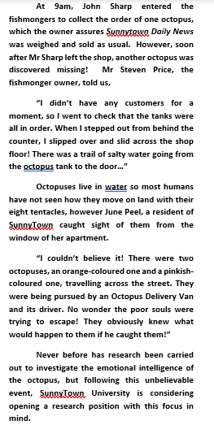

Write your newspaper article in the third person.
Ensure that you use the past tense. We are talking about something that has already happened.
Split your writing into paragraphs to help the reader clearly understand the information.
A newspaper can be written in columns.

Slide 11
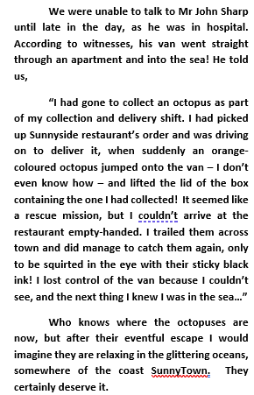
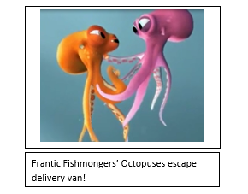
Use quotes to make your report more interesting and believable. Make sure that you use inverted commas (speech marks) to punctuate these.
Your newspaper article will report both facts and opinions.
Use a photo with a caption to enable to the reader to imagine what has happened.
Opinions will come from your quotes from eye witnesses or experts.
Facts will come from the 5 Ws. You will need to expand on these (add more detail) in the main body of your text.

Slide 12
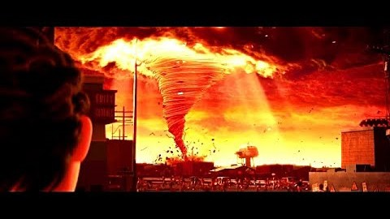
Newspaper article writing
So what happened in the small town of Chewandswallow?
https://www.youtube.com/watch?v=MrftPRShFdY

Slide 13
Newspaper article writing
It is always important to plan before you write. However, it is up to you how you do this. On the next slide are boxes outlining the key parts to a newspaper with some guidance on what to put in.
Note down your initial ideas, in your green book, of what you will put in each section of your newspaper article.

Slide 14
Catchy headline – try not to use too many words.
For example, you could use, “SPAGHETTI TWISTER TURMOIL!”
Introductory paragraph
Who? Flint Lockwood
What? Invention causes a twister (tornado)
Why? Wanted to make food for everyone
Where? Small town of Chewandswallow
When? Make up a date
Main body continued:
Did you get an interview with Flint? What did he say?
Did you get any comments from bystanders?
(perfect opportunity to use SPAG learning – speech marks)
Were there any damages caused?
What was the twister caused by?
How did they stop it?
Will it happen again?
What advice would you give to people in the future?
Main body of writing
Use more detail to discuss the 5Ws outlined above.
What details could you add?
Picture with a caption
What picture will summarise the article?

