Slide 1
Home Learning: English
Wednesday: Writing

Slide 2
Persuasive speech writing
A persuasive speech is a specific type of speech in which the speaker has a goal of convincing the audience to accept his or her point of view.

Slide 3
Techniques
There are many techniques you can use when writing persuasively.
Rhetorical Question
A rhetorical question isn't used so that you get an answer.
Its purpose is to make the reader think...
You could start your persuasive speech with a rhetorical question.
Examples
Do we need to change our lives when everything gets back to normal?
Is there a lesson that we should learn?

Slide 4
Techniques
There are many techniques you can use when writing persuasively.
2) The Rule of Three
Using the rule of three is a great way to ensure that
your point that you are trying to persuade/argue is clear.
Using three examples shows the listener/reader that
your point is backed up by three pieces of evidence...meaning you must be right!
Examples
We can use this as an opportunity to make our society better. We can make sure that we wash our hands. This will reduce the amount of germs being spread, we will all be healthier and we can spend more time doing the things we want.

Slide 5
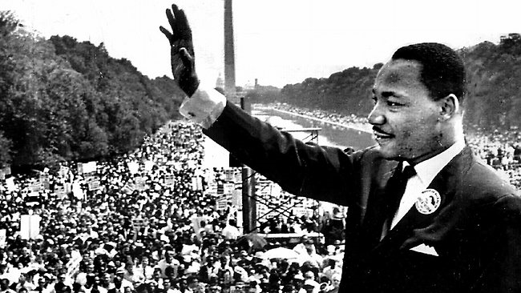
Techniques
There are many techniques you can use when writing persuasively.
3) Repetition
Using repetition is a great way to make your speech memorable. If you repeat a phrase of word, it will be “catchy” and the listener will be able to remember what was said. Repetition can also give a point that you are making more emphasis.
Think back to Martin Luther King’s “I have a dream” speech.
Examples
Children need to…children need to…children need to…
In ten years time, we will look back on this with pride. In ten years time, we will have made massive changes. In ten years time, we will have a healthier and more kind world.

Slide 6
Techniques
There are many techniques you can use when writing persuasively.
4) Anecdote
An anecdote is a short and interesting story taken from a person's past experience - or that of someone they know or have heard about.
For your writing, of course, your own anecdotes will need to be imaginary - made up (but they must still be entirely believable and relevant).
Examples
I woke up this morning and thought to myself, when this is over I hope that…
On a recent visit to the supermarket I didn’t see any cars on the road, I smelt the fresh air all around me and I knew that this was the time to change.

Slide 7
Subject: What should we change about our world when we get back to normal?
Yesterday you wrote 5 sentences about how life should be when we are back to normal. You can use these in your speech.
Some of my examples are below.
If I were you, I would catch public transport or walk to school so that we are damaging our environment less.
I recommend that we all phone or call our grandparents to make sure they are okay in these troubling times.
When this is all over, I insist that everyone washes their hands as regularly as possible to stop the spread of germs.

Slide 8
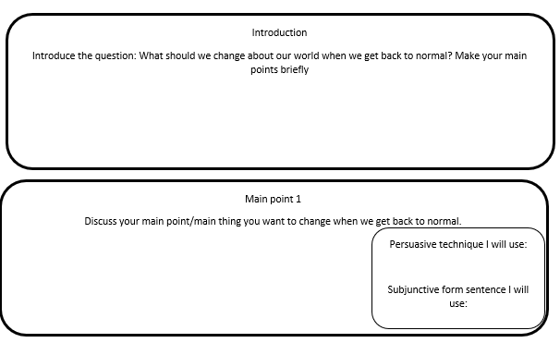
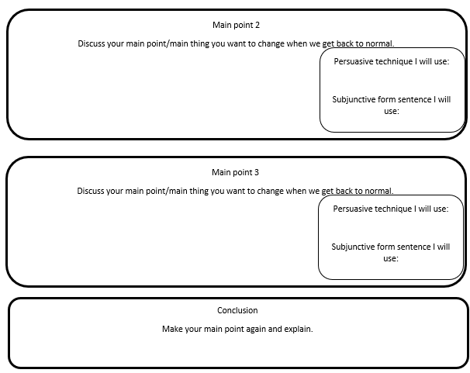
Before you write your persuasive speech, first you need to plan.
Even though your detailed points are essential, it is also crucial that you use some of the persuasive techniques we have looked at and the subjunctive form. Add them in when you plan.

Slide 9
Subject: What should we change about our world when we get back to normal?
Time to write!
Remember:
Expand on your points
Use the persuasive techniques where appropriate
Use the subjunctive form to offer advice
Proof-read after every paragraph to ensure impact on the reader and so that there are no basic errors

