Slide 1

Home Learning: English
Wednesday: Writing

Slide 2








Jayson Reynolds
He is a New York Times best-selling author
He is a national Book Award Finalist for Young People's Literature.
Here’s a word from him: “Here's what I know: I know there are a lot — A LOT — of young people who hate reading. I know that many of these book haters are boys. I know that many of these book-hating boys, don't actually hate books, they hate boredom. If you are reading this, and you happen to be one of these boys, first of all, you're reading this so my master plan is already working (muahahahahahaha) and second of all, know that I feel you. I REALLY do. Because even though I'm a writer, I hate reading boring books too.’

Slide 3
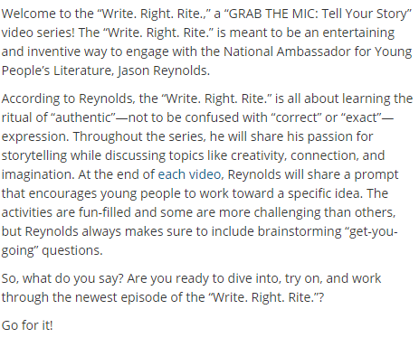

#WriteRightRite
Check out his video →
https://guides.loc.gov/jason-reynolds/grab-the-mic/wrr

Slide 4
Your Challenge from Jason Reynolds
To write a letter from your hero to you.
Purpose: To give yourself purposeful, life advice based on you hero’s experiences, successes and views.
Audience: YOU!

Slide 5



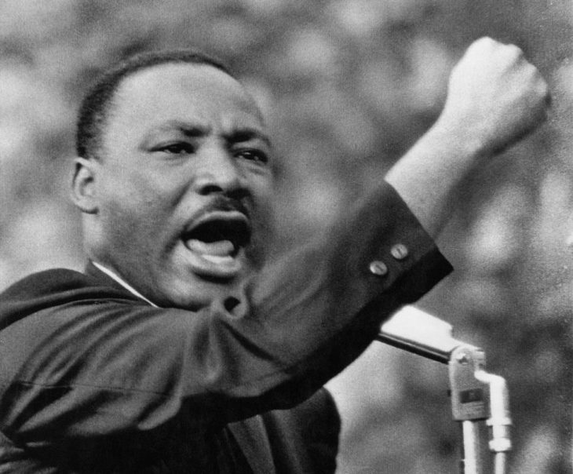


Who’s your hero and why?
A family member?
A singer/performer?
Workers of the NHS?
A fictional character?
A historic figure?
A sports personality?

Slide 6
Things To Consider
How does your hero speak? Are they chatty and funny, gentle or harsh? If they’re from another time period or country, then do they use words we do not often hear?
Will your letter be informal or formal?
What struggles has your hero conquered?
What successes has your hero achieved?
What advice would they give you based on these?

Slide 7
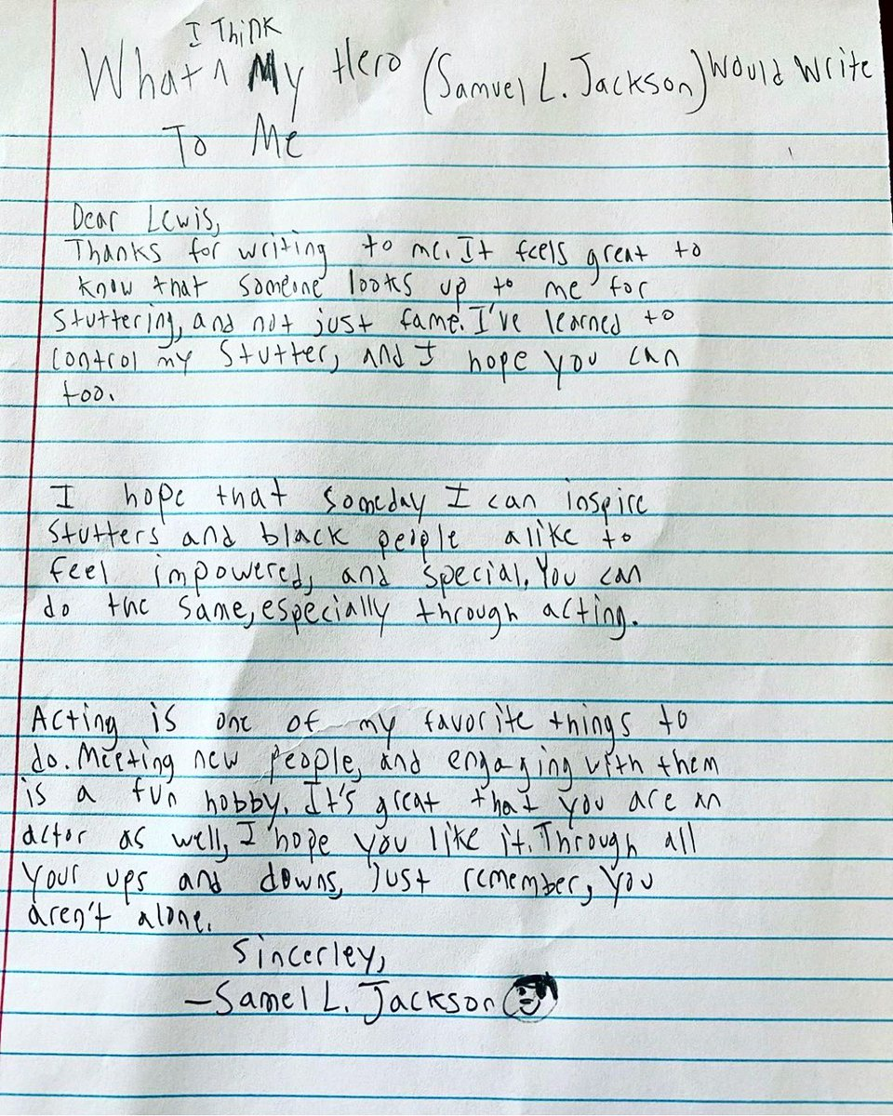
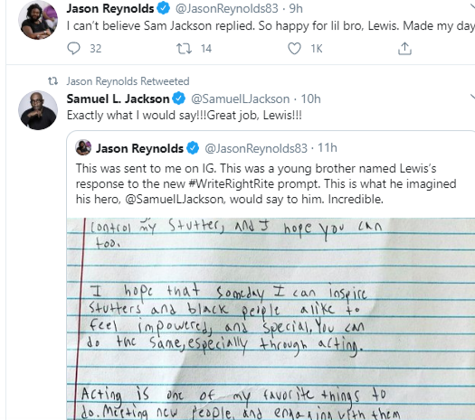
Your hero may even reply to your letter…

Slide 8
Letter Writing Language Toolkit
Write in the first person
Want to make it informal? Use idioms and colloquialisms
Choose emotive language when reflecting on your experiences (Winning my first World Championship was a dream-come-true)
Use words that give reasons for your point of view (because, so, this means that)
Use dare-to-disagree expressions to get the reader on your side. Try to appear friendly and reasonable (There is no doubt that you can achieve your dreams too)
Use cohesive devices to signal your points (In my earlier career,…)
Use alliteration, rhyme and modal verbs (probably, perhaps) to help persuade
Use rhetorical questions (Ever doubted your own capabilities?)

Slide 9
WAGOLL Planning
Purpose/ audience: I’m Lewis Hamilton, writing a letter of advice to Miss Williams on how to conquer her life goals. How will this affect how you write your letter: Lewis is a chilled and cool guy so he will use informal language but he is also very reflective and will give very thoughtful advice.
Opening: Why are you writing? Advice 1: Never doubt yourself. Advice 2:Choose a supportive team to have around you and keep them. In the 7 years I have been with Mercedes, I have won 5 World Championship Titles. Advice 3: Enjoy every moment. I am in the latter stages of my career which seems to have literally raced past me. I have experienced things I always new were possible but sometimes I doubted were probable. Every the highs, the lows and every single moment in-between. Closing:
Techniques/ vocabulary:

Slide 10
Another way to plan…
Advice 1
Why writing?
Advice 2
Sign off
Advice 3

Slide 11
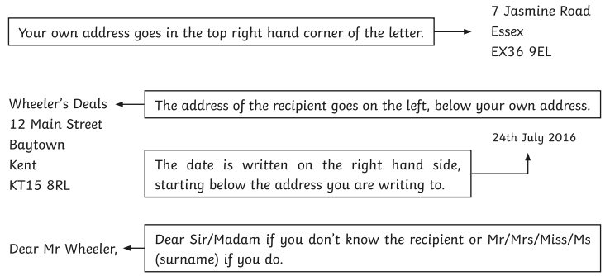
Setting Out a Formal Letter

Slide 12
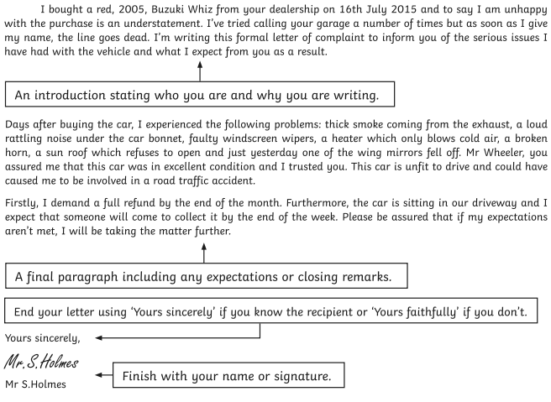
Setting Out a Formal Letter

