Slide 1

Home Learning: English
Tuesday: Grammar

Slide 2
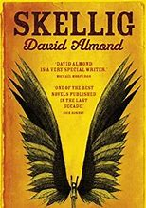
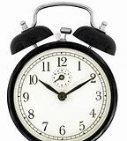
Write a sentence that gives advice for the two situations…
Mr Silvester is really struggling to get up early enough because he isn’t in school.
Michael and Mina are worried about Skellig being in the shed alone.
Notes:
Answers could be:
If I were you, I would set an alarm.
If I were you, I would go and check on Skellig to see if he is okay.

Slide 3
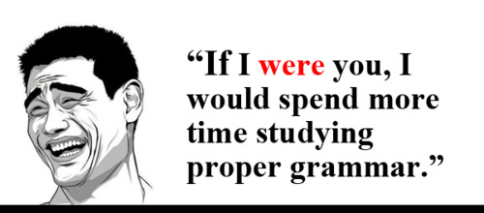
Did you start your sentence with “If I were you”?
If you did, you are using the subjunctive form.

Slide 4

The subjunctive mood is all about how the verb (doing word)appears in a sentence.
Subjunctives make language sound more formal.
They can be used for:
•showing conditions that are not true;
•making a command more formal;
•making a wish more formal;
•making a request more formal

Slide 5
The subjunctive form Have a look at these sentences. What is the subjunctive form below? If I were him, I would sharpen my pencil. Were I a little bit younger, I would be able to run around all day. I would stay up really late if I were younger. If I were him, I'd sleep a little bit earlier than 11pm.
We use the verb “were” instead of “was” as it sounds more formal.

Slide 6
ANSWERS If I were him, I would sharpen my pencil. Were I a little bit younger, I would be able to run around all day. I would stay up really late if I were younger. If I were him, I'd sleep a little bit earlier than 11pm.

Slide 7
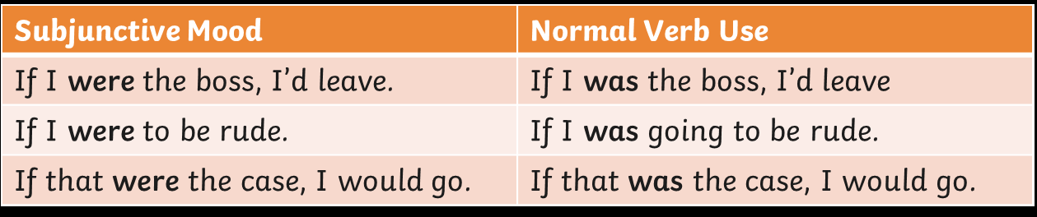
Can you change this sentence so that it is in the subjunctive form?
If I was rich, I'd buy a Ferrari.
Notes:
Answer: If I were rich, I’d buy a Ferrari.

Slide 8
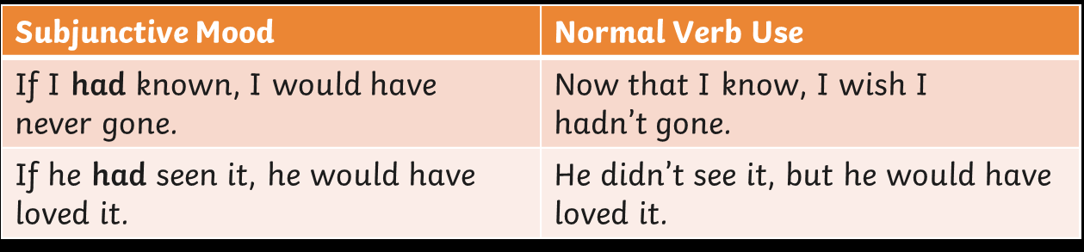
'Had' can also be used to create the subjunctive mood in sentences that show things that are not true.
Can you change this sentence so that it is in the subjunctive form?
Notes:
Answers: If I had known, I would have never gone.
If he had seen it, he would have loved it.

Slide 9

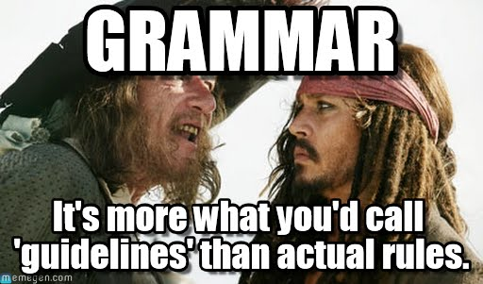
The subjunctive form is formal.
Instead of using “was” we use “were”.
It often has the word “if” in it, but not always.
You can also use “had” to create the subjunctive form.

Slide 10
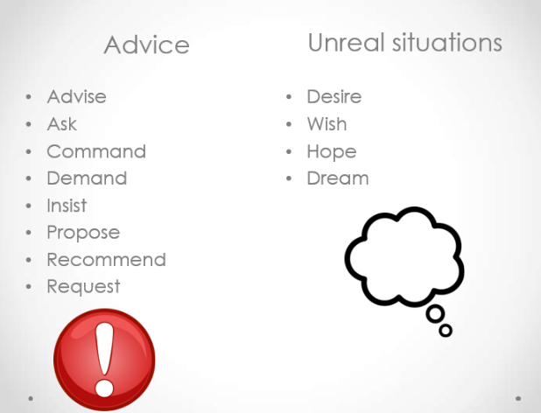
A few more things…
We can use the subjunctive when we use formal verbs to give advice, a command or for unreal situations.
We need to use the word “that”.
Formal verbs you can use in the subjunctive form.

Slide 11
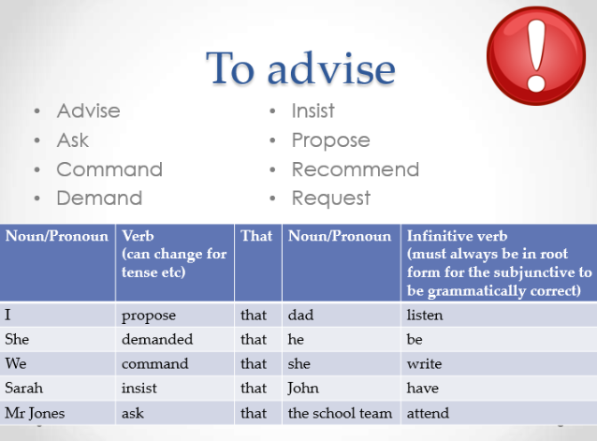
Write a sentence using each of the formal verbs:
Propose
Demand
Command
Insist
Ask
For example,
I propose that we open school as soon as it is safe to do so.
Notes:
Example answers:
She demand that the children listen.
We command that they all stay indoors.
I insist that you take the last slice of cake.
I ask that you all play Monopoly kindly.

Slide 12

The subjunctive form is formal.
Instead of using “was” we use “were”.
It often has the word “if” in it, but not always.
You can also use “had” to create the subjunctive form.
Formal verbs can also be used to create the subjunctive forms.
When using a formal verb like “demand” you also need “that” in the sentence.

Slide 13
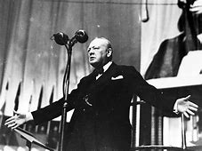
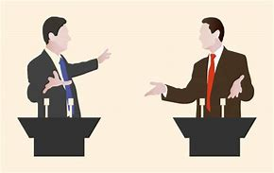
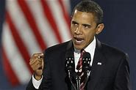
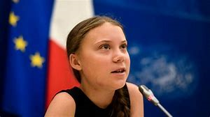
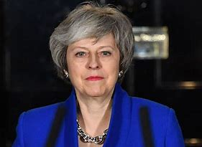
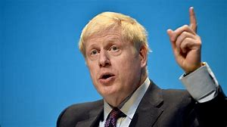
Tomorrow you will be writing our own persuasive speech.
Subject: What should we change about our world when we get back to normal?

Slide 14
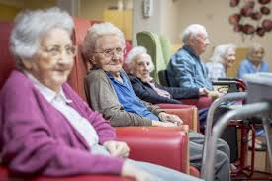
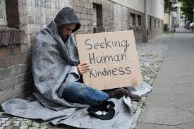
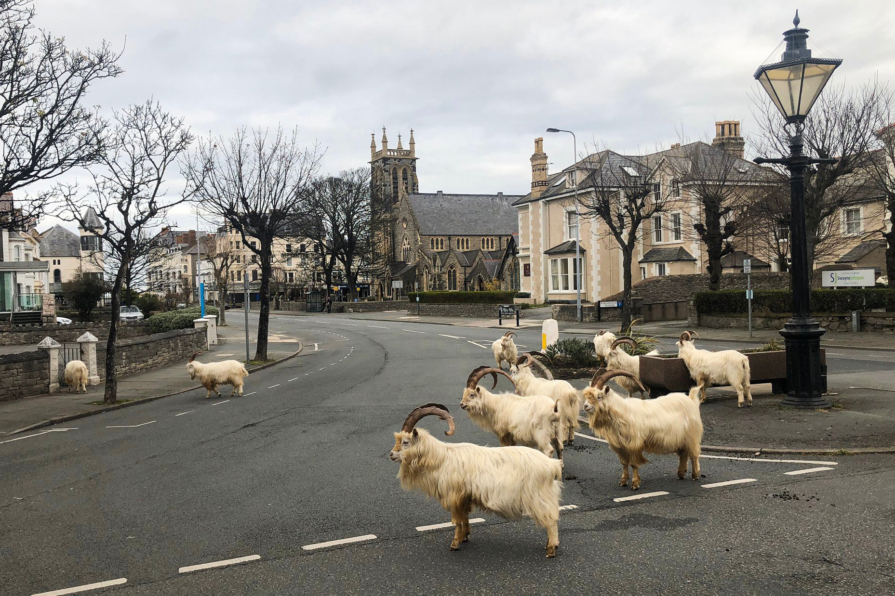

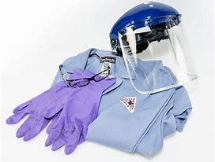
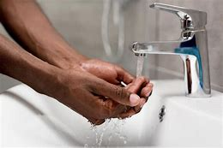
Subject: What should we change about our world when we get back to normal?
Use the subjunctive form to write at least 5 sentences about how life should be when we are all back to normal. Use the previous slides to help you on the subjunctive form.
Ideas that might help
What would we like to change/make better?
Notes:
Notes for parents:
In tomorrow’s persuasive speech, the children will be writing to the public on how we should all change our lives after we are allowed to go back to school.
Ideas could include:
Ensuring that doctors and nurses working in the NHS are looked after and work manageable hours.
Anyone who is in potential danger should have protective equipment. (You could discuss both of these points in relation to what is happening now)
We should all make sure we as hygienic as possible by washing hands regularly so that we don’t spread germs.
People should drive less to limit pollution in the world.
We should look after our most vulnerable adults – the elderly and the homeless - and ensure they are safe.
Example sentences:
If I were you, I would catch public transport or walk to school so that we are damaging our environment less.
I recommend that we all phone or call our grandparents to make sure they are okay in these troubling times.
When this is all over, I insist that everyone washes their hands as regularly as possible to stop the spread of germs.

