Slide 1
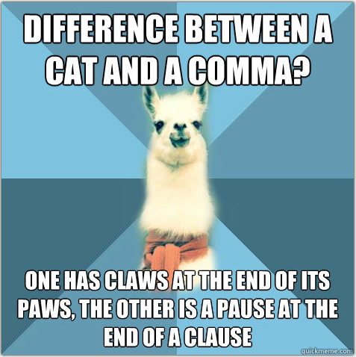
Home Learning: English
Tuesday: Grammar

Slide 2
Today we are researching subject specific vocabulary for tomorrow’s writing task (take a sneak peek).
You will be given a list of technical terms linked to either owls, angels or Skellig himself. You will need to research the terms and create a word map of at least 4 of the words. Examples of word maps have been provided for you to look at.
The word maps will give you a firm grasp of the meaning of the words, in order for you to use them in tomorrow’s writing. I have included some words which you could most definitely use as a type of pun for e.g. ‘heavenly meal’ so keep this in mind for tomorrow.

Slide 3
Subject Specific Vocabulary
What is ‘subject specific vocabulary’?
Each subject has words which are either used specifically in that subject area (and not in general English), or common words which are used with special meaning in that subject area. Such words are known as technical or subject-specific words. The following are two examples of non-general words used in the subject area of the human circulatory system:
White-blood cell: a type of cell found in the blood which fights off viruses and disease
Pulmonary Vein: the vein that transfer oxygenated blood from the lungs to the heart

Slide 4
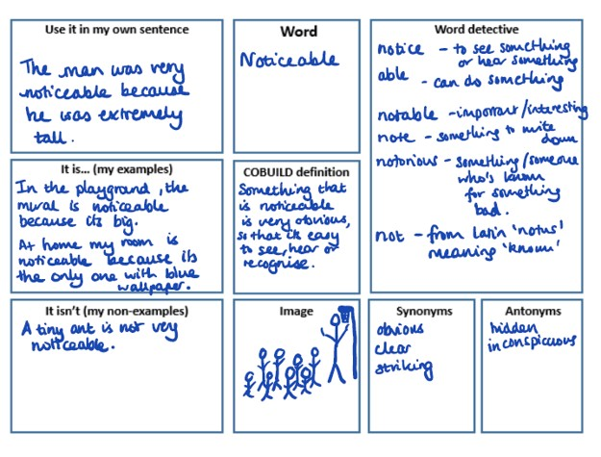
Example Word Maps

Slide 5
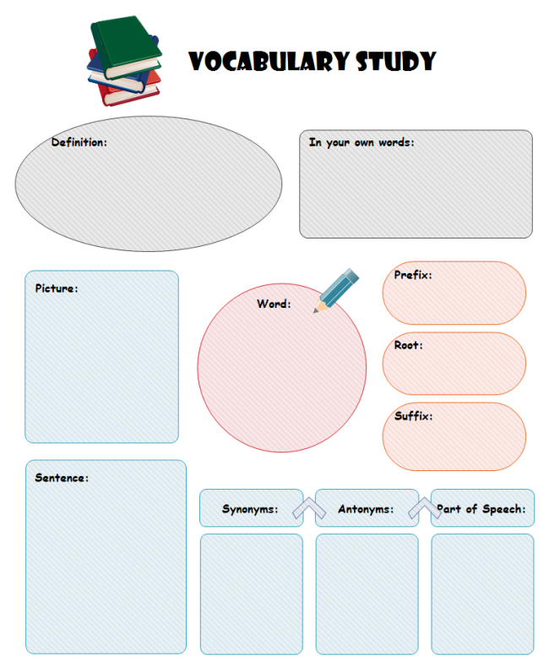
Example Word Maps

Slide 6
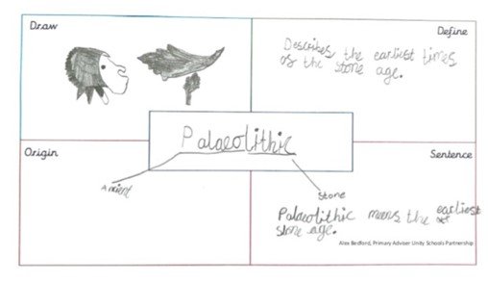
Example Word Maps

