Slide 1
Year 6 Revision
Calculation #11 multi step word problems

Slide 2
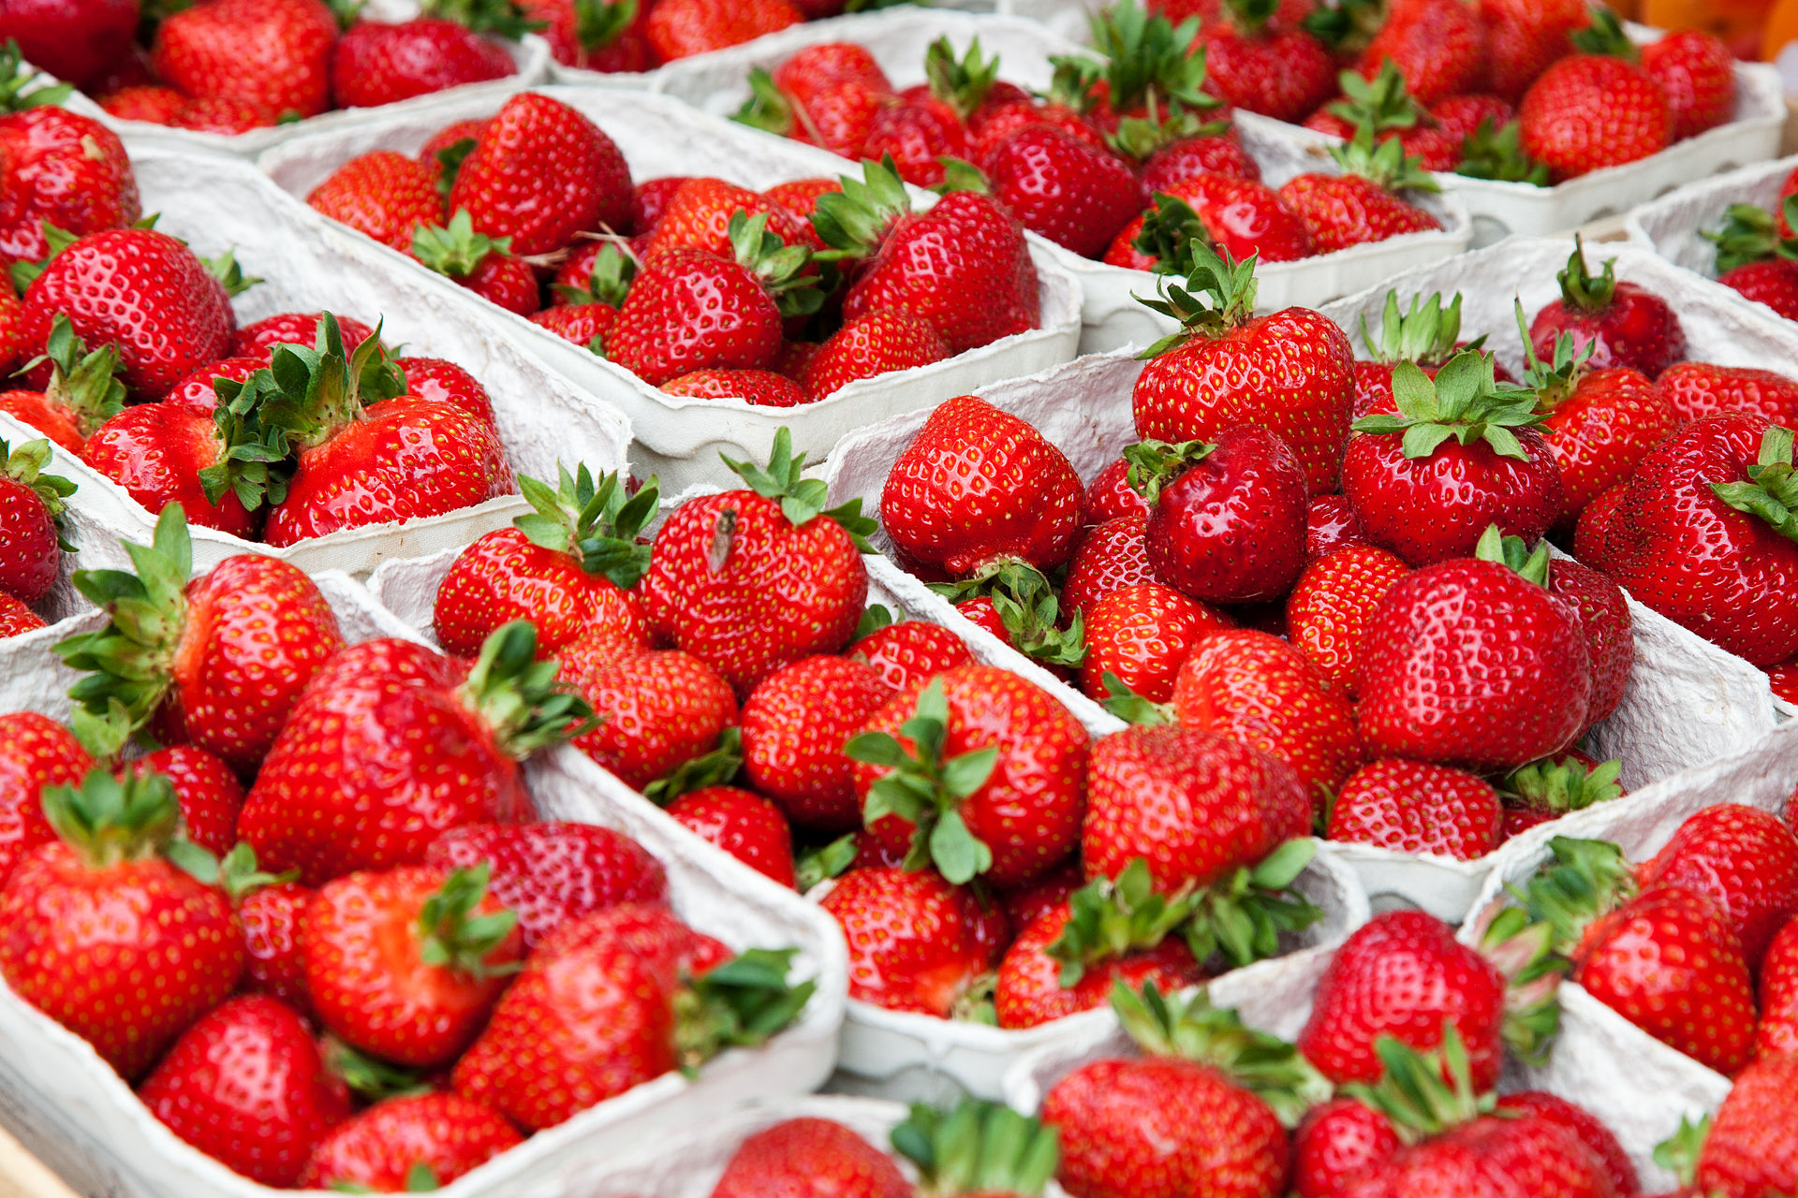
A box contains punnets of strawberries.
There are 6 punnets in a box.
There are 18 strawberries in each punnet.
How many strawberries are there in 5 boxes?
Read the question carefully first to find out what the question is asking you to do.
To find out how many strawberries are in 5 boxes we first need to find how many strawberries are in 1 box.
There are 6 punnets in one box and each punnet contains 18 strawberries.
18 x 6 = 108 There are 108 strawberries in 1 box.
Now we know how many are in 1 box. We can work out how many are in 5 boxes.
108 x 5 = 540
There are 540 strawberries in 5 boxes

Slide 3
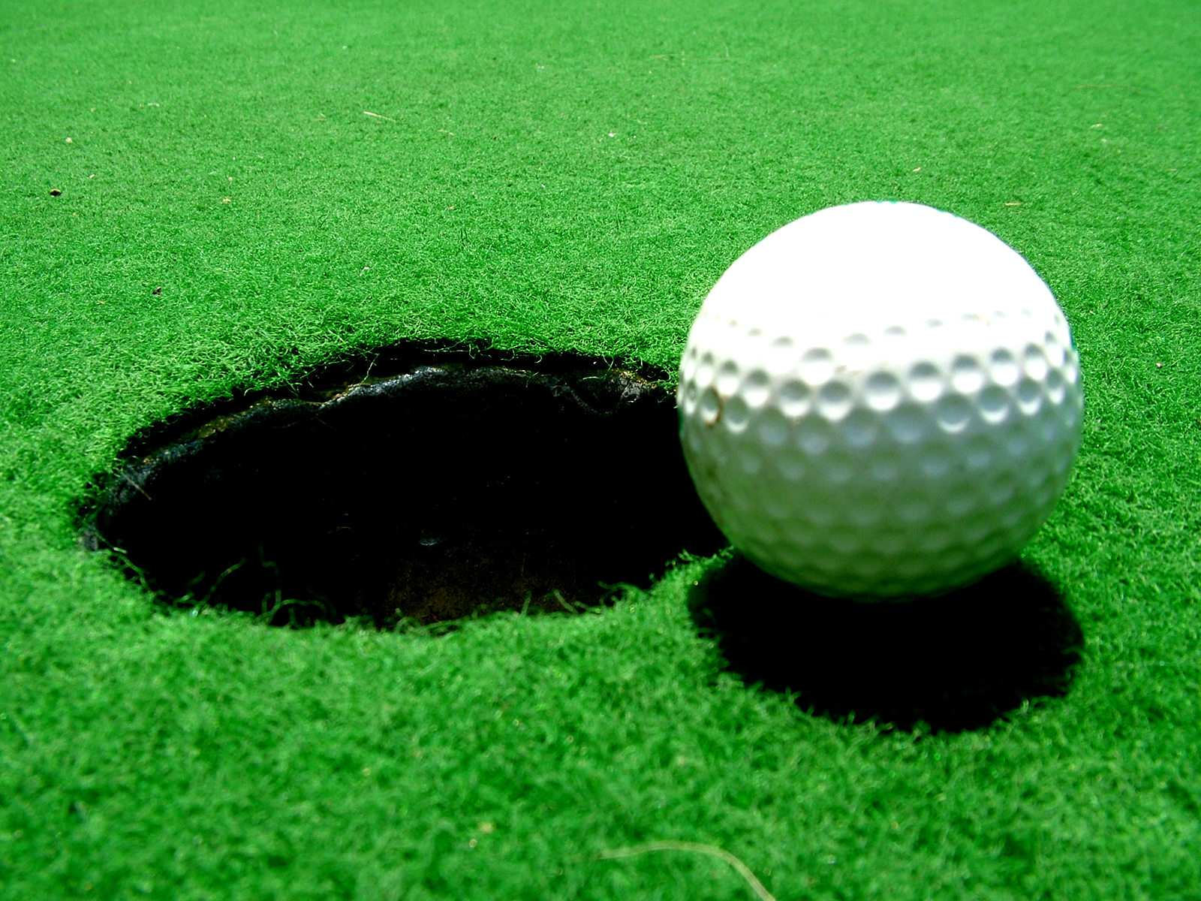
6 people pay £35 each to be a member of a golf club.
This money is used to buy each member a cap, 2 golf balls and a members mug.
A cap costs £8.
A box of 3 golf balls cost £5.50
A mug costs £12.50.
How much money does the club have left over?
Read the question carefully first to find out what the question is asking you to do.
First find out how much the golf club makes.
35 x 6 = £210
Now find out how much they spend on the caps, golf balls and mugs.
3 golf balls = £5.50.
Each of the 6 members get 2 balls so we need 12 balls (4 boxes)
4 x 5.50 = £22
Mugs = £12.50
6 x 12.50 = £75
Caps = £8
6 x 8 =£48
Add together what they spend:
48 + 22 + 75 = £145
Then take away from the money they make
210 – 145 =£65

Slide 4
3 melons cost the same as 2 pineapples.
1 melon costs £2.32.
How much does 1 pineapple cost?
Read the question carefully first to find out what the question is asking you to do.
We know 3 melons are the same as 2 pineapples.
We can find the cost of 3 melons: 2.32 x 3 = £6.96
So now we know 2 pineapples cost £6.96 (as it is the same as 3 melons) we can work out 1 pineapple.
6.96 ÷ 2 = £3.48
1 pineapple costs £3.48

Slide 5
Lucy is using beads to make necklaces and bracelets.
She needs 32 beads to make a necklace.
She needs 15 beads to make a bracelet.
She makes 12 necklaces and 18 bracelets.
How many beads does she use altogether?
Read the question carefully first to find out what the question is asking you to do.
We need to know how many beads she uses for the bracelets and how many she uses for the necklaces then add them together to find a total.
Each necklace needs 32 beads and she makes 12.
32 x 12 = 384
Each bracelet needs 15 and she makes 18 bracelets.
15 x 18 = 270
Add them together to find a total
384 + 270 = 654
She uses 654 beads altogether.

Slide 6
A school buys 8 boxes of paper each containing 300 sheets.
5 teachers each take 150 sheets each.
How many pieces of paper were left over?
Read the question carefully first to find out what the question is asking you to do.
First find the total amount of paper the school bought.
300 x 8 = 2400.
Then find out how much the teachers took.
5 x 150 = 750
Take away to find out how much is left.
2400 – 750 = 1650

