Slide 1
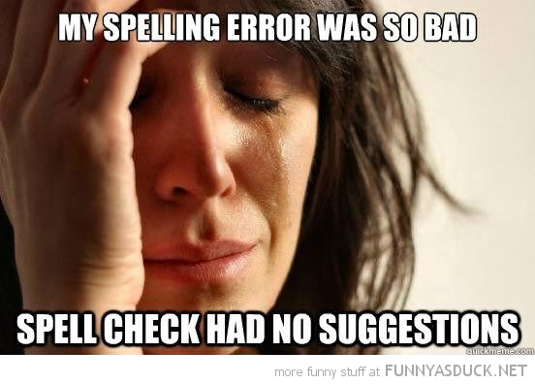
Home Learning: English
Thursday: Spelling

Slide 2
Can you guess the spelling rule?
symptom
myth
oxygen
Egypt
system
gym
hymn
pyramid
mystery
cygnet

Slide 3
Spelling Rule: The short ‘i’ sound spelt with a ‘y’ other than at the end of words.
symptom
myth
oxygen
Egypt
system
gym
hymn
pyramid
mystery
cygnet

Slide 4
Spelling Rule: The short ‘i’ sound spelt with a ‘y’ other than at the end of words.
Can you use the rule to unscramble the following words?
1. l r c i y
2. y m s l o b
3. y l a t p c i
4. s s h c y i p
Notes:
Answers:
1. lyric
2. Symbol
3. typical
4. physics

Slide 5
Spelling Rule: The short ‘i’ sound spelt with a ‘y’ other than at the end of words.
Watch and Read:
https://www.bbc.co.uk/bitesize/topics/zt62mnb/articles/z3mktv4
Play and Test:
https://spellingframe.co.uk/spelling-rule/9/2-The-I-sound-spelt-y-elsewhere-than-at-the-end-of-words
https://www.spellzone.com/word_lists/games-175.htm

Slide 6
Spelling Rule: The Year 5 and 6 Spelling Words

Slide 7
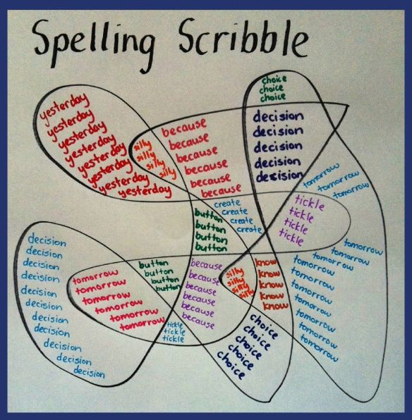
Spelling Rule: The Year 5 and 6 Spelling Words
Draw a spelling squiggle for the following Year 5 and 6 Spelling Words:

