Slide 1
Home Learning: English
Monday: Reading

Slide 2
Synopsis
Set in 1912, this action-packed adventure feels both classic and contemporary, with Marina, its young heroine, yearning to break free from societal constraints to become the “new woman” she’s read about in modern magazines. Namely, the kind of woman who is “mistress of her own destiny”. Frustratingly, Marina’s father dismisses her desires outright. Being a naval captain he’s often away at sea and, with her mother gone, Marina is about to be shipped off to boarding school when all she really wants to do is set sail with her dad. So much so, Marina ends up stowing away on his ship. As his mission is vitally urgent, Captain Denham has little choice but to continue with Marina aboard.
As their perilous voyage progresses, the thrilling dangers of enemy sightings, superstitious shipmates and icebergs are interlaced with myth and mystery as Marina feels an inexplicable “urgent tugging in her chest to go north” after being accused of possessing the power to “call up storms”. Indeed, Marina’s affinity with the sea adds an extra edge of intrigue throughout, leading to an eerie explanation as the novel twists and swells to its pulse-quickening crescendo.

Slide 3
Reading character recap
Usually one word or short phrase answers that you need to find in the text. You may have to tick a box, draw a line or say whether something is true or false.
Asking you to look more into “why” something has happened. You may be asked why or how something happened, give reasons or explain with evidence.
All about the vocabulary! You may be asked to find words that are similar to other words. Remember – if it says copy something, write it exactly how it appears in the text.

Slide 4
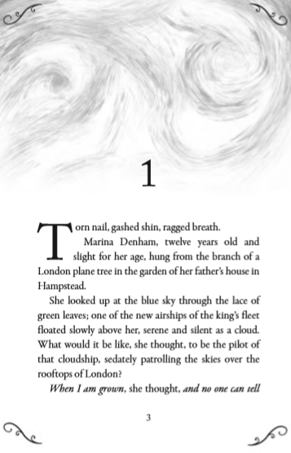
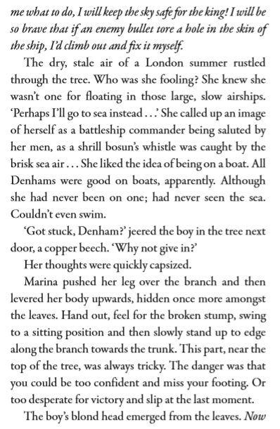

Slide 5
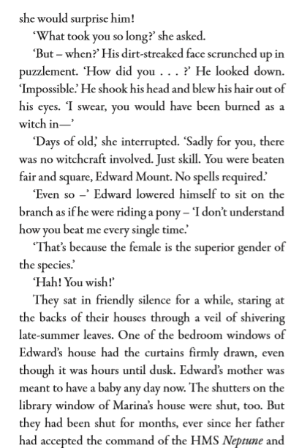
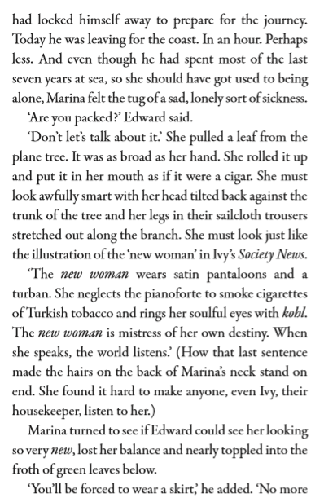

Slide 6
After you have read the extract, read it again and highlight any key words you do not know OR think are impactful words.
Use a dictionary or iPad/Laptop to find the definition.
On the next slide are some that I have found…
The whole extract can be found at: https://www.worldbookday.com/wp-content/uploads/2019/10/Primary_8-12_Extract_Pearl-in-the-Ice.pdf

Slide 7
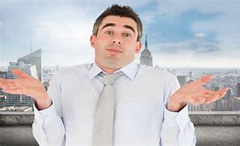
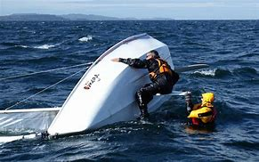
Sedately
(sedate)
ADJECTIVE
calm, dignified, and unhurried.
“In the old days, business was carried on at a rather more sedate pace”.
puzzlement
NOUN
a feeling of confusion through lack of understanding.
capsize
(of a boat) be overturned in the water.
"the craft capsized in heavy seas"
synonyms:
overturn
turn upside down.

Slide 8
Find and copy a phrase which shows that Marina Denham was particularly small for a 12 year old.
Find and copy a phrase which suggests that you would not notice the new airships if they were over your head.
Why might Marina not be a good candidate for becoming a battleship commander? Give two reasons.
According to Marina, what were the two dangers of climbing this part of the tree?
Why did the boy think “witchcraft” might have been involved?
Why were the shutters on Marina’s house shut?
Find a phrase which shows that Marina thought girls were better than boys.
When was Marina’s dad leaving? Tick one.
0-1 hours
1-2 hours
2-3 hours
3-4 hours
9) “You’ll be forced to wear a skirt…”
Do you think Marina would mind wearing a skirt? Give two reasons.

Slide 9
ANSWERS
Find and copy a phrase which shows that Marina Denham was particularly small for a 12 year old.
Twelve years old and slight for her age.
2) Find and copy a phrase which suggests that you would not notice the new airships if they were over your head.
Floated slowly above her, serene and silent as a cloud.
3) Why might Marina not be a good candidate for becoming a battleship commander?
She had never been on a boat.
She had never seen the sea.
She couldn’t swim.
Do not accept just the word “slight”.
“Serene” and “silent” need to form part of the answer.
Any 2 of these answers.

Slide 10
ANSWERS
4) According to Marina, what were the two dangers of climbing this part of the tree?
You could be too confident and miss your footing. Or you can be too desperate to win and slip at the last moment.
5) Why did the boy think “witchcraft” might have been involved?
Marina beat Edward to the top of the tree. Edward thought that Marina would be burned as a witch in the olden days because she was so fast.
6) Why were the shutters on Marina’s house shut?
Marina’s father had accepted the command of the HMS Neptune and they were shut so he could prepare.

Slide 11
ANSWERS
7) Find a phrase which shows that Marina thought girls were better than boys.
The female is the superior gender of the species.
8) When was Marina’s dad leaving? Tick one.
0-1 hours
1-2 hours
2-3 hours
3-4 hours
9) “You’ll be forced to wear a skirt…”
Do you think Marina would mind wearing a skirt? Give two reasons.
I don’t think Marina would like to wear a skirt. My first reason is that Edward said the word “forced” meaning that she would have to do it against her will. Forcing someone is usually doing something they don’t want or like. Secondly, Marina imagined herself to be like the “new woman” who was wearing “pantaloons” and not a skirt.

