Slide 1
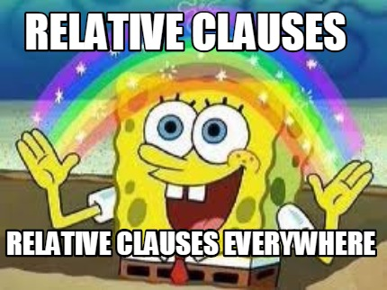
Home Learning: English
Tuesday: Grammar

Slide 2
Our grammar focus today is... RELATIVE CLAUSES What do you know about them?

Slide 3
A relative clause is a type of
embedded clause (meaning it goes in the middle of a main clause) that expands on/gives more information about a noun.
Warning:
A relative clause can go at the end of a sentence too!
Nouns = people, places or things

Slide 4
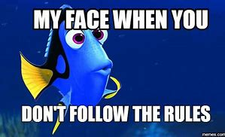
Rules:
1) A relative clause doesn't make
sense on its own.
2) If you take out a relative clause, the main clause still makes sense.
3) Your relative clause must begin with a relative pronoun.

Slide 5
The structure of a relative clauses is:
Noun to start main clause ( or , or - relative pronoun + clause ) or , or - end of main clause.
Examples
Mr Silvester, who couldn’t wait to get back to school, was planning some exciting lessons.
Featherstone, which was eerily quite during lockdown, wasn’t the same without the children.

Slide 6
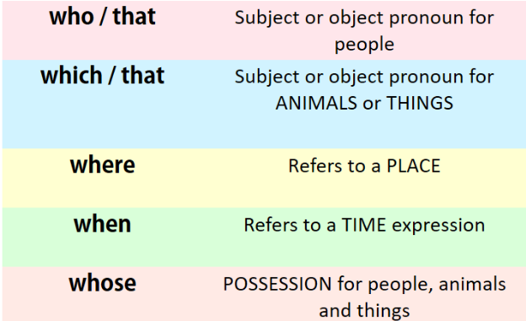
Which relative pronoun should I use?

Slide 7
The structure of a relative clauses is:
Noun to start main clause ( or , or - relative pronoun + clause ) or , or - end of main clause.
Rules:
1) A relative clause doesn't make
sense on its own.
2) If you take out a relative clause, the main clause still makes sense.
3) Your relative clause must begin with a relative pronoun.
Use the following starting main clauses to write a sentence.
My family…
Featherstone…
Mr Silvester
Miss Whitehouse
Miss Williams

Slide 8
The structure of a relative clauses is:
Noun to start main clause ( or , or - relative pronoun + clause ) or , or - end of main clause.
Rules:
1) A relative clause doesn't make
sense on its own.
2) If you take out a relative clause, the main clause still makes sense.
3) Your relative clause must begin with a relative pronoun.
Look at some of my examples…
My family, who were all helping around the house, decided to do a quiz today.
Featherstone, which was currently closed, is a great school.
Mr Silvester (who hoped he could go out for his birthday) was turning 27 this year.
Miss Whitehouse – who was a massive Harry Potter fan – decided to visit Hogwarts.

Slide 9
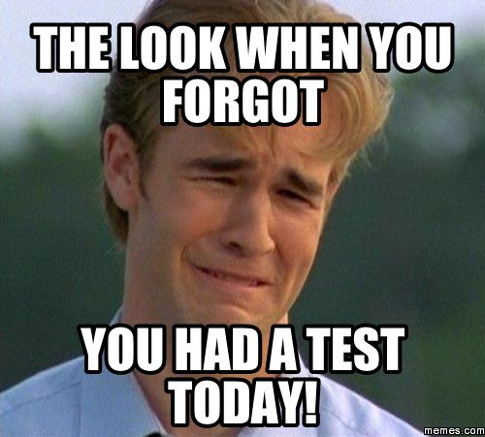

Slide 10
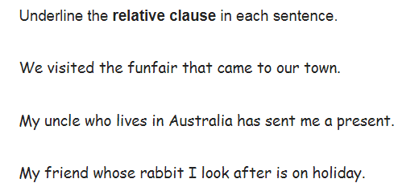

Slide 11
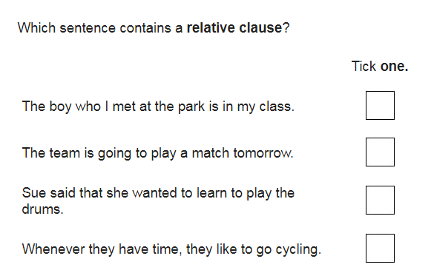

Slide 13
who…

Slide 14
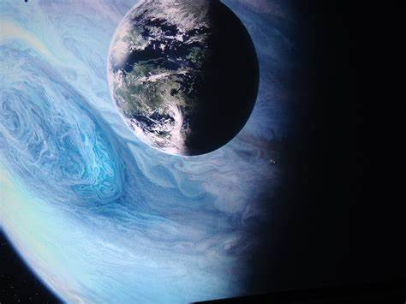
Preparation for tomorrow
As our theme this week is all about the universe and space, you will be doing a piece of writing tomorrow about your own planet.
Once you have a name, write down at least 5 facts about your planet.
You could also draw it!
Your facts need to be written in sentences using relative clauses.
To prepare, start to think about your own made up planet and what you would call it.
E.g. Pandora, which is home to the humanoid species called the Na’vi, is similar to Earth.

