Slide 1
Year 6 Revision
Calculation #3 prime numbers

Slide 2
Prime numbers
Prime numbers are only divisible by 1 and itself.
In other words they only have 2 factors – 1 and itself.

Slide 3
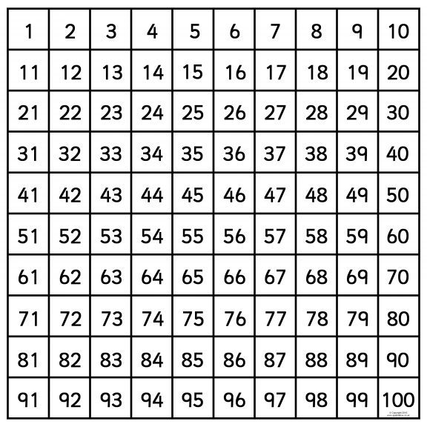
Prime numbers up to 100
Prime numbers up to 10
2 is the only even prime number
Now lets rule out columns that we know cannot be prime.
We can rule out the rest of the even numbers as they are all divisible by at least 2 as well as 1 and itself.
We can rule out any number ending with a 5 (after 5) as they are all divisible by 5.

Slide 4
Prime numbers up to 100
We are left with just these numbers remaining.
Go through each option and check. Can you divide it by more than one and itself.
Be careful with the larger numbers – don’t assume.

