Slide 1
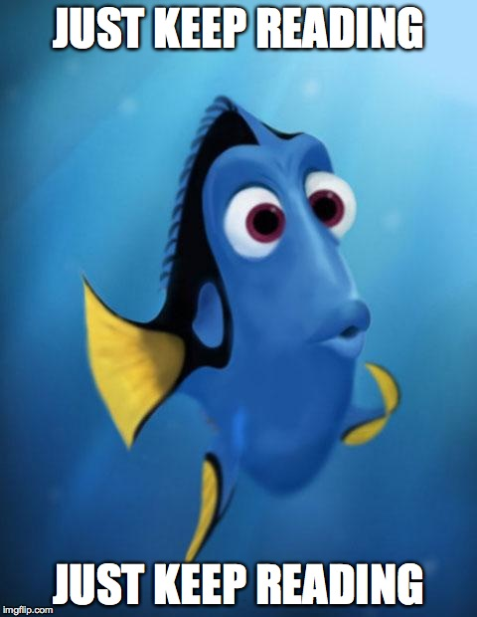
Home Learning: English
Monday: Reading

Slide 2
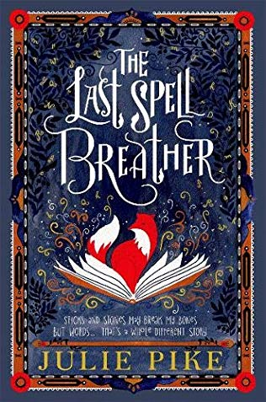
“A stunning fantasy debut, enter the unique world of the Spell Breathers. Spell Breathing does not come naturally to Rayne - she loathes the hours of practice, the stacks of scrolls, and the snapping mud devils that cover her mothers precious spell book.
But it is spell breathing that keeps her village safe from the dreaded monster curse that plagues their world. It is ancient powerful magic, but as Rayne learns to her horror . . . it is also fragile.
In one clumsy move, the magic that keeps them safe is broken, her village is plunged into danger, and an incredible adventure begins . . .”
Notes:
Available online at: https://www.worldbookday.com/wp-content/uploads/2019/06/Last-Spell-Breather-Extract.pdf

Slide 3
THE MUD BOOK
The Spell wouldn’t stay on the shelf. It bounced on the floor and rolled under the kitchen table. Rayne sighed and picked it up for the third time, feeling the scroll softly vibrate. ‘Stay there,’ she muttered, wedging it underneath a pile of scrolls on the shelf. It was always the same with the Spell of Energy, it could never wait to be released. She turned to a stack of parchments lying on the table. On top, beautifully inked in Mam’s golden script, was the Spell of Sleep. She rolled it up, tied it with twine, and tried to stop herself yawning. Sunlight streamed through the window, brightening the dimly lit kitchen. Its playful beams danced across the copper pans hanging from the ceiling, reminding her she was stuck inside while Tom and the others were in the orchard.

Slide 4
The school bell had rung ten minutes ago. Everyone would be outside now, helping with the apple harvest. Rayne’s mouth turned up at the corner. Well, maybe not helping. More like hanging upside down and sneaking apples into their pockets. She struggled to tie a knot around the last scroll. The Spell of Strength felt heavier than the others, and it took both hands to hoist it onto the shelf. ‘All done, Mam,’ she said, wiping her hands on her apron. ‘Can I go down to the orchard now?’ Mam sat at the other end of the table, hunched over a blank parchment. Her long braids draped across her back out of the way. Deep lines of concentration crinkled the corners of her eyes. ‘Just a minute, love,’ she said, not taking her eyes off the sheet. Her face began to glow with a golden light; a light Rayne knew had nothing to do with the candles on the table. The light glowed outwards, radiating from deep inside. It shone brighter and brighter. Rayne’s heart skipped a beat as bright inky words swept from Mam’s forehead and cascaded onto the parchment like a waterfall. They jostled and circled each other, forming themselves into the lines of a Spell. As the ink dried, the words stilled, and their shimmer dissipated.

Slide 5
Mam sat back in her chair, closing the Spell book at her elbow. ‘Sorry, the orchard will have to wait. I need your help in the village this afternoon. Market day is always busiest with people wanting Spells breathed over them.’ ‘Can’t I go out? Just for a bit? I haven’t seen my friends for weeks.’ Mam shook her head. ‘You knew how it would be when you became my apprentice. You’ve got too much to learn. There’s no time for playing games.’ ‘But we wouldn’t be playing. We’d be helping Farmer Wyn with the harvest.’ Mam grinned. ‘I’m not sure Wyn sees it that way.’ She held out her freshly written parchment. ‘Come on. Roll that up and I’ll make us a nice cup of tea.’ Rayne took the Spell. Word-magic tingled into her hand and the muscles in her legs twitched. ‘What’s this one?’ ‘What does it feel like?’ Rayne shrugged. ‘I don’t know.’ Lightning quick, she rolled the parchment and put it with the others. ‘It’s the Spell of Speed.’ Mam rose from her chair and went to the fire. Using a tea towel, she unhooked a steaming copper kettle. ‘Winter will be here soon. The village council want the Spell to help finish ploughing the fields out by the barrier.’

Slide 6
Rayne rubbed her hands to dispel the tingle of word-magic. ‘You could’ve warned me it was a weird one.’ Mam poured hot water into the teapot. ‘If you concentrate on your studies, you’ll soon get used to the way each Spell feels.’ Rayne sighed and turned back to the sunlit window, wondering what Tom and Jenna and the others were up to without her. Mam stirred the pot thoughtfully. ‘Perhaps it’s time you learned to mindwrite a Spell. You’ll recognize them faster then.’ Rayne’s eyes slid to the Spell book on the table. She bit her lip. ‘Shouldn’t we wait? I mean, you always said the Great Library was the best place to learn to mindwrite.’ ‘It is. But you know the place has been abandoned for years. There’s no apprentice school now.’ Mam lifted two cups from the dresser and poured the tea. ‘Maybe it’ll re-open soon?’ Rayne murmured. The teapot clunked on the table. ‘It won’t. The place is crawling with monsters.’ Mam’s chair creaked as she sat down. ‘You can’t put it off any longer.’ I can try, thought Rayne. Mam spooned honey into both cups. ‘I’ve told you a million times, there’s nothing to worry about.’ She patted the chair beside her. Rayne’s mouth went dry. She perched next to Mam, her eyes fixed on the book. It was as wide as her hand and covered in a thick layer of dried mud. She hadn’t been this close to it for years, not since she was a toddler. Not since Mam had accidentally left it in reach of her curious fingers.

Slide 7
Reading character revision
Usually one word or short phrase answers that you need to find in the text. You may have to tick a box, draw a line or say whether something is true or false.
Asking you to look more into “why” something has happened. You may be asked why or how something happened, give reasons or explain with evidence.
All about the vocabulary! You may be asked to find words that are similar to other words. Remember – if it says copy something, write it exactly how it appears in the text.

Slide 8
Answer the ten questions from today’s activity sheet using your knowledge of the extract.
The answers to each question are on the next slides.

Slide 9
What room was the spell in?
The spell was on the shelf in the kitchen.
DO NOT ACCEPT REFERENCE TO JUST “ON THE SHELF”.
2) Why did Rayne sigh?
Rayne sighed because the spell kept falling. She picked it up for the third time and sighed because she was frustrated.
3) Do you think Rayne was actually tired?
No, I think Rayne yawned because she had tied up the “Spell of Sleep.”

Slide 10
4) Which word is closest to the meaning of “hoist”? Tick one.
Raise
5) Find and copy a phrase which shows Rayne was excited.
Rayne’s heart skipped a beat.
6) “As the ink dried, the words stilled, and their shimmer dissipated.” What does the word “dissipated” mean?
Dissipate means to disappear.

Slide 11
7) Why does Mam not want Rayne to go and play? Give two reasons.
She has too much to learn as she was an apprentice.
She needed her help in the village.
8) How would the Spell of Speed help the village council plough the fields?
Winter was coming soon so the farmers needed to quickly plough the fields. The Spell of Speed would make them faster.

Slide 12
9) Find and copy a phrase which shows Rayne was nervous about learning how to “mindwrite”.
She bit her lip.
Children have to copy the whole sentence.
10) Name three spells that are mentioned in the extract.
Spell of Sound

