Slide 1
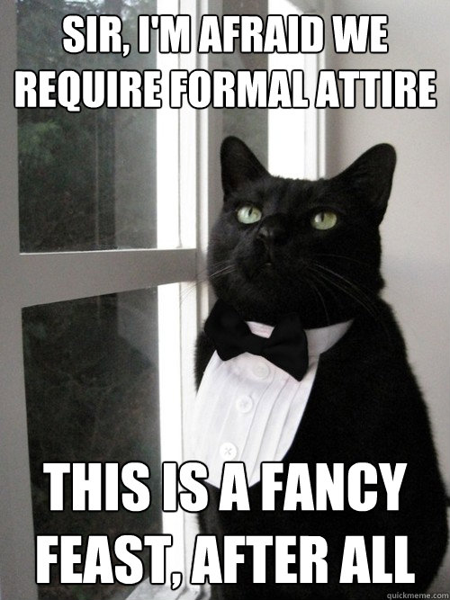
Home Learning: English
Tuesday: Grammar

Slide 2
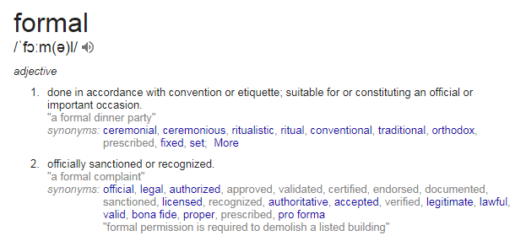


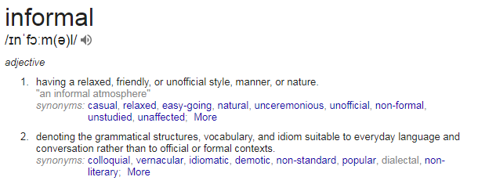

Slide 3
Formal language is more official
and serious. Correct grammar
should be used.
In informal situations a more
relaxed and casual speaking style is
used. Slang words are accepted
here.

Slide 4

Task 1
What examples can you give me of
where you would use these types of language?
Notes:
Formal examples: writing a letter to someone you do not know, in a meeting, in a job interview etc.
Informal examples: chatting with friends, texting, speaking to family

Slide 5
Task 2
Now Variety Chance Immediately Unfairness Apparent Speak Profession Aggressive Sacrifice
Sufficient Enough Speak Injustice Correspond Inhabit Clear Link to Clear Opportunity
Worked up Types of Job Communicate Give up Live in
Highlight the formal words in blue and the informal words in red.

Slide 6
Now Variety Chance Immediately Unfairness Apparent Speak Profession Aggressive Sacrifice
Sufficient Enough Speak Injustice Correspond Inhabit Clear Link to Opportunity
Worked up Types of Job Communicate Give up Live in
Can you link any of these?
E.g. Now and Immediately

Slide 7
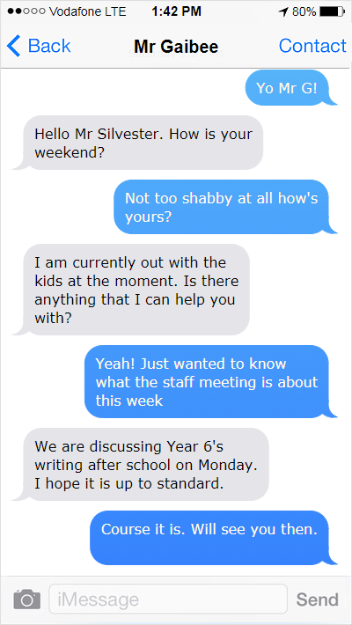
Task 3
As you know, a text
message is quite
informal.
However,
my informal language
isn't appropriate
for talking to Mr
Gaibee here. Can you
change my informal/
slang into more formal language?

Slide 8
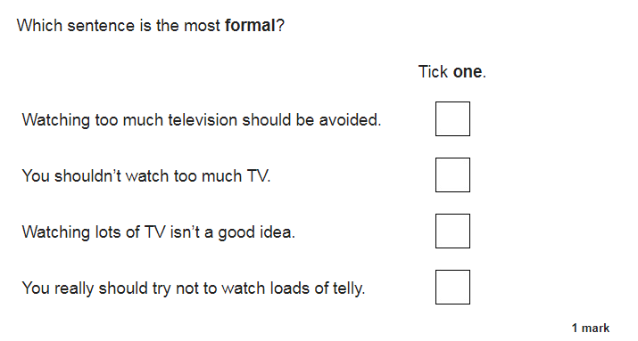
Final task

Slide 9
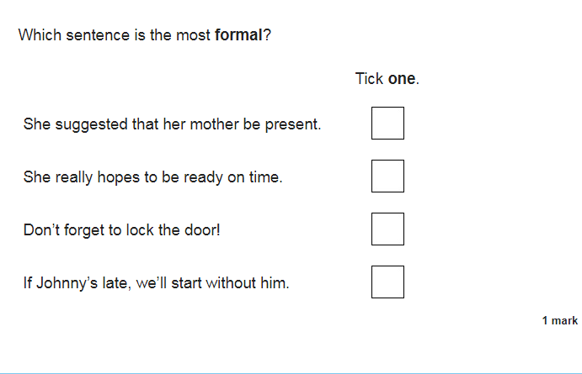

Slide 10
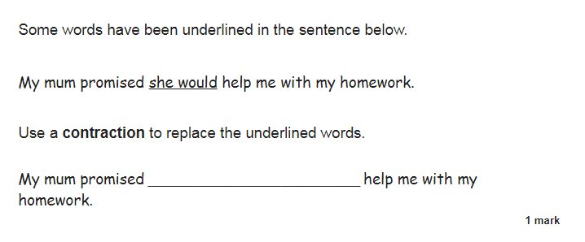

Slide 11
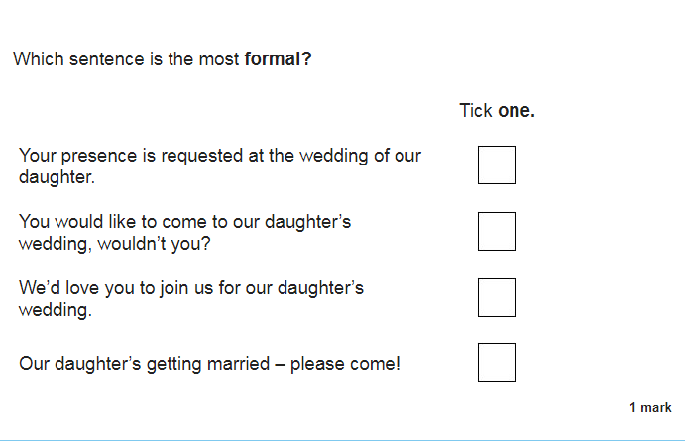

Slide 12

ANSWERS

Slide 14
she’d

