Slide 1
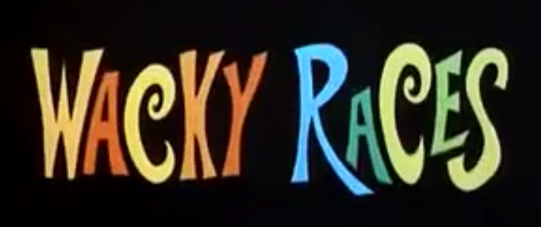
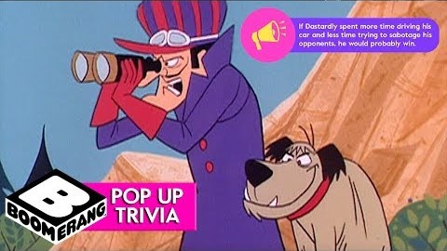

Slide 2
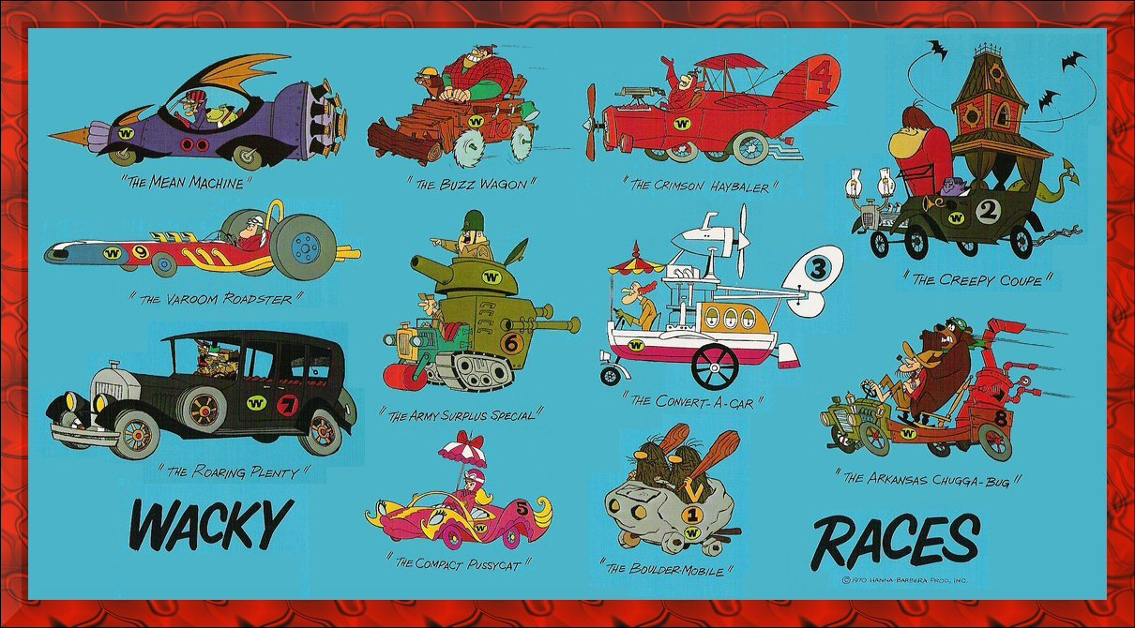
Wacky Races is an American animated television series produced by Hanna-Barbera Productions. The series features 11 different cars racing against each other in various road rallies throughout North America, with all of the drivers hoping to win the title of the "World's Wackiest Racer".

Slide 3
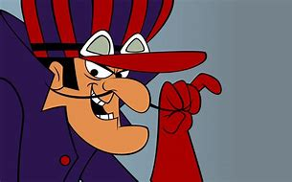
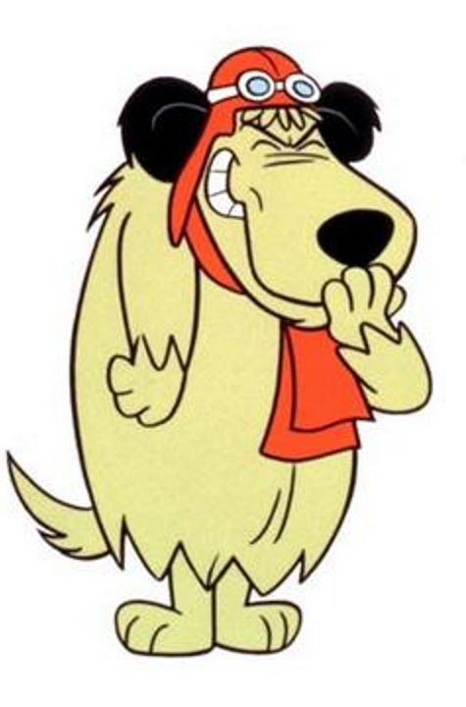
The villain of the series drives The Mean Machine (00), a purple, rocket-powered car with an abundance of concealed weapons and the ability to fly. Dastardly is an archetypal moustache-twirling villain; Muttley is his wheezily snickering dog.
Dastardly's usual race strategy revolves around using the Mean Machine's great speed to get ahead of the other racers, and then setting a trap to stop them and maintain the lead, but most of his plans backfire, causing him to fall back into last place. Dastardly is the only racer who not only never wins, but never even finishes in the top three in any race.

Slide 4
Today’s task
Today you are going to write your sales pitch to Mr Gaibee to persuade him to invest in your car.
He wants :
A car that’s going to win the race.
An original design with original gadget ideas.
A car which is high quality.

Slide 5
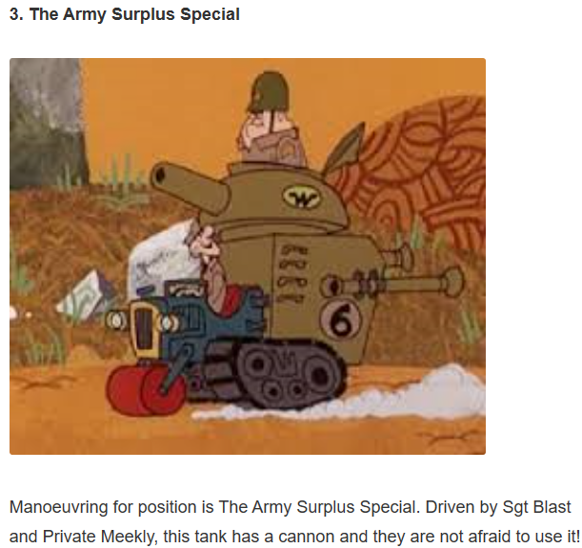
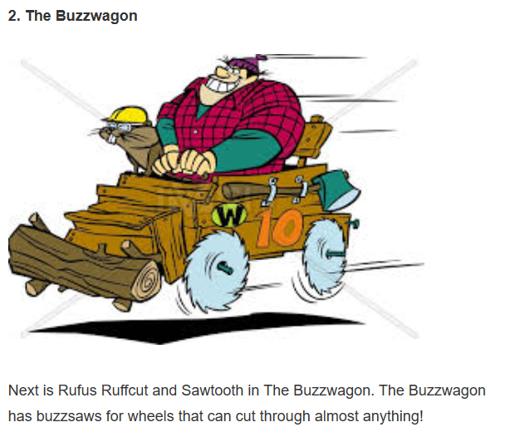
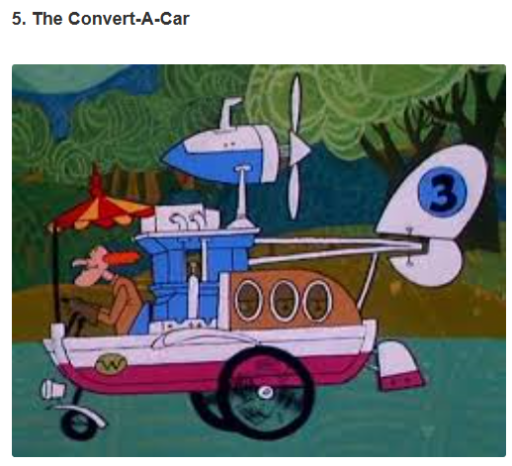
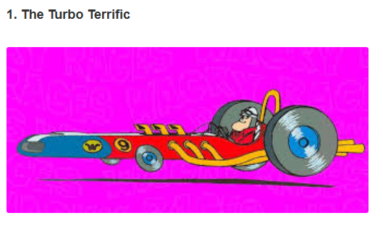
Before you start to think about writing, first you need to design your car. Use the following website to have a look at some of the original Wacky Races cars: https://www.gosocial.co/vehicles-wacky-races/
Notes:
For a list of all cars, visit: https://www.gosocial.co/vehicles-wacky-races/

Slide 6
Car design
Your car must:
Be original (not just the latest Ferrari)
Have gadgets (at least three to help persuade Mr Gaibee)
Have the potential to be a winning car
Annotate your drawing with your gadgets and why it will win.

Slide 7
Audience- Mr Gaibee
What implications does this have on the formality of your sales pitch?
Purpose – to persuade
What implications does this have on how you are going to write?

Slide 8

So how are you going to make it persuasive?
The basics
You have to say your point of view/what you want from Mr Gaibee (money to invest in your car).
Reasons (why would he invest in a car that won’t win? Why should he invest in your car?)
Facts/Evidence to support your reasons
Powerful adjectives
Rhetorical questions
Persuasive sentences
Conclusion to summarise the
points you have made

Slide 9
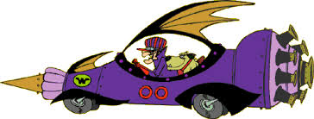
The basic persuasive features I showed you earlier are essential in any piece of persuasive writing.
However, to get to a Year Six quality piece of writing, we need to have impact.
We need to have sentence types that will explain, excite and persuade the reader – Mr Gaibee.
The next few slides will be a selection of our “Exciting Sentences”. Some we will have used before, others will be brand new. Look at the next few slides and note down your own examples that you could use for your car.

Slide 10

Super sentences
Getting worse/getting better sentences
What is it?
This sentence type serves to dramatically heighten a text by using three words/phrases that get better or worse.
Example (getting worse)
How would you feel if you child could be hurt, maimed or even killed by a car.
Example (getting better)
Steam engines were good, combustion engines were even better, but hydrogen-powered engines are set to change the world.

Slide 11

Super sentences
Does not/does will not/will
What is it?
The first sentence says something that does not /will not happen the second sentence shows something that negates this (argues against it) using does/ will
Example (does not/does)
I’ve know people who say that dropping a sweet wrapper does not matter. What does matter is the fact that if everyone thought like this then the world would be a dreadful place.
Example (will not/ will)
I know that you will not believe how phenomenal this car will be. What you will believe is that I am capable of building you a car that can win this race.

Slide 12
Super sentences
Then and now
What is it?
The first part of this sentence opens with a time-related statement about how things were.
The second shows how things are now.
Example
Although this was once a peaceful neighbourhood, now, with the building of the motorway, things are very different.
Before I wrote this sales pitch you didn’t realise how much you needed this car, now you do.

Slide 13
Super sentences
Most important – in short.
What is it?
Typically used when you are concluding. It states several of the most (or one of the most) important aspects of the subject then ends, after he words in short, with the same thing said in a summed up way.
Example
But above al fox-hunting should be banned because of the extreme cruelty involved in the chase and kill – in short, it is barbaric.

Slide 14

Magpie time
Read the following example and magpie any ideas you think are good or have lots of impact!

Slide 15
The Mclaren was good, the Mazda was better, but nothing beats the StrawberryLaceinator. This is the only car you will need to invest in to guarantee you are the ultimate Wacky Races champion. A beacon in car engineering and ingenuity, this original design and ingenious gadgets will not be beaten on that all important race track.
Sporting a unique strawberry-shaped shell, the StrawberryLaceinator stands at an impressive 10ft tall; this enables the driver to plan ahead and see out onto the race track. Made of the strongest titanium, the shell is impenetrable to any incoming attack.
From the top of the design, you will see 8, 6ft long and 30cm in diameter, strawberry laces. Why have I attached giant sweets to the top of my car do you ask? Well, reaching up to 100mph, these spinning laces provide enough up thrust to send the StrawberyyLaceinator into the air: this allows the driver to escape any tricky situations down below and advance to the front of the pack. That’s not the only thing that will propel you into front place! The single wheel situated at the bottom of the vehicle can allow top speeds of 120mph – that is faster than any other car on the track. The one wheel design allows easy manoeuvring in and out of the competition as well as a nifty response to any issues up ahead.
Defending the rear of the vehicle, is a barrage of Strawberry ‘Bomb Bombs’ – yes they may look cute and cuddly, but they are truly deadly. Shooting from the open hatch, they grow bigger and bigger as they launch themselves at opponents. Upon connecting with their car, they explode causing a deathly strawberry mess and prevent your opponents from continuing.

Slide 16

TIME TO WRITE!
Remember to continuously proof read your work to ensure:
It makes sense.
It has impact.
It is persuasive.
You have used higher-level vocabulary.
You have used Year Six grammar and punctuation.
With your parent/carer permission. Get them to take a photo of your design and writing and then share it with us @FeathrstoeYR6.

