Slide 1


Home Learning: English
Thursday: Spelling
Eighth
Neighbour

Slide 2
Both words have the long /a/ sound but are
spelt with 'ei'.
Eighth
Neighbour

Slide 3

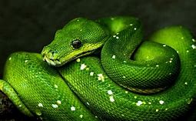
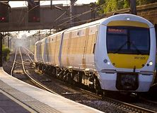
How else can the long /a/ sound be formed?
Short /a/ = Apple
Long /a/ = Neighbour
snake
train
pray

Slide 4
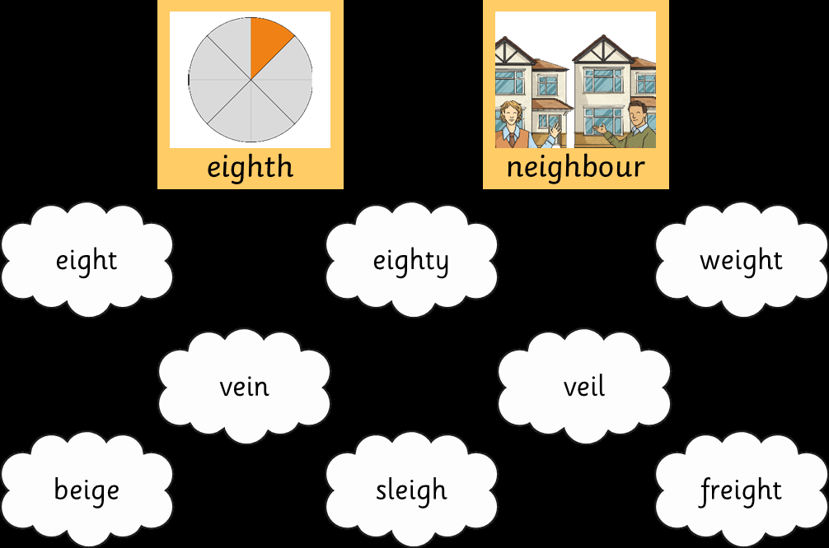
How many words can you think of that have
a long /a/ sound spelt with “ei”?

Slide 5
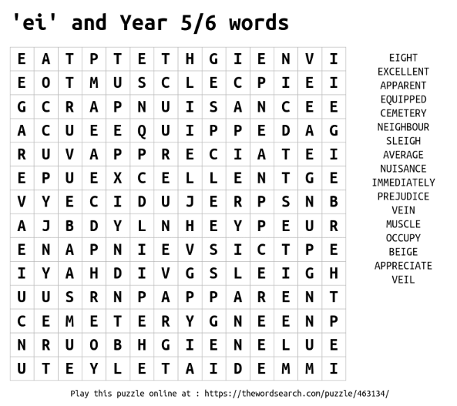
Some of your Year 5 and 6 words have been mixed in with your “ei” spellings. Can you find them all?

Slide 6
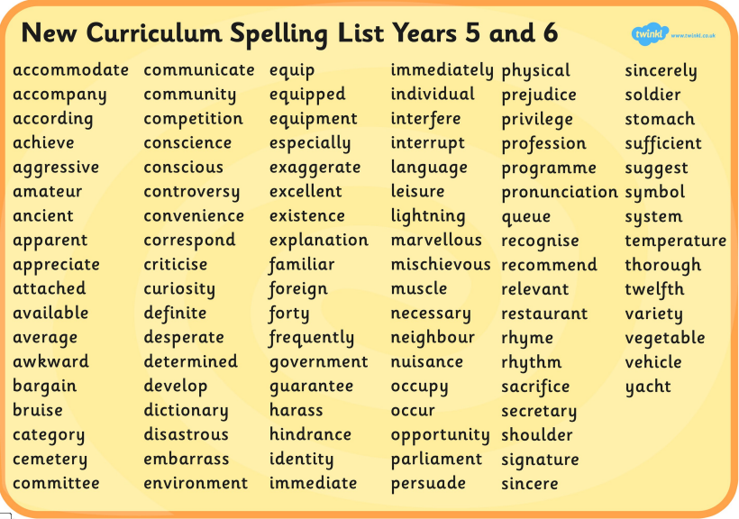
Choose ten spelling words and create your own story using them. Make sure that the word actually fits in the story.
For example:
“Mr Silvester knew he had to eat at a restaurant soon. He was incapable of buying vegetables and his parents always criticised him for it.”

