Slide 1
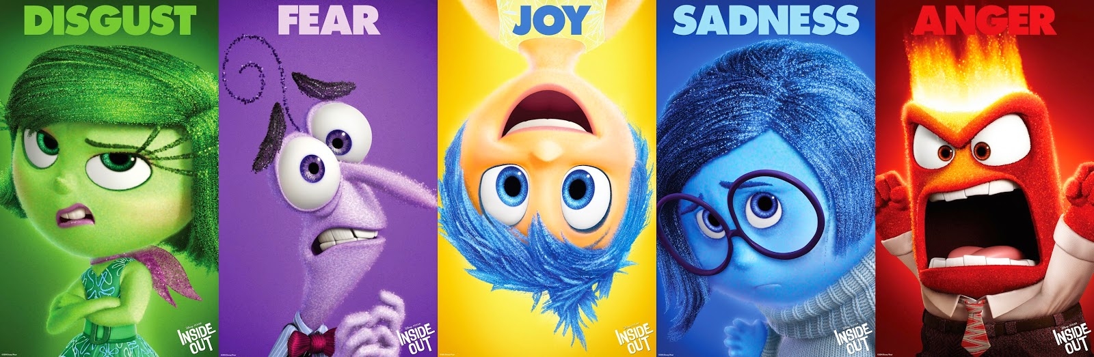
Home Learning: English
Tuesday: Grammar

Slide 2
Today we are going to be revising and applying our knowledge of inverted commas to punctuate speech.
Can you remember how to do this?

Slide 3

Speech at the start of your sentence
Follow this:
Inverted comma
What is actually said using a capital letter to start
Punctuation ALWAYS at the end (! ? , .)
Inverted comma
Reporting clause with lower case letter, unless it is a proper noun (who said it and how)
What is missing in the bad example?
Good Example:
“I’m sadness,” groaned Sadness with a tear in her eye.
Bad example:
“I’m sadness” Groaned Sadness with a tear in her eye
Notes:
Missing comma and incorrect capital letter

Slide 4

Speech at the end of your sentence
Follow this:
1) Reporting clause with an capital letter (who said it and how)
2) Comma
3) Inverted comma
4) What is actually said with a capital letter
5) Punctuation ALWAYS at the end (! ? .)
6) Inverted comma
What is missing in the bad example?
Good Example:
Anger fumed, “Wait! What did he just say?”
Bad example:
Anger fumed “Wait! What did he just say?”
Notes:
Missing comma.

Slide 5

Speaker in the middle of your sentence
Follow this:
Inverted comma
Speech starting with a capital letter and finishing with punctuation (usually not a full-stop)
Inverted comma
Reporting clause (who and how it was said)
Comma
Inverted comma
Speech starting with a capital letter and finishing with punctuation.
Inverted comma.
What is missing in the bad example?
Good Example:
“It was amazing,” Joy exclaimed with a smile on her face, “Just Riley and me, forever!”
Bad example:
“It was amazing,” Joy exclaimed with a smile on her face “just Riley and me, forever!”
Notes:
Missing comma and capital letter.

Slide 6

Task one
Think about the last conversation you had with someone. This could be on the phone, as a text message or in real life.
Take that conversation and write it down using inverted commas to punctuate speech. Use a mixture of where the speech is (beginning, middle or end) and then self- assess using the last three slides.

Slide 7
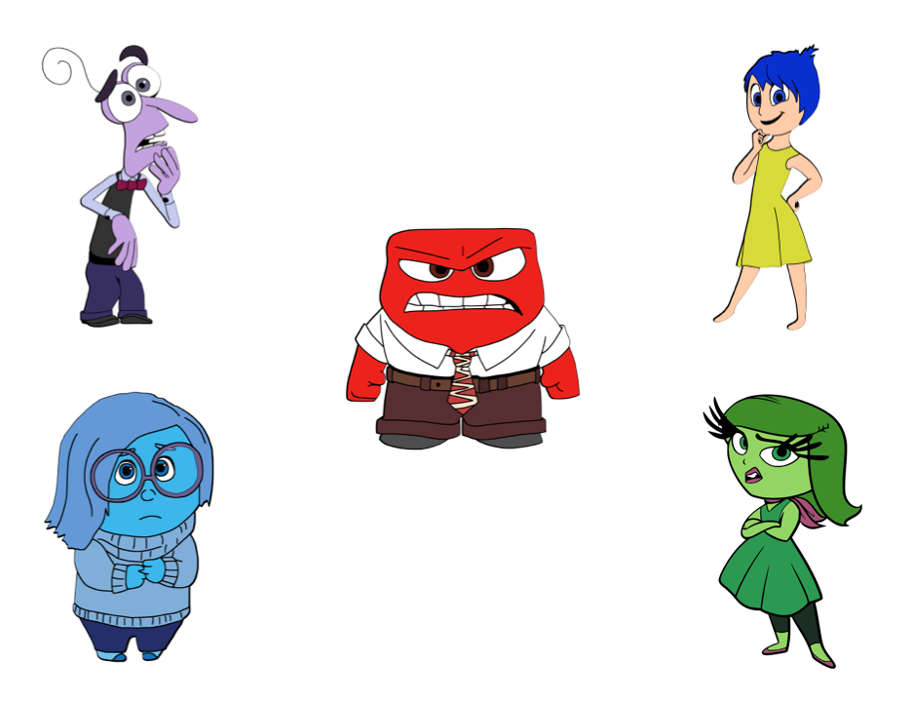
Conveying character
It was amazing.
So that is how you want to play it old man.
Okay. Caution. There is a dangerous smell people.
How do you know?
Which character would say what?
I am sadness.
Making speech more effective is what we will discuss next. How do you convey character using speech? How do you show what a character’s thoughts, feelings and personality is like?
Very nice. Okay. Looks like you’ve got this.

Slide 8
Okay. Caution. There is a dangerous smell people.
Very nice. Okay. Looks like you have got this.
It was amazing.
I’m sadness.
So that is how you want to play it old man.
Watch the clip on YouTube to gain a better understanding of each character.
https://www.youtube.com/watch?v=1S0RKRRyqhQ

Slide 9
Task two
Okay. Caution. There is a dangerous smell people.
Very nice. Okay. Looks like you have got this.
It was amazing.
I’m sadness.
So that is how you want to play it old man.
Take each bit of speech and turn it into a sentence full of impact. Remember to accurately punctuate it and convey character by carefully choosing punctuation and your reporting clause. See my example on the next slide!

Slide 10
Example
Okay. Caution. There is a dangerous smell people.
Mr Silvester’s thoughts
Disgust seems quite bossy in the clip and also afraid of new things. She clearly doesn’t like the broccoli. I will use short sentences, exclamation marks and a carefully-chosen reporting clause.
“Okay!” Disgust shouted as she pushed her way past Joy to the console, “Caution! There is a dangerous smell people!”

