Slide 1
Year 6 Revision
Number and Place Value #6
Negative numbers – problem solving
This session requires the skills from the previous session.

Slide 2
The table below shows the temperature in five locations.
Location | Temperature ºC
Location A | -8ºC
Location B | 5ºC
Location C | 13ºC
Location D | -2ºC
Location E | 23ºC
Which location is the coldest?
If we were to put all the numbers on a number line which would be the furthest below 0?
The coldest location is location A -8 is the lowest value.
Which location is the warmest?
If we were to put all the numbers on a number line which would be highest about 0?
The warmest location is location E 23 is the highest value

Slide 3
The table below shows the temperature in five locations.
Location | Temperature ºC
Location A | -8ºC
Location B | 5ºC
Location C | 13ºC
Location D | -2ºC
Location E | 23ºC
What is the difference in temperature between location C and location D.
What is the difference between 13ºC and -2ºC. You can use a number line to help you.
The difference is 15ºC

Slide 4
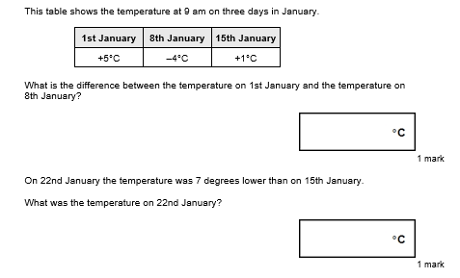
We need to find the difference between 5ºC and -4ºC
9
We need to start at 1ºC and subtract 7 ºC
-6

Slide 5
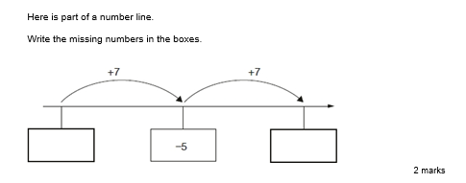
Count on in your hear or use the number line to help you.
-12ºC
2ºC

Slide 6
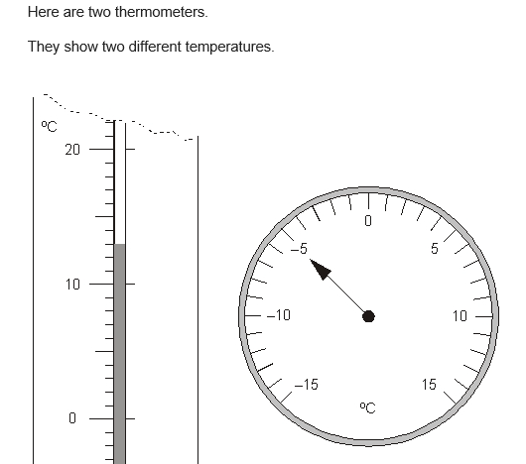
Read each scale
Find the difference between -5 and 13
-5ºC
13ºC
18ºC

Slide 7
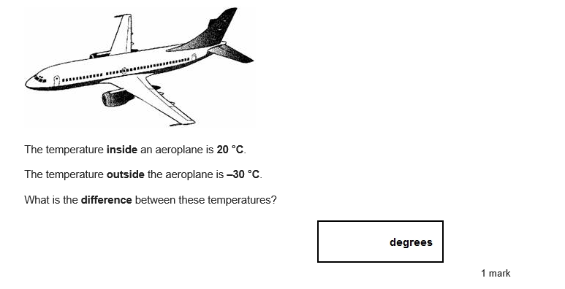
Use a number line to find the difference between 20 and -30
50

