Slide 1
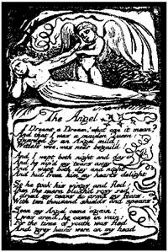
Home Learning: English
WB 20/04/20
Monday: Reading

Slide 2
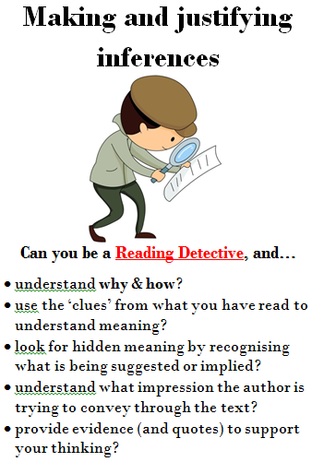
Today, we are practising our reading comprehension.
We are reminding ourselves of where we left off at school, by applying a range of skills we have learned in order to correctly answer questions based on poetry.

Slide 3
Year 6 Top Tips:
Highlight the key word(s) in the question.
Scan for this key word, or a synonym of it, in the text.
Read around the key word to retrieve or infer the answer to the question.

Slide 4
As we were unable to complete the wonderful book that is Skellig, I have found a thought-provoking poem which links to its overriding theme. Context: The poem is entitled ‘The Angel’ from Songs of Experience by Williams Blake, published in 1794. The poem reminds us to register the importance of seizing experience whilst it is there, rather than arming oneself against love and ending up in a world of rejection. The importance of embracing experience is highlighted by Mina, in Skellig, when she tells Michael: ‘Sometimes we just have to accept there are things we can’t know. Why is your sister ill? Why did my father die?…Sometimes we think we should be able to know everything. But we can’t. we have to allow ourselves to see what there is to see, and we have to imagine.’

Slide 5
Your Task) Read the poem and complete the questions. You can go through your answers with an adult or you can wait for the answers on Friday, in order to self-assess (green pens at the ready).
The Angel
I dreamt a dream! What can it mean? And that I was a maiden Queen Guarded by an Angel mild: Witless woe was ne'er beguiled! And I wept both night and day, And he wiped my tears away; And I wept both day and night, And hid from him my heart's delight. So he took his wings, and fled; Then the morn blushed rosy red. I dried my tears, and armed my fears With ten-thousand shields and spears. Soon my Angel came again; I was armed, he came in vain; For the time of youth was fled, And grey hairs were on my head.
William Blake

