Slide 1
Year 6 Revision
Calculation #4 BODMAS

Slide 2
8 – 2 x 3
How would I go about answering this question?

Slide 3
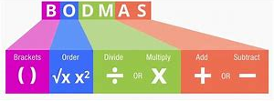
Where there is more than one calculation in a question BODMAS sets out which part of the question you need to answer first.
Brackets
Order (square numbers)
Division
Multiplication
Addition
Subtraction

Slide 4
8 – 2 x 3 =
Multiplication first.
8 – 6 =
Then complete
8 – 6 = 2

Slide 5
4 + 8 x 3
Multiplication first.
4 + 24
Then complete
4 + 24 = 28

Slide 6
36 – 9 ÷ 3 =
Division first
36 - 3
Then complete
36 – 3 = 33

Slide 7
6² + 4 x 8
36 + 4 x 8
Square number first
36 + 32
Then multiplication
38
Then complete

