Slide 1
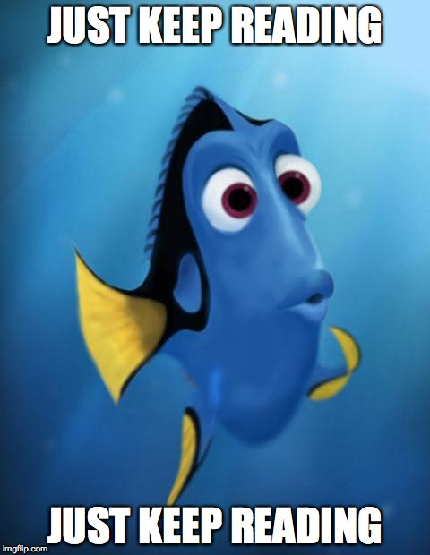
Home Learning: English
Monday: Reading

Slide 2
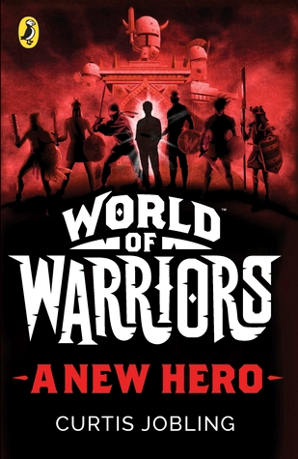
Synopsis
Richard 'Trick' Hope is used to getting into trouble, but not like this. . . On the run from bullies, Trick finds himself transported to the mystical Wildlands, a place where the greatest warriors throughout history have been summoned to fight in a battle for survival - from Romans and Vikings to Knights and Samurai! A cryptic old man tells Trick that he's there for a reason - to deliver the Wildlands from the evil Boneshaker, who rules with an army of terrifying minions. Trick has been chosen to form a band of the seven greatest warriors to defeat this terrible enemy. As Trick begins his epic quest the stakes couldn't be higher: defeat Boneshaker or never see home again.

Slide 3
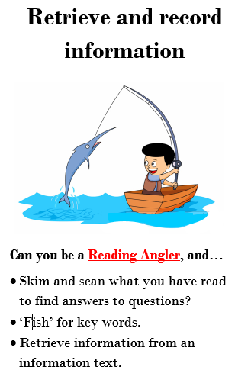
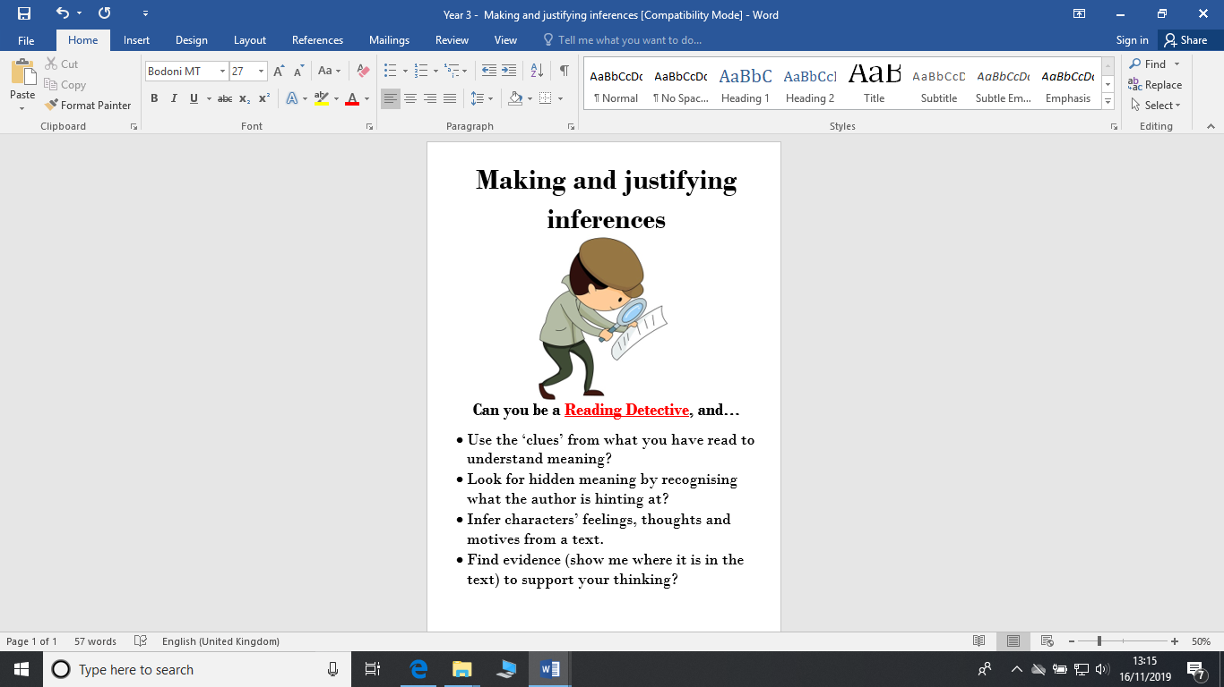
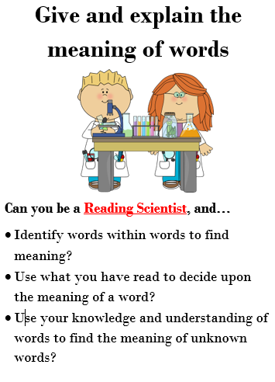
Reading character recap
Usually one word or short phrase answers that you need to find in the text. You may have to tick a box, draw a line or say whether something is true or false.
Asking you to look more into “why” something has happened. You may be asked why or how something happened, give reasons or explain with evidence.
All about the vocabulary! You may be asked to find words that are similar to other words. Remember – if it says copy something, write it exactly how it appears in the text.

Slide 4
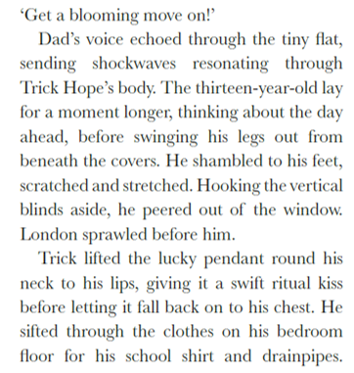
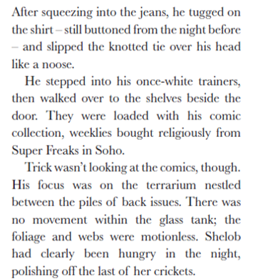

Slide 5
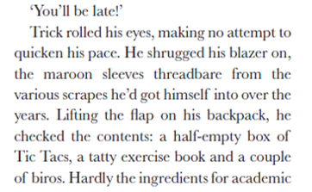
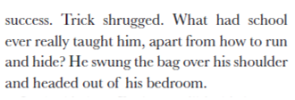
After you have read the extract, read it again and highlight any key words you do not know OR think are impactful words.
Use a dictionary or iPad/Laptop to find the definition.
On the next slide are some that I have found…

Slide 6

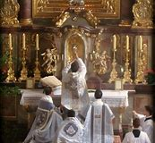
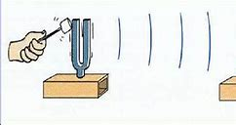
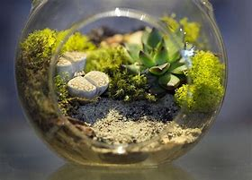
Resonating
produce or be filled with a deep, full, reverberating sound.
Or
To evoke images, memories or emotions.
Ritual
a religious or solemn ceremony consisting of a series of actions performed according to a prescribed order.
Terrarium
a vivarium for smaller land animals, especially reptiles, amphibians, or terrestrial invertebrates, typically in the form of a glass-fronted case.

Slide 7
Find and copy one word that shows that Trick’s blazer is old.
Find and copy one word that shows that Trick never forgets to buy his magazines.
What type of creature lives in the terrarium and how do you know?
Why do you think Trick kisses his necklace?
Is Trick’s room tidy? Give two pieces of evidence to support your answer.
Why has the author selected words like “shrugged” and “shambled” to describe how Trick moves?
Extension
7) Describe what you think Trick might be like at school, using quotes from the text to support your answer.

Slide 8
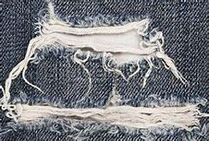
ANSWERS
Find and copy one word that shows that Trick’s blazer is old.
Threadbare
(this word means that his blazer is losing thread – see picture)
2) Find and copy one word that shows that Trick never forgets to buy his magazines.
Religiously
(this word means he does it over and over again- he consistently buys magazines)
3) What type of creature lives in the terrarium and how do you know?
A spider is in the terrarium. I know because the author mentions how the webs were not moving.
(an arachnid or tarantula can also be accepted)

Slide 9
ANSWERS
4) Why do you think Trick kisses his necklace?
Trick’s necklace was lucky to him. I think he kissed the pendant because he thought it gave him good luck.
5) Is Trick’s room tidy? Give one piece of evidence to support your answer.
No it is not tidy. I know this because he had a lot of clothes on his bedroom floor.
6) Why has the author selected words like “shrugged” and “shambled” to describe how Trick moves?
I think the author uses “shrugged” and “shambled” to show how much Trick does not want to get out of bed and go to school. He shambled to his feet showing that he wasn’t moving quickly to go to school. Also, he shrugged his blazer on which suggests he didn’t really care about it.

Slide 10
ANSWERS
Extension
7) Describe what you think Trick might be like at school, using quotes from the text to support your answer.
I don’t think Trick does well at school. It is clear that he doesn’t want to be there as when he was late, he didn’t “quicken his pace” and also “rolled his eyes” showing that he didn’t care.
Furthermore, I don’t think he goes to school prepared to learn. He has a “tatty exercise book” and he thinks that school has never really taught him anything.
(answers can vary here but the main points are that he does not like school, he doesn’t want to be there and he is never prepared)

