Slide 1
Year 5 Measure
Volume
Week 4 Lesson 3 – converting units of measurement
ML to L
L to ML

Slide 2
Today’s lesson
In the past, we have looked at measurement and weight. We are now moving on to volume. All bottles and cans you drink our measured in volume.

Slide 3
How to convert volumes & liquids…
ML |  | L | ÷ 1,000
L |  | ML | X 1,000
1,000ml = 1L 1L = 1,000ml

Slide 4
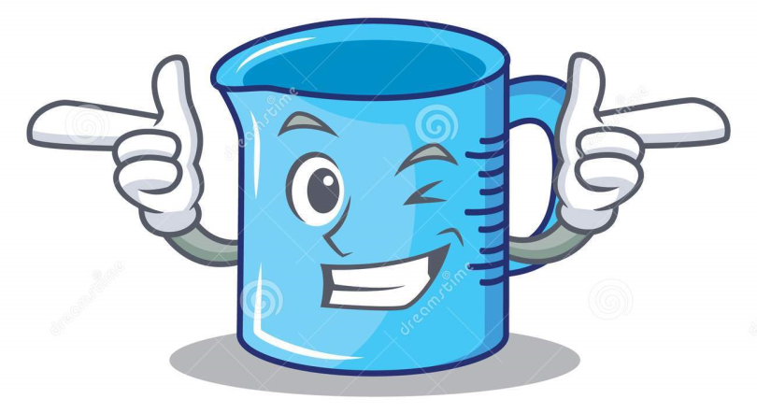
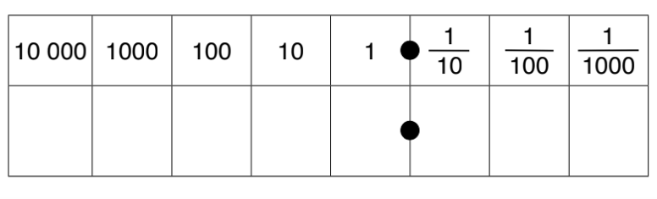
Convert 2,600ML to L
Multiplying means that we are getting bigger so the place value grid we would move to the left.
If we are multiplying/dividing by 1,000 we would move three place value.
2,600ML into L = 2,600÷ 1,000
Have a look at the number sentence that you have.
If we are multiplying are we getting bigger or smaller?
How many times are we getting bigger or smaller?
The number sentence can answer both these questions.
ML | to | L | ÷ 1,000
L | to | ML | X 1,000
1,000ml = 1L 1L = 1,000ml
Place value grid
2
6
0
0

Slide 5
2,600ML into L = 2,600÷ 1,000 = 2.6L
From the previous slide, we have moved three times to the right.
Place value grid
2
6

Slide 6
What about this time?
Are we multiplying or dividing?
What are we multiplying or dividing by (means the amount of place values we are moving)
0.06L to ML
0
0
6

Slide 7
0.06 to ML =
0.06 x 1,000 = 600ml
This time we have got larger so have moved 3 times to the left.
ML | to | L | ÷ 1,000
L | to | ML | X 1,000
1,000ml = 1L 1L = 1,000ml
6
0
0

Slide 8
How to convert volumes & liquids…
ML |  | L | ÷ 1,000
L |  | ML | X 1,000
1,000ml = 1L 1L = 1,000ml

Slide 9

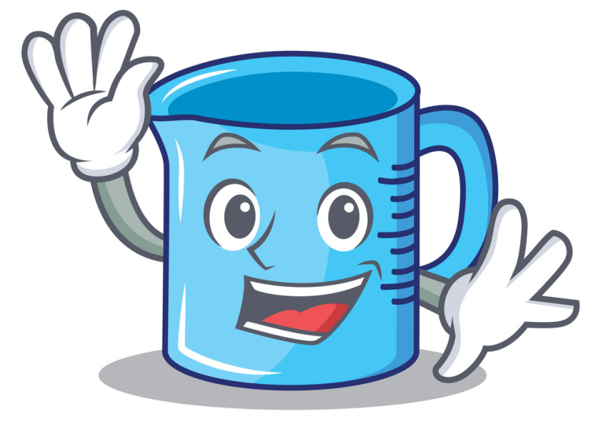
Today’s learning
I am going to do this by:
÷ by 1,000 when converting ML to L.
X by 1,000 when converting L to ML.

