Slide 1
Year 5 Measure
Length
Week 3 Lesson 1 – converting units of measurement
M to KM
KM to M

Slide 2
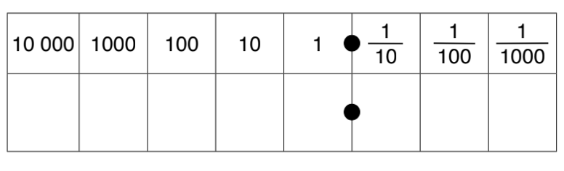
Similar to last week’s last two lessons, we will be using a method we have learnt before to apply to the context of measurement.
Multiplying means that we are getting bigger so the place value grid we would move to the left.
If we are multiplying/dividing by 1,000 we would move three place value.
68 x 1,000=
Have a look at the number sentence that you have.
If we are multiplying are we getting bigger or smaller?
How many times are we getting bigger or smaller?
The number sentence can answer both these questions.
Place value grid
6
8

Slide 3
68 x 1,000 = 68,000
We have moved three to the left.
As you can see, I have added a 0 into the ones column, the tens and the hundreds. This acts as a place holder as we have no other number to put there and we cannot leave this value blank.
Place value grid
6
8
0
0
0

Slide 4
What about this time?
Are we multiplying or dividing?
What are we multiplying or dividing by (means the amount of place values we are moving)
12,561 ÷ 1,000
1
2
5
6
1

Slide 5
12,561 ÷ 1,000 = 12.561
As you can see, we are dividing this means now we are moving to the right because we are getting smaller.
We are dividing by 1,000 so we are moving three place values to the right.
1
2
5
6
1

Slide 6
We need to convert between these two measurements when comparing!
M |  | KM | ÷ 1,000
KM |  | M | X 1,000
1,000M = 1KM 1kM = 1,000CM

Slide 7
78km into m
M | to | KM | ÷ 1,000
KM | to | M | X 1,000
1,000M = 1KM 1kM = 1,000CM
From the question, you can see that we need to convert from a km to a m. On the table to the right, it will guide you to whether you are multiplying or dividing.
KM to M = x1,000
Place value grid
7
8

Slide 8
78km into m
KM to M = x1,000
78km x 1,000 = 78,000m
Because we are multiplying, we move to the left (getting larger). We are multiplying by 1,000 so we move three times to the left. As there was no number in the ones , tens or hundred column we must add our place holder.
M | to | KM | ÷ 1,000
KM | to | M | X 1,000
1,000M = 1KM 1kM = 1,000CM
Place value grid
7
8
0
0
0

Slide 9
3,762m to km
M | to | KM | ÷ 1,000
KM | to | M | X 1,000
1,000M = 1KM 1kM = 1,000CM
From the question, you can see that we need to convert from m to a km. On the table to the right, it will guide you to whether you are multiplying or dividing.
M to KM = ÷ 1,000
Place value grid
3
7
6
2

Slide 10
3,762m to m
M | to | KM | ÷ 1,000
KM | to | M | X 1,000
1,000M = 1KM 1kM = 1,000CM
M to KM = ÷ 1,000
Because we are dividing, this means we are getting smaller. As we are dividing by 1,000, this means we are moving three times to the right.
No place holders needed as we have a number in the ones column when converted.
3,762 ÷ 1,000 = 3.762
Place value grid
3
7
6
2

Slide 11
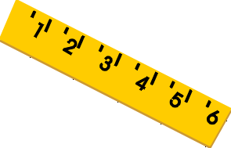
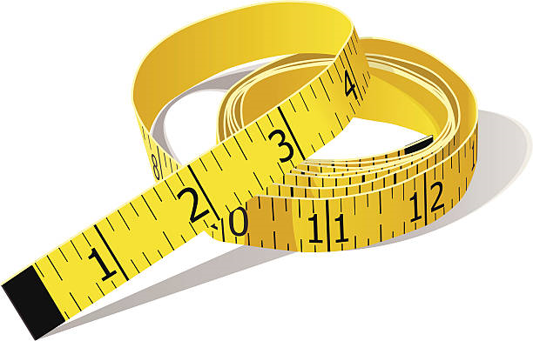
Today’s rule.
÷ by 1,000 when converting M to KM.
X by 1,000 when converting KM to M.

Slide 12
Notes:
Print back2back for the chn to use if needed.

Slide 13
Notes:
Print back2back for the chn to use if needed.

