Slide 1
What can you remember about autobiographies(you wrote them in Autumn all about yourselves)?

Slide 2
Today, you will be creating a biography.
What do you think will be different between an autobiography and a biography?

Slide 3
What is a biography?
An account of someone’s life written by someone else.
What is the purpose of a biography?
To inform you/give information about somebody’s life. It gives detailed information about their life, with facts, stories and often their greatest achievements.
Notes:
Why? What is the purpose/job of an biography?

Slide 4
Features of a biography
Formal language is used.
Experiences are described in detail and are anecdotal (story like to engage the reader) – they are not lists!
Specific people’s names and dates are included.
The biography is written in the past tense, using the third person.
Time connectives / fronted adverbials.
A range of sentence structures.
Structure:
Opening statement introduces the subject and explains why he/she is known.
Significant events are ordered chronologically.
Closing statement explains how this person will be remembered.

Slide 5
Time connectives / fronted adverbials word and phrase bank
Short amount of time
Soon afterwards, | After a few days, | Earlier that day,
Before long, | At that moment, | To begin with,
At first, | In the beginning, | A few days later,
Medium amount of time
After a few weeks / months, | Earlier that week / month, | After some time,
Gradually, | A few weeks / months later, | As time passed,
Days turned to weeks until… | Before long, | By the time he was _________,
Long amount of time
Eventually, | Finally, | After many years,
Earlier that year, | In the end, | Months turned to years until…
Before Leonardo knew it, | In May 1506, | Long after,
Other
Meanwhile, | Afterwards, | Later,
After that, | In the mean time, | Until then,
When ___________, | At that point, | Besides,
Also, | As well as _____________, | Last of all,

Slide 6
Your task
Using your knowledge you have acquired from your non-core learning this week, create your own biography for Leonardo Da Vinci.
How this is presented is entirely up to you but it must have a clear structure (heading, paragraphs etc). Think carefully about your sub-headings etc.
Suggested structure – opening paragraph, main event, main event, conclusion.
It must include the features identified on slide 2 (try to include some of our year 5 techniques we learnt before we broke up).
Refer back to the non-core slides to help you ☺
Notes:
This is not expected to be pages of writing – encourage children to choose 2 main events of Da Vinci’s life which can make up their main paragraphs.
Children were taught to use … in replacement of where a paragraph would go when creating their autobiographies in Autumn.

Slide 7
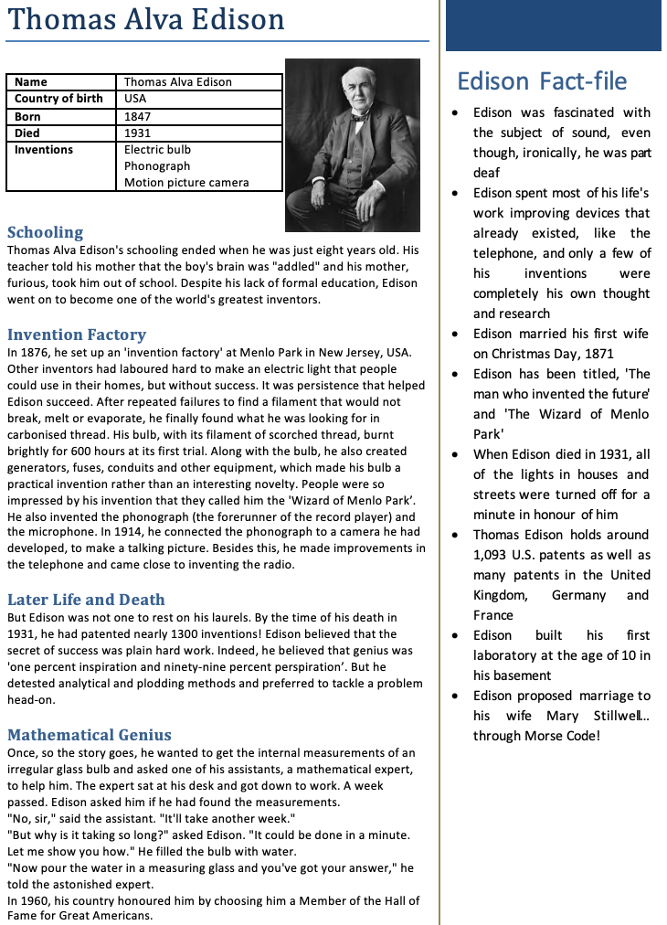
What features can you identify on this example of Thomas Edison?
Notes:
An example of how it could be presented based on Thomas Edison. The fact file box at the top could be replaced with an introductory paragraph.

Slide 8
Headline
Picture/ diagram
Introductory facts – you could make yours better by writing a short paragraph.
Fact file
Bullet points to add any additional facts or points that have not been explored in the main paragraphs
Sub-heading
Paragraphs
Fronted adverbials
Parenthesis
Notes:
An example of how it could be presented based on Thomas Edison. The fact file box at the top could be replaced with an introductory paragraph.
Just a few key features highlighted.

