Slide 1
Monday 8th June 2020
Punctuation and Grammar – Apostrophes for plural possession

Slide 2
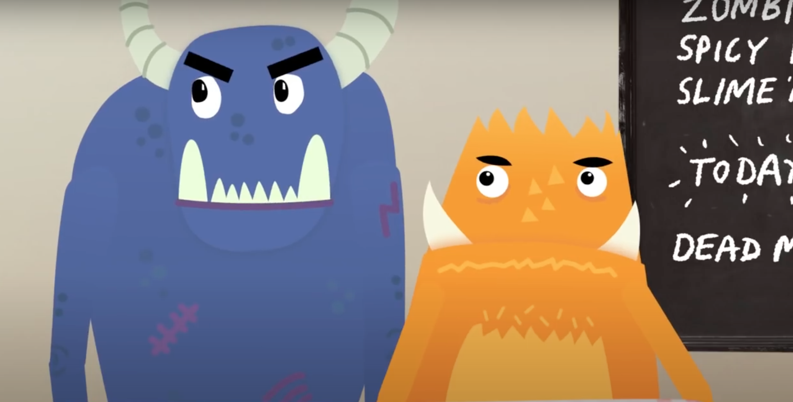
Click on the video below or paste this link into the internet.
https://www.youtube.com/watch?v=zNFPnVz7JB4
This is a short video to explain how you use apostrophes for plural possession. It will also explain how this is different to singular possession and test your knowledge at the end.
Notes:
https://www.youtube.com/watch?v=zNFPnVz7JB4

Slide 3
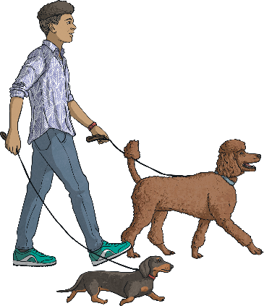
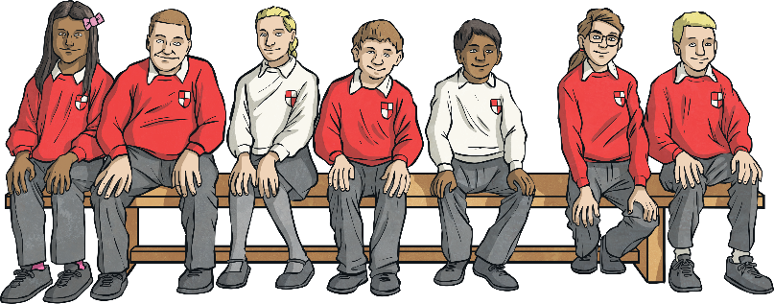
What Is Plural Possession?
Apostrophes can be used to show that something belongs to someone or something. This is called possession. When we are talking about more than one thing, we call this plural.
The dogs’ leads were too long.
The children’s lunch was delayed.
If the noun is plural and ends with an s, we just attach the apostrophe to it without an additional s.
If the noun is plural and does not end with s, we add ’s to the end.

Slide 4
Plural Possession
Now it is your turn. Read the singular form of the noun, make the noun plural and then show where the apostrophe would need to be to show plural possession.
Singular | Plural | Plural Possession
kitten
actress
baby
knife
child
volcano
kittens
kittens’
actresses
actresses’
babies
babies’
knives
knives’
children
children’s
volcanoes
volcanoes’

Slide 5
s or ’s ?
Read the words below and decide whether they would need just an apostrophe (’), or an apostrophe followed by an s (’s) to show plural possession.
’
’s
churches
next

Slide 6
s or ’s ?
Read the words below and decide whether they would need just an apostrophe (’), or an apostrophe followed by an s (’s) to show plural possession.
’
’s
back
men
next

Slide 7
s or ’s ?
Read the words below and decide whether they would need just an apostrophe (’), or an apostrophe followed by an s (’s) to show plural possession.
’
’s
back
mice
next

Slide 8
s or ’s ?
Read the words below and decide whether they would need just an apostrophe (’), or an apostrophe followed by an s (’s) to show plural possession.
’
’s
back
babies
next

Slide 9
s or ’s ?
Read the words below and decide whether they would need just an apostrophe (’), or an apostrophe followed by an s (’s) to show plural possession.
’
’s
back
people
next

Slide 10
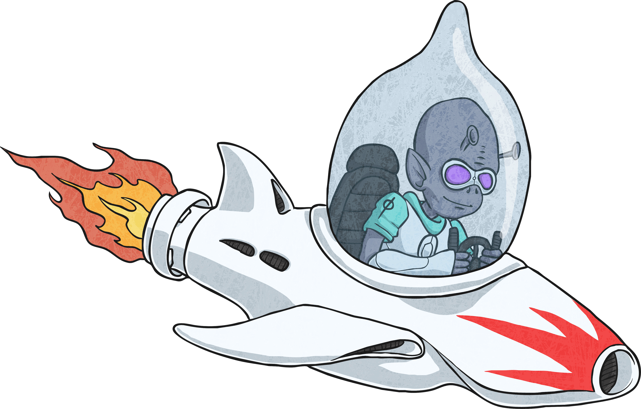
Correct!
’
’s

Slide 11
Correct!
’
’s

Slide 12
Incorrect!
’
’s
try again!

Slide 13
Which Word Is Correct?
Read the sentences below and decide which word should go in the gap. Which one accurately shows plural possession?
planets’
The orbits all centre around the star.
planets / planet’s / planets’ / planets’s
lice’s
Some eggs are difficult to remove.
lices / lice’s / lices’ / lices’s
teeth’s
All of the cavities must be filled.
teeths / teeth’s / teeths’ / teeths’s

Slide 14
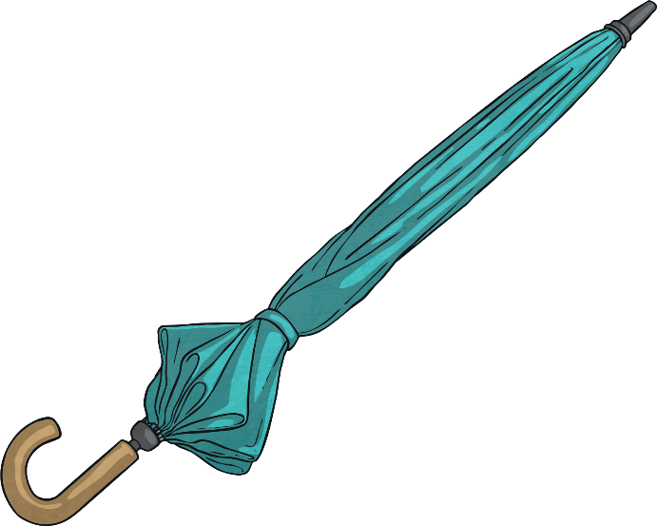
Plural Possession Quick Quiz
Take a quiz to see if you are an expert!
Which word should go in the gap to show plural possession?
handles are sometimes made from wood.
Umbrella’s
Umbrella’s
Umbrellas’
Umbrellas’
Umbrellas’s
Umbrellas’s
next
You’ve got it!
Try again!
Try again!

Slide 15
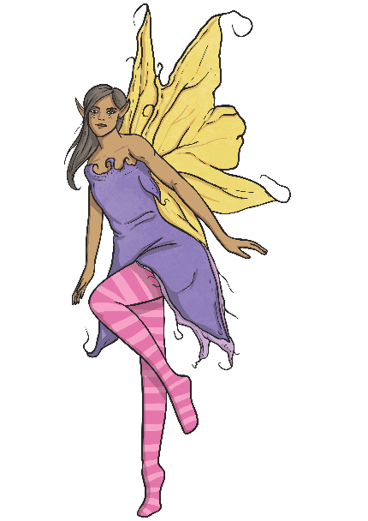
Plural Possession Quick Quiz
Take a quiz to see if you are an expert!
Which word should go in the gap to show plural possession?
The wings shimmered in the moonlight.
fairies
fairies
fairies’s
fairies’s
fairies’
fairies’
back
next
Try again!
Try again!
You’ve got it!

Slide 16
Task One - Silly Sentences
Choose one word from each column to make the silliest sentences you can which still make sense and show plural possession.
Example: The witches’ money is made of frogspawn!
Determiner | Plural Possession | Random
the | bosses’ | smile
some | bushes’ | money
these | witches’ | days
many | people’s | clean
those | women’s | lantern

Slide 17
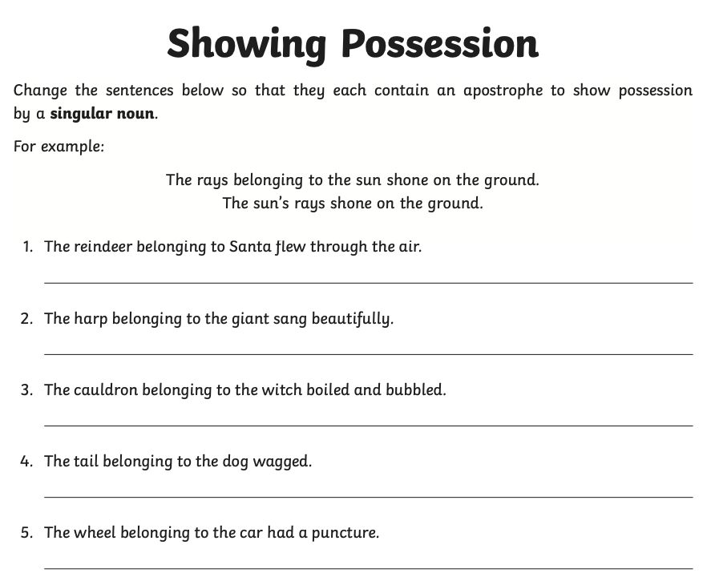
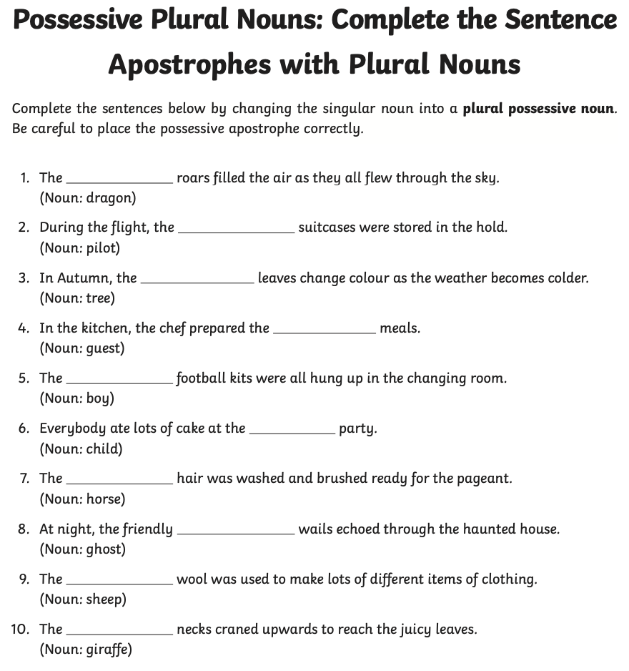
You are now superstars at identifying plural possession with apostrophes!
Try completing the two worksheets to consolidate your knowledge – there are some examples at the top to help ☺

