Slide 1
Tuesday 5th May 2020
Reading

Slide 2
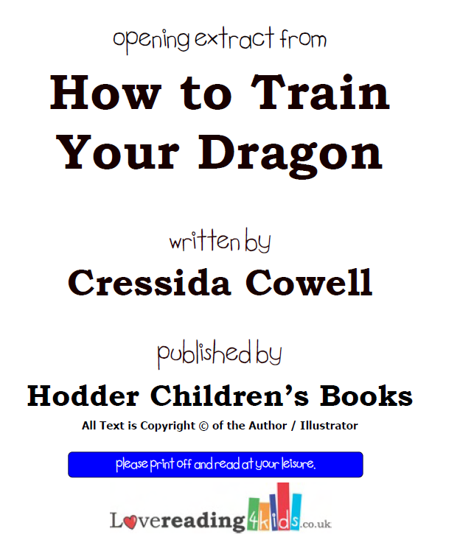
The extract for today’s reading comprehension is taken from www.lovereading4kids.co.uk This really is a fantastic website for ideas for new books to read. Most books allow you to download a small extract to see if you like it. You do
have to sign up but it is completely free. This is what I did for today’s session.
Top tip for
eager readers from Miss Lacey!
Today’s extract is already included in this Powerpoint.

Slide 3
To start with, let’s read the extract.
This is the first chapter from How to train your dragon by Cressida Cowell.
This is the book you would have been studying this half term in school ☺
If you like our extract/lessons, you could always order yourself a could always order yourself a copy.

Slide 4
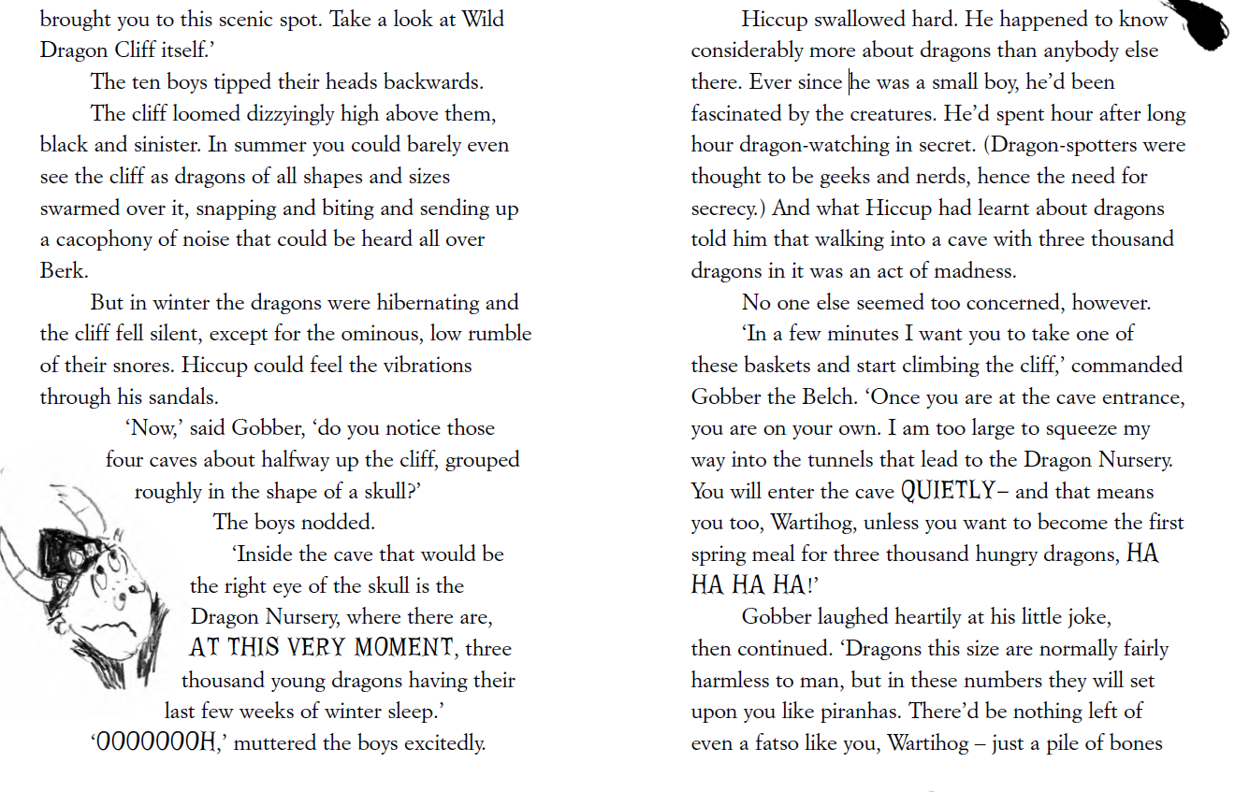
Pages 1 and 2

Slide 5
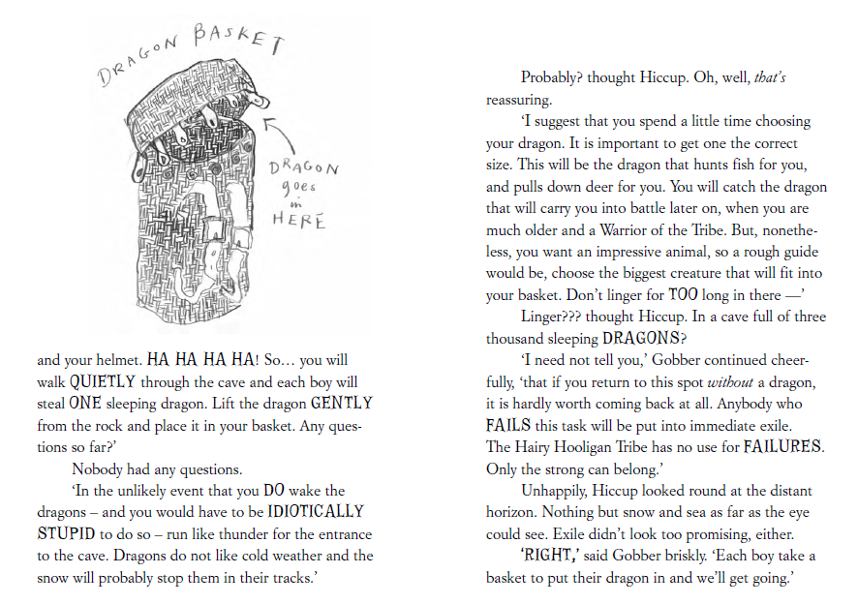
Pages 3 and 4

Slide 6
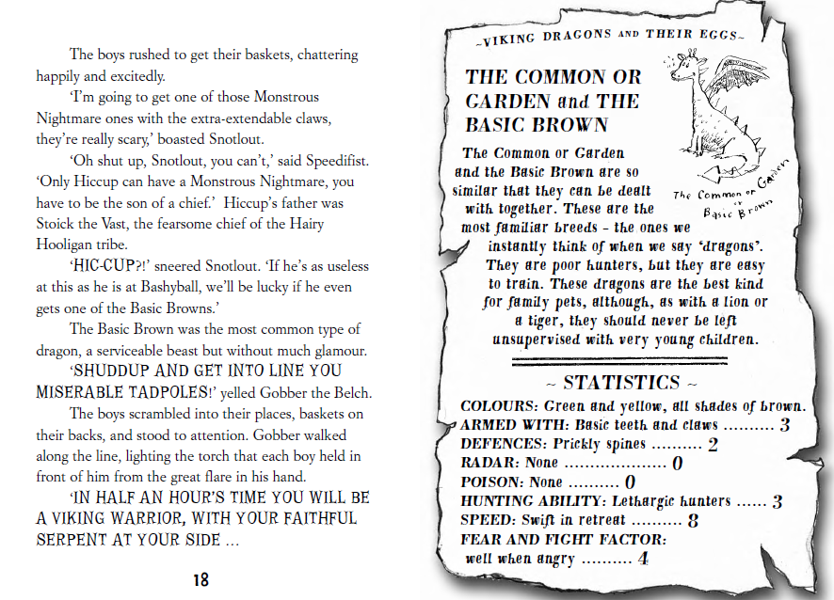
Pages 5 and 6

Slide 7
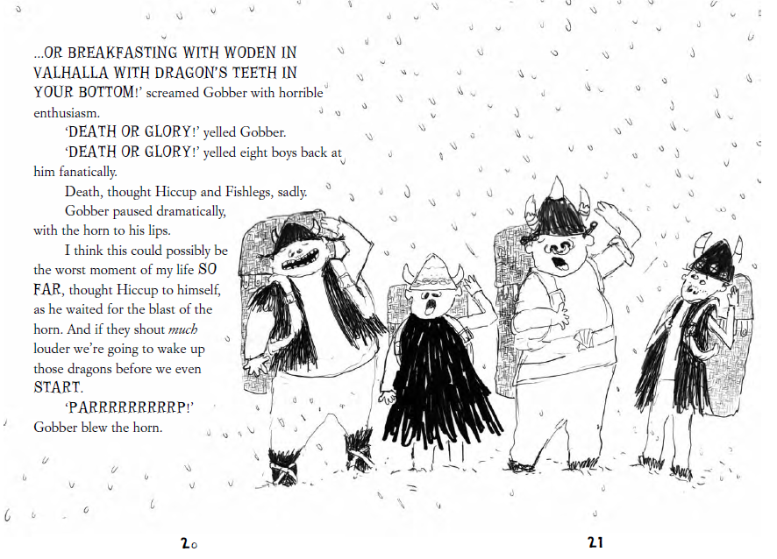
Page 7

Slide 8
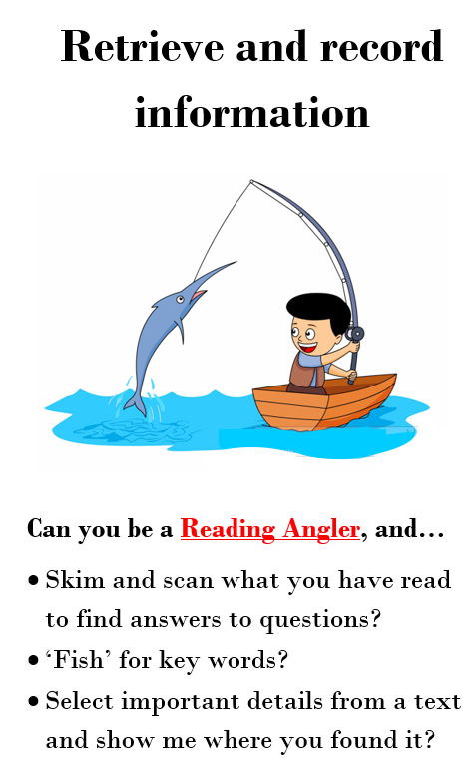
Today we are going to focus on both skills that we have looked at over the last 2 weeks.

Slide 9
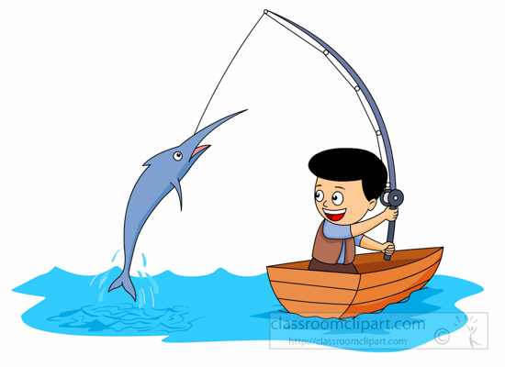
Tips from Reggie
Once you’ve read the text, you can skim and scan for key words to help you find the answer.
For example: Who was the pizza menu actually addressed to?
I would scan for the words pizza menu and addressed. These then sign post me to the answer.
In the whole of his entire, actual life, Eric Doomsday
had never got anything through the post. No letters, no postcards, no parcels, no nothing.
He did get a pizza menu once, although, as it had been addressed to a Mrs Eric Dumsday, he
didn’t think it counted.
Answer: The pizza menu was addressed to Mrs Eric Dumsday.

Slide 10
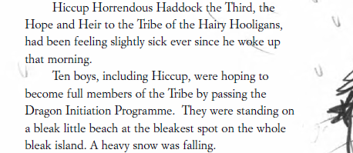
Tips from Derek
Once you’ve read the text, you can skim and scan for key words to help you find the right area for you answer like we did last week..
For example: Why was Hiccup feeling sick?
I would scan for the words Hiccup and sick.. These then sign post me to the section I need to focus on.
Answer: Hiccup felt sick because he was about to take part in
The Dragon Initiation Programme and he felt scared.
Now I need to think a little deeper..
What reasons do people usually
feel sick.
Illness? Nervousness?
Does anything in the text link to this?

Slide 11
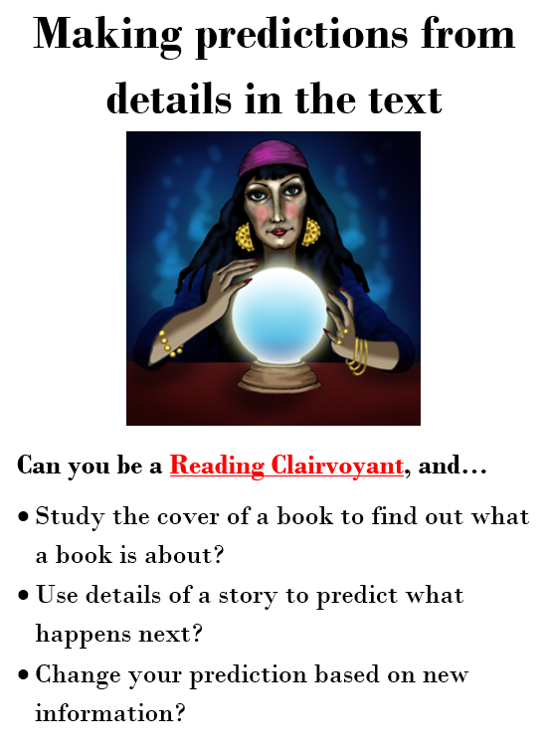
Our last question today asks us to make a prediction.
This is Claire. She encourages us to use the clues in the text to make a sensible guess about what happens in the future.

Slide 12
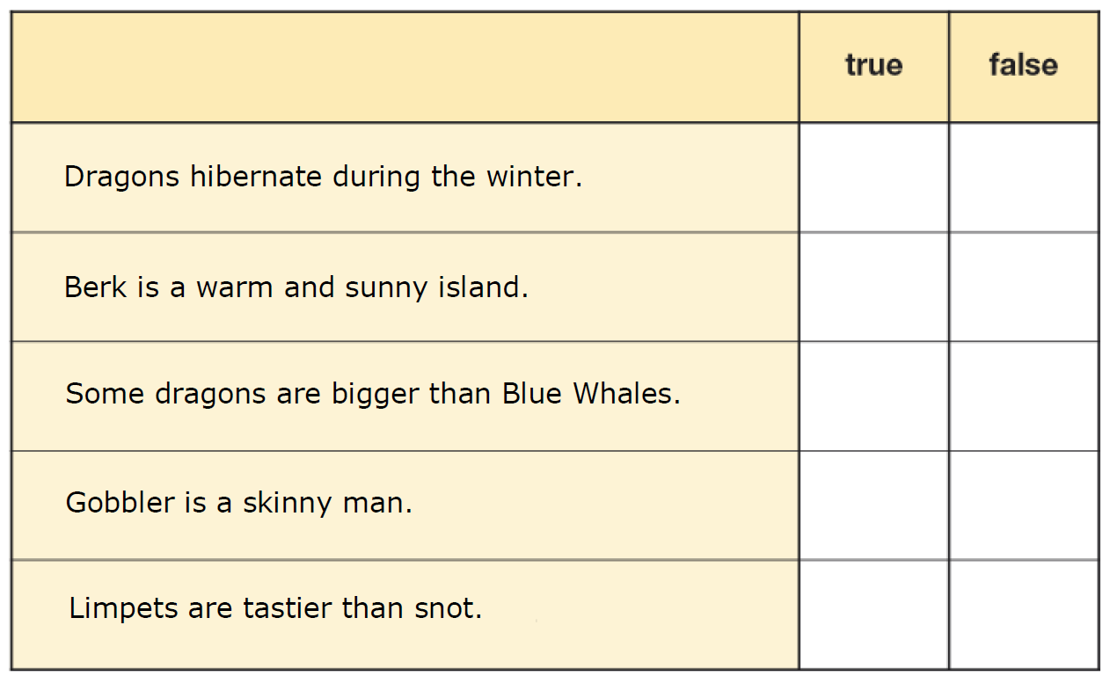
Write the answers in full sentences in your green book.
How does the dragon cliff change between summer and winter? (Page 1)
Why did Hiccup watch dragons in secret? (Page 2)
Why does no-one what a ‘basic brown’ dragon? (Page 5)
4)Use the text to decide if these statements are true or false? (All reading including last week).
5) What do you think will happen in the next chapter?

