Slide 1
Wednesday 8th July 2020
Writing narratives

Slide 2
Today we are going to carry on adapting the story to make our own.
We are going to be writing the narratives we planned yesterday.

Slide 3
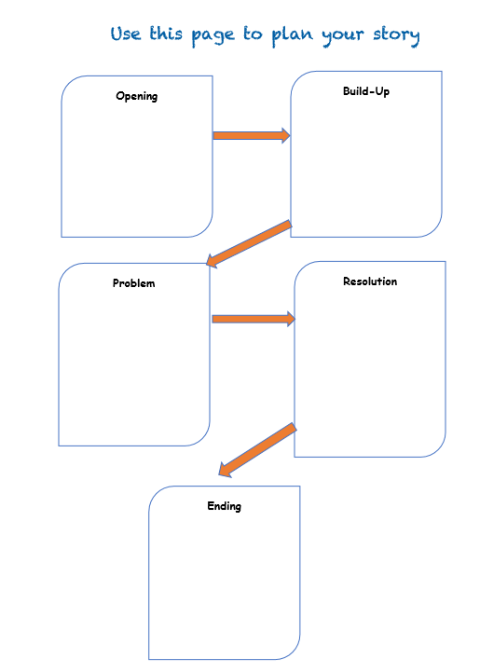
Before we start, take 5 minutes to look back over your plan from yesterday to remind yourself of all your ideas.

Slide 4
It is time to write your portal story.
Remember to look back at the original story if you need
extra guidance.
Take your time and really think carefully
about your word choices.
Try to use a range of sentence types
(exclamation, command, question).
When you’ve finished a section, go back....read it
and check that you are totally happy with
it before moving on. If you’re not, change the
elements you don’t like, improve your word choices.
This type of editing and proof reading is an important
writing skill.

Slide 5
Year 4, I love it when you send me your
writing to read, it really brightens up my
day. I especially love seeing how much
progress you have made since I last
taught you!
When you’ve finished, why not take
pictures of your writing and email
them to me?
Miss Lacey
(My email address is on lots of letters but it is definitely on the letter you have received about collecting books).

