Slide 1
Maths Week 6 Lesson 1
Barcharts (Final Session)

Slide 2
Practise 8 x multiplication as a warm up…
1 x 8 = 9 x 8 =
2 x 8 = 10 x 8 =
3 x 8 = 11 x 8 =
4 x 8 = 12 x 8 =
5 x 8 =
6 x 8 =
7 x 8 =
8 x 8 =

Slide 3
Practise 8 x multiplication as a warm up…
1 x 8 = 8 9 x 8 = 72
2 x 8 = 16 10 x 8 = 80
3 x 8 = 24 11 x 8 = 88
4 x 8 = 32 12 x 8 = 96
5 x 8 = 40
6 x 8 = 48
7 x 8 = 56
8 x 8 = 64

Slide 4
Barcharts – Final Session

Slide 5
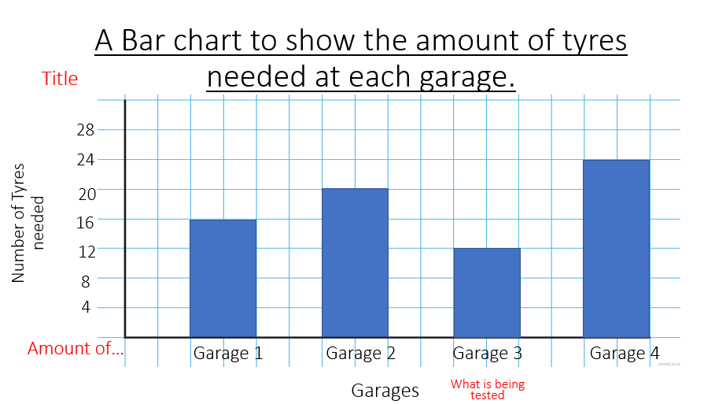
Look at the information below:
Garage | Number of tyres needed at each garage
1
2
3
4
Key = 4 Tyres

Slide 6
A Bar chart to show the amount of tyres needed at each garage.
Title
28
24
20
Number of Tyres needed
16
12
8
4
Amount of…
Garage 1
Garage 2
Garage 3
Garage 4
Garages
What is being tested

Slide 7
Questions:
Which garage needed the least amount of tyres?
How many more tyres did Garage 4 need to Garage 2?
Did any of the garages needed the same amount of tyres?
Why has the bar chart counted up in 4s each time?

Slide 8
Questions:
Which garage needed the least amount of tyres? Garage 3
How many more tyres did Garage 4 need to Garage 2? 4 more tyres
Did any of the garages needed the same amount of tyres? No
Why has the bar chart counted up in 4s each time? The bar chart has counted up in 4s because each tyre is worth 4.

