Slide 1
Week 11 English 1
The Girl and the Robot

Slide 2
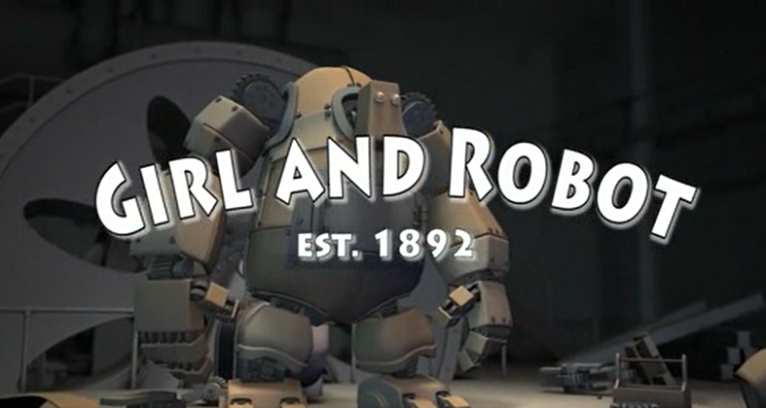
You are going to watch this short clip:
https://www.literacyshed.com/girlandrobot.html

Slide 3
Your task…
You are going to create your robot to use in your English work this week.
Use any bits of materials in your house/ garden.
Upload a picture on twitter so I can see!

Slide 4
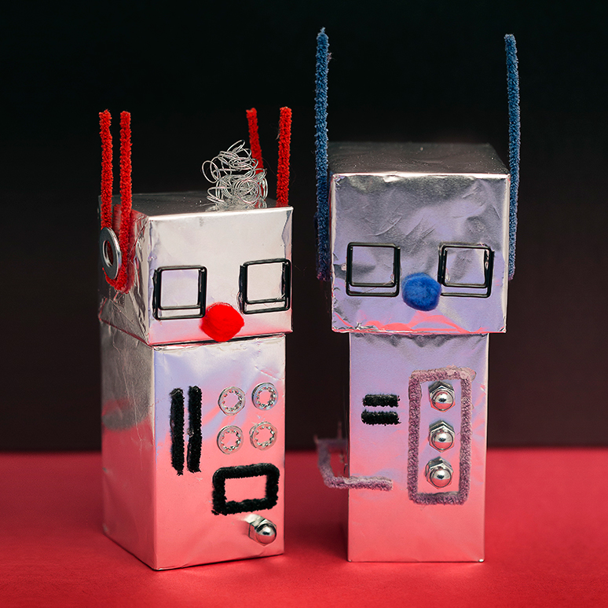
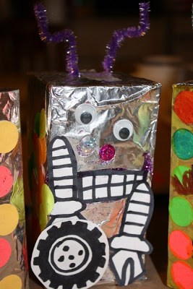
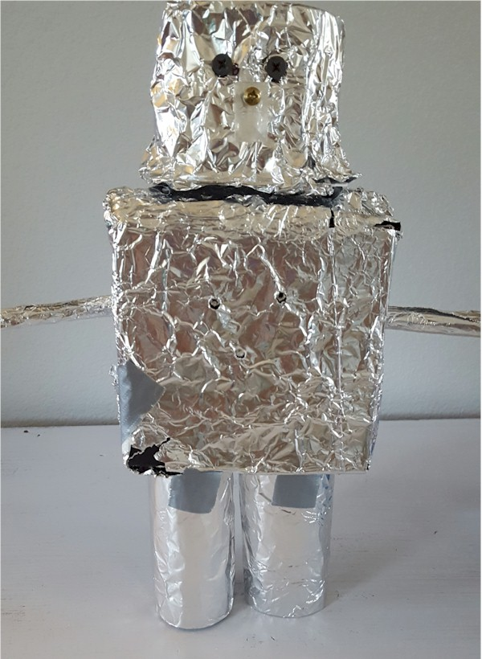
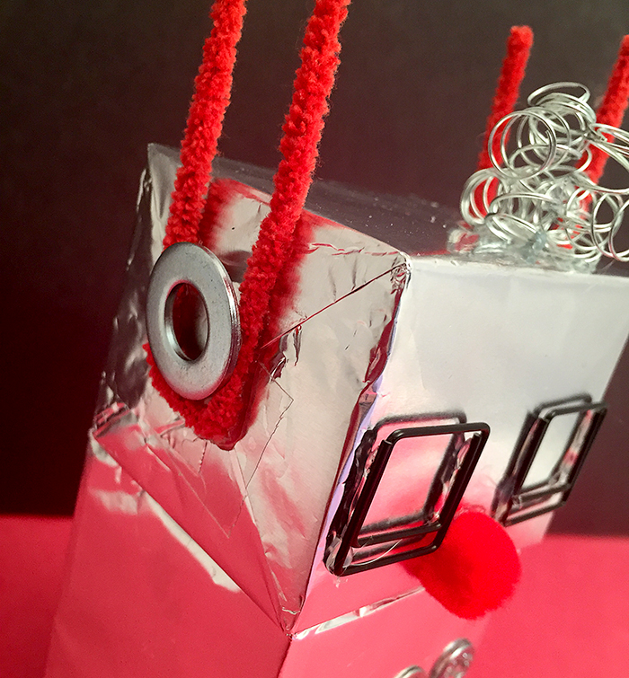
Here are some ideas!

