Slide 1
Monday 27th April 2020
English - Spelling
Notes:
© Copyright Showeet.com – Free PowerPoint Templates. Photo credits: Pixabay (CC0 Public DomainFree for commercial use No attribution required)

Slide 2
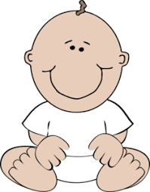
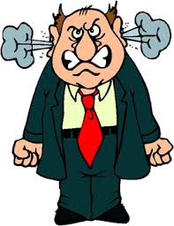
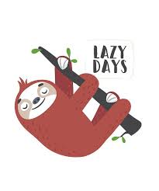
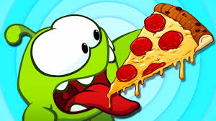
What do you notice about the y at the end of these words? What sound is it making?.
angry
baby
lazy tasty
The y in all these words makes an ‘ee’
sound. When you hear ‘ee’ at the end
of a word it is usually (but not always) spelt
with a y.
Notes:
© Copyright Showeet.com – Free PowerPoint Templates

Slide 3
How many words can you spot that use y to show an ‘ee’ sound? Make a list.
The Hungry Pony was lazy but wanted plenty of food. If you gave it a strawberry, a cherry or even some gravy or a curry it would eat it. This pony would get angry, even crazy, if it got too hungry. Many people found this very funny, a great comedy, but some thought it was silly.
Notes:
© Copyright Showeet.com – Free PowerPoint Templates

Slide 4
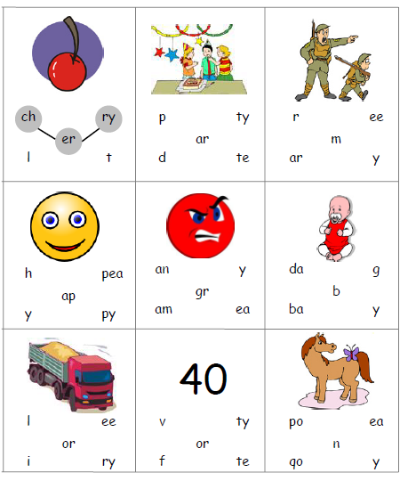
Use the sheet for today to complete this activity. Your sheet should look like this
Use the sounds provided to create the
Spelling path that matches the picture.
The first one has been done for you.
If you can’t print off the sheet, don’t worry. Just use your finger to track the path on the screen.
Notes:
© Copyright Showeet.com – Free PowerPoint Templates

Slide 5
To finish our spelling session today…
We are going to use our tch sound to play…
Fred Fingers!
The children will be experts at this!
This is how we play…
Adult says the word.
Child counts the sounds (not the letters) on their fingers.
Child writes the word.
Adult and child check together
Adults – Use words with tch that we have looked at today
Or choose some of your own to test our tch sound knowledge!

