Slide 1
Year 2 - Time
Session 5 – Finding duration of times

Slide 2
Today we are learning to find the duration of times

Slide 3
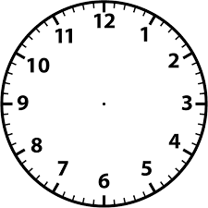
Lets find the time difference
I left my house at 8 o’clock
How long did it take me to get to work?
I got to work at 9 o’clock
From 8 o’clock to 9 o’clock it is 1 Hour

Slide 4
Lets find the time difference
I went to work at 10 o’clock.
How long was I at work for?
I left work at 12o’clock.
From 10 o’clock to 12 o’clock is 2 hours
Let’s start counting from 10 o’clock
11 o’clock
12 o’clock
1 hour
2 hours

Slide 5
Lets find the time difference
I went shopping at 9 o’clock
How long did I go shopping for?
I got home at 1 o’clock
From 9 o’clock to 1 o’clock is 4 hours
Let’s start counting from 9 o’clock
10 o’clock
11 o’clock
12 o’clock
1 o’clock
1 hour
2 hours
3 hours
4 hours

Slide 6
Lets find the time difference
I left my house at half past 10
How long did it take me to get to the beach?
I got to the beach at half past 1
From half past 10 to half past 1 it is 3 Hours
Let’s start counting from half past 10
Half past 11
Half past 12
Half past 1
1 hour
2 hours
3 hours

Slide 7
Lets find the time difference
I left my house at quarter to 3
How long did it take me to get to London?
From quarter to 3 to quarter to 6 it is 3 Hours
I got to London at quarter to 6
Let’s start counting from quarter to 3
Quarter to 4
Quarter to 5
Quarter to 6
1 hour
2 hours
3 hours

