Slide 1
Monday 22nd June 2020
Notes:
© Copyright Showeet.com – Free PowerPoint Templates. Photo credits: Pixabay (CC0 Public DomainFree for commercial use No attribution required)

Slide 2
We are going to read some more of ‘George’s Marvellous Medicine’ later in the session.
First, we are going to finish writing our
Explanation text.
Notes:
© Copyright Showeet.com – Free PowerPoint Templates. Photo credits: Pixabay (CC0 Public DomainFree for commercial use No attribution required)

Slide 3
Last week, we wrote...
Our title
A question opener
Miss Lacey’s magical medicine
Do you have the world’s grumpiest teacher? Do they have a black cloud over their head?
If so, worry no more! Use Miss Lacey’s magical medicine and your teacher will be a ray of sunshine! So, how does it work?
First, the mouthwash will trickle down their neck as a result all the mean words will be washed straight out of their mouth.
Next, the slimy conditioner starts to bubble consequently your teacher’s voice will be
silky and smooth.
After that, the toothpaste blasts away all the brown dirt from their teeth so that they
have a beautiful, clean smile.
3 sentences about our ingredients to tell the reader what they do. These included time and causal conjunctions.

Slide 4
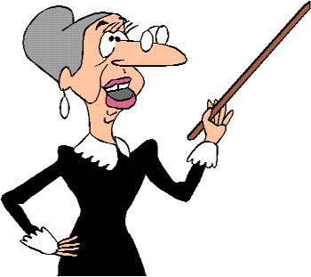
What would I put in a medicine for Miss Strict?
Mouthwash – To wash the mean words out of her mouth.
Conditioner – To make her voice smooth and friendly.
Toothpaste – To clean her horrid, brown teeth.
Washing powder – To make her have clean, happy thoughts.
5 cans of pop – To give her fizz and energy (or to make her explode!)
Perfume – To stop her from smelling badly.

Slide 5
So far, my explanation text looks like this.
Miss Lacey’s magical medicine
Do you have the world’s grumpiest teacher? Do they have a black cloud over their head?
If so, worry no more! Use Miss Lacey’s magical medicine and your teacher will be a ray of sunshine! So, how does it work?
First, the mouthwash will trickle down their neck as a result all the mean words will be washed straight out of their mouth.
Next, the slimy conditioner starts to bubble consequently your teacher’s voice will be
silky and smooth.
After that, the toothpaste blasts away all the brown dirt from their teeth so that they
have a beautiful, clean smile.
Soon, the washing powder will crackle away in their brain as a result all their
thoughts clean and kind.
Finally, the pop will begin to fizz so that your teacher is full of energy.

Slide 6
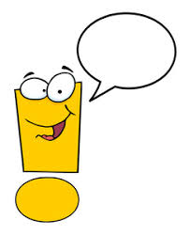
At the end of an exclamation, there is a closing statement. It sometimes gives a small warning and nearly always finishes with a positive, encouraging feel.
Warnings that if you don't use it correctly....
Positive sentences.
Exclamations.
Your life will be..
Your problem will be gone.

Slide 7
Warnings that if you don't use it correctly.. What will happen if your
Person takes too much medicine or doesn’t follow the instructions?
Warning: Only use 1 spoon of medicine. If they take
more the fizziness of the pop might make your teacher
explode.
Positive sentences.
Exclamations.
Your life will be..
Your problem will be gone.
As you can see this medicine is incredible. Your grumpy teacher problem will be gone forever!

Slide 8
Miss Lacey’s magical medicine
Do you have the world’s grumpiest teacher? Do they have a black cloud over their head?
If so, worry no more! Use Miss Lacey’s magical medicine and your teacher will be a ray of sunshine! So, how does it work?
First, the mouthwash will trickle down their neck as a result all the mean words will be washed straight out of their mouth.
Next, the slimy conditioner starts to bubble consequently your teacher’s voice will be
silky and smooth.
After that, the toothpaste blasts away all the brown dirt from their teeth so that they
have a beautiful, clean smile.
Soon, the washing powder will crackle away in their brain as a result all their
thoughts clean and kind.
Finally, the pop will begin to fizz so that your teacher is full of energy.
Warning: Only use 1 spoon of medicine. If they take more the fizziness of the
pop might make your teacher explode.
As you can see this medicine is incredible. Your grumpy teacher problem will be gone
forever!

Slide 9
Time to relax Chapter 11
Mr Kranky’s Great Idea
https://www.youtube.com/watch?v=Xls7XtU8hq0
Notes:
© Copyright Showeet.com – Free PowerPoint Templates. Photo credits: Pixabay (CC0 Public DomainFree for commercial use No attribution required)

Slide 10
See you on Monday for more of George’s Marvellous Medicine!
Notes:
© Copyright Showeet.com – Free PowerPoint Templates. Photo credits: Pixabay (CC0 Public DomainFree for commercial use No attribution required)

