Slide 1
Wednesday 17th June 2020
Notes:
© Copyright Showeet.com – Free PowerPoint Templates. Photo credits: Pixabay (CC0 Public DomainFree for commercial use No attribution required)

Slide 2
We are going to read some more of ‘George’s Marvellous Medicine’ later in the session.
First, we are going to look a little deeper at
Causal conjunctions.
Notes:
© Copyright Showeet.com – Free PowerPoint Templates. Photo credits: Pixabay (CC0 Public DomainFree for commercial use No attribution required)

Slide 3
Before we start, let’s read a new example of an explanation text.

Slide 4
The Teacher Pleaser!
What do you think this machine might be for?

Slide 5
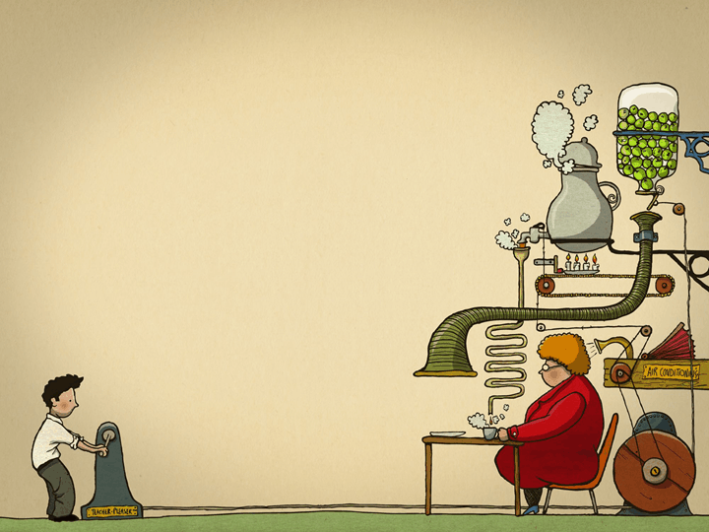
The ‘Teacher Pleaser’ machine Do you suffer from a grumpy teacher? If so, then use the 'Teacher-Pleaser' machine and soon your teacher will become the jolliest person in school. How does the machine work? To start the machine running, you have to wind up the handle this causes a large wheel to begin to turn .As the wheel spins, a hot cup of tea is made. Your teacher receives a lovely cup of tea therefore, she will feel in a good mood instantly.

Slide 6
You can also turn on one of the best features of the 'Teacher-Pleaser'. Press the red button on the top of the machine so that, the pencil sharpener is switched on.
The pencil sharpener is extremely fast consequently, in 30 seconds you can sharpen every pencil!

Slide 7
The 'Teacher-Pleaser' also writes notes saying, “You are the best teacher in the world” because these make a teacher smile.
Finally, there is an in-built calendar which alerts you to your teacher's birthday so that you can remember to buy a present.
Use the machine with care. Make sure the water tank is always filled otherwise the tea function will boil over causing the machine to explode.
Use one of these amazing machines because it will keep your teacher happy therefore your school life will be a breeze! What an amazing invention it is!

Slide 8
Explanation texts contain 3 types of conjunctions. Two we already know all about.
Subordinating and co-ordinating conjunctions. That join sentences to make the longer.
and because but or so and when
Time conjunctions – First, Next, After that, Soon, Finally.

Slide 9
Causal conjunctions
Our new type of conjunction is slightly trickier.
This conjunction joins to short phrases.
One phrase needs to have caused the other.
I like to think of it as a chain reaction!

Slide 10
Let's think about it like this....
Our causal conjunction would go here.
The player hits the ball
so that
it whizzes through the air.
_____________
this happen.
made (caused)
This

Slide 11
Examples of causal conjunctions
now that
so that
therefore
consequently
as a result
this causes

Slide 12
Let's read some of the teacher pleaser and spot some causal conjunctions.
To start the machine running, you have to wind up the handle this causes a large wheel to begin to turn. As the wheel spins, a hot cup of tea is made. Your teacher receives a lovely cup of tea therefore, she will feel in a good mood instantly.
Finally, there is an in-built calendar which alerts you to your teacher's birthday so that you can remember to buy a present.

Slide 13
Help me to add causal conjunctions to these sentences for the teacher pleaser machine.
I chose these, but you could use any that make sense.
Press the green button______________ a pen will pop out and mark all the books in the classroom.
The books are all marked _________your tired teacher can have a nap.
consequently
as a result
Therefore so that consequently as a result this causes

Slide 14
Help me to finish these sentences to make our own sentences for ‘The Teacher Pleaser’ that use causal conjunctions.
I chose these, but you could use any that make sense.
Pull the purple lever…
Turn the blue dial….
Pull the purple lever to start the compliment giver. The machine will say nice things to your teachers this causes them to be instantly happier.
Turn the blue dial, as a result the machine will begin to vacuum the whole classroom leaving it clean and tidy.
Therefore so that consequently as a result this causes

Slide 15
What do explanations need?

Slide 16
Complete your two tasks using causal conjunctions to make sentences about ‘The Teacher Pleaser’

Slide 17
Time for our reading session Chapter 9
The Pig, The Bullocks, The Nanny Goat, The Sheep, The Pony and The Nanny Goat.
https://www.youtube.com/watch?v=Xls7XtU8hq0
Notes:
© Copyright Showeet.com – Free PowerPoint Templates. Photo credits: Pixabay (CC0 Public DomainFree for commercial use No attribution required)

Slide 18
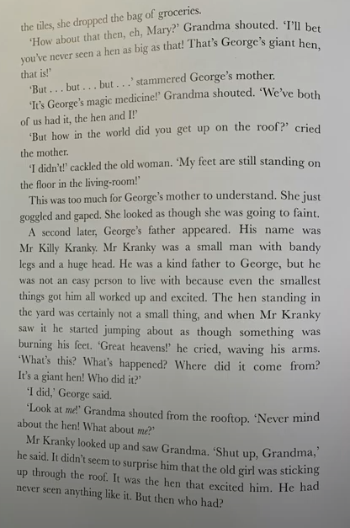
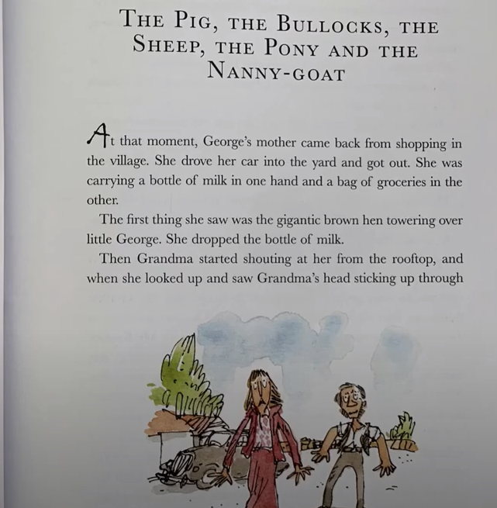

Slide 19
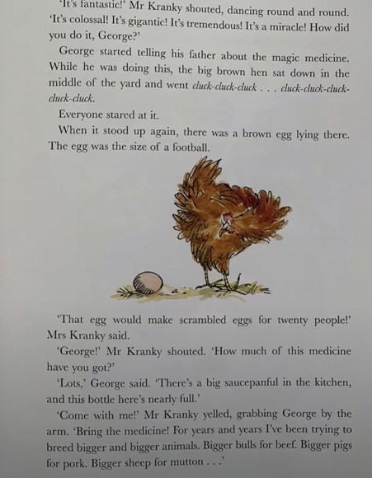
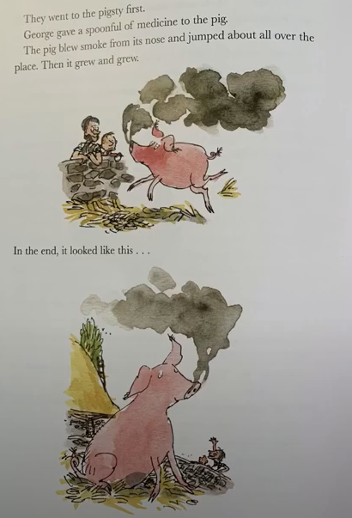

Slide 20
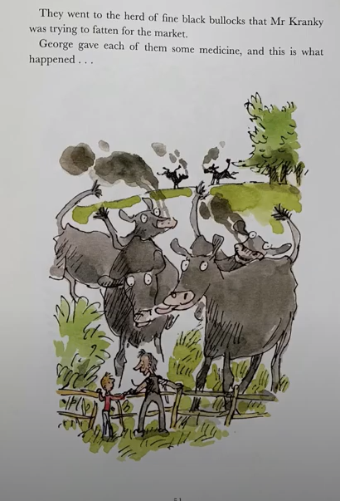
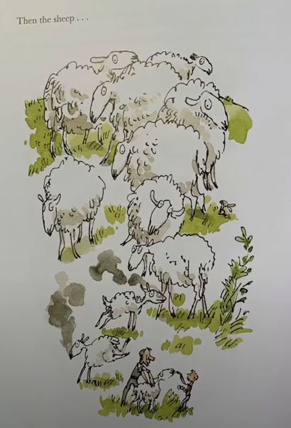

Slide 23
See you tomorrow for more of George’s Marvellous Medicine!
Notes:
© Copyright Showeet.com – Free PowerPoint Templates. Photo credits: Pixabay (CC0 Public DomainFree for commercial use No attribution required)

