Slide 1
Monday 15th June 2020
Notes:
© Copyright Showeet.com – Free PowerPoint Templates. Photo credits: Pixabay (CC0 Public DomainFree for commercial use No attribution required)

Slide 2
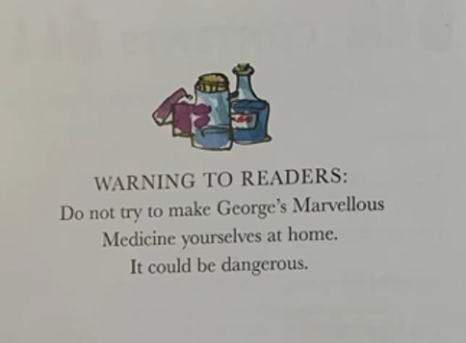
First, a small message from Roald Dahl and I…
Remember, this is a story.
We do not make
mixtures from things at home and
drink them…especially some of the things
George uses. They could make us very poorly
and it is not safe.

Slide 3
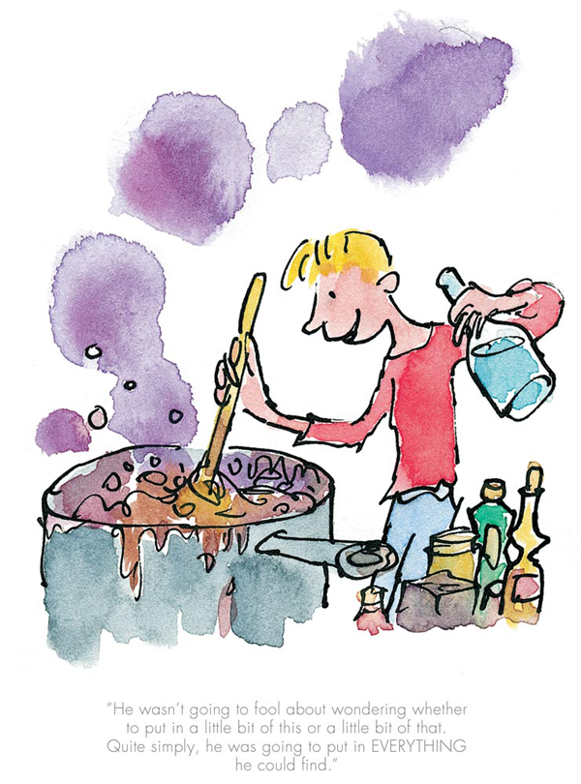
Before we do, let’s remind ourselves. What has happened so far in the story? Why is George making a medicine? What does he want to happen?
We are going to listen to read chapter 7 today.

Slide 4
Chapter 7
Grandma gets the medicine!
https://www.youtube.com/watch?v=6-YgPWf7ppw
Notes:
© Copyright Showeet.com – Free PowerPoint Templates. Photo credits: Pixabay (CC0 Public DomainFree for commercial use No attribution required)

Slide 5
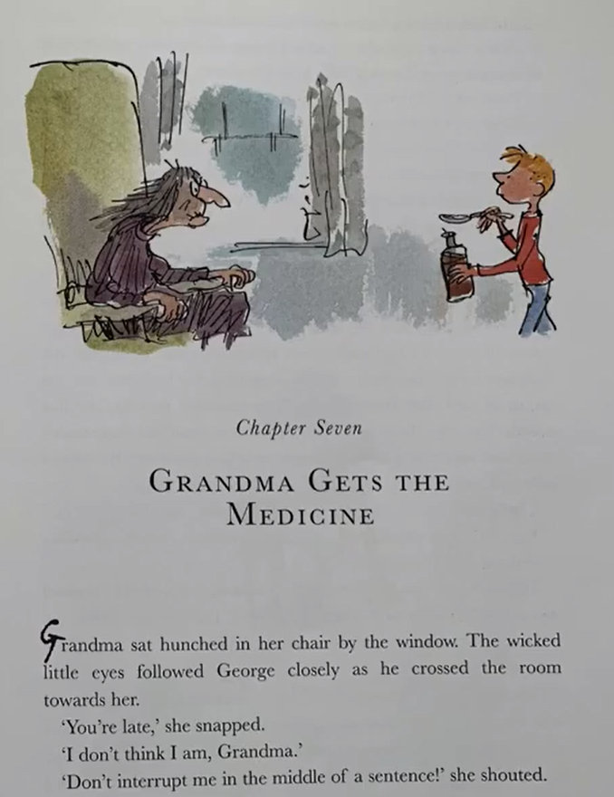
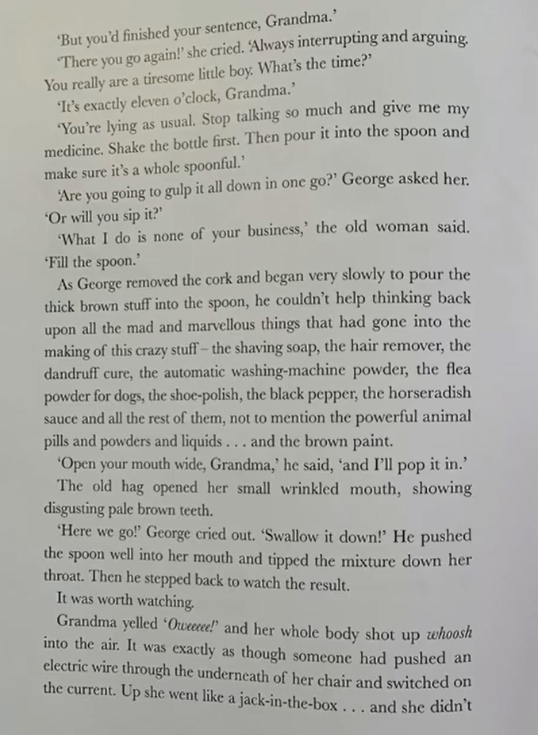

Slide 6
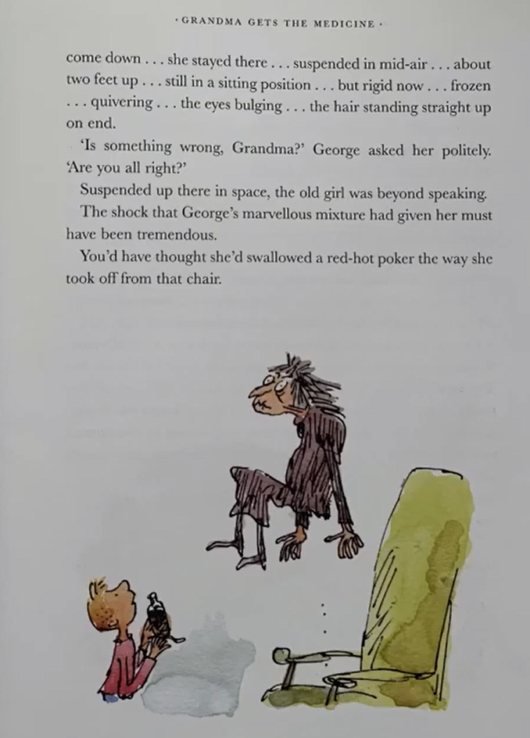
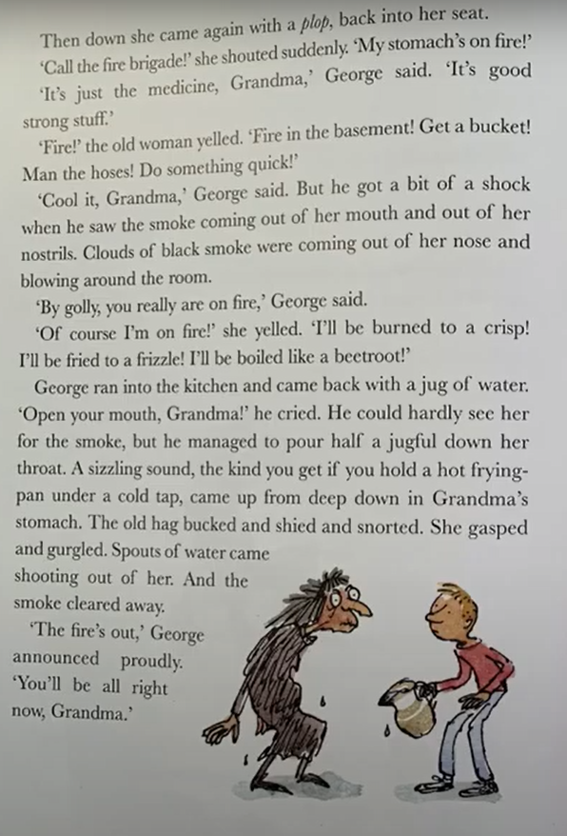

Slide 7
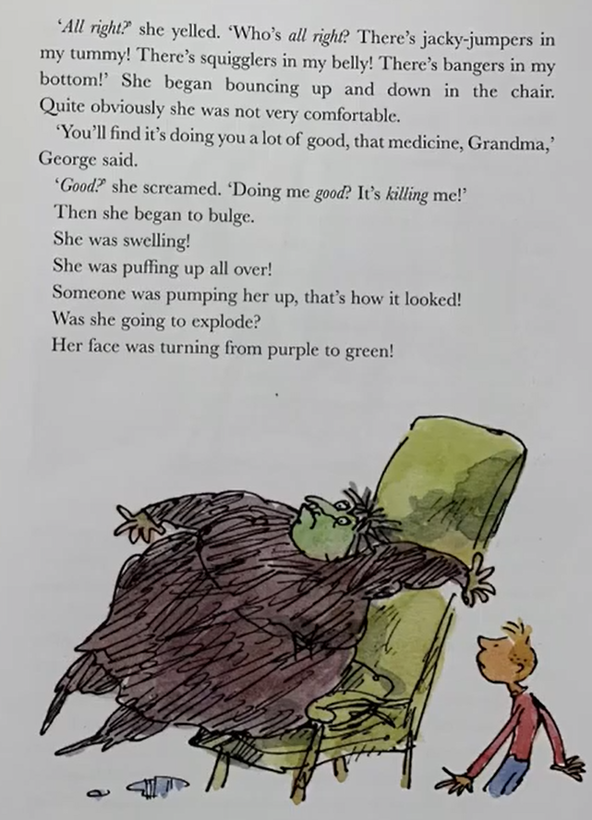
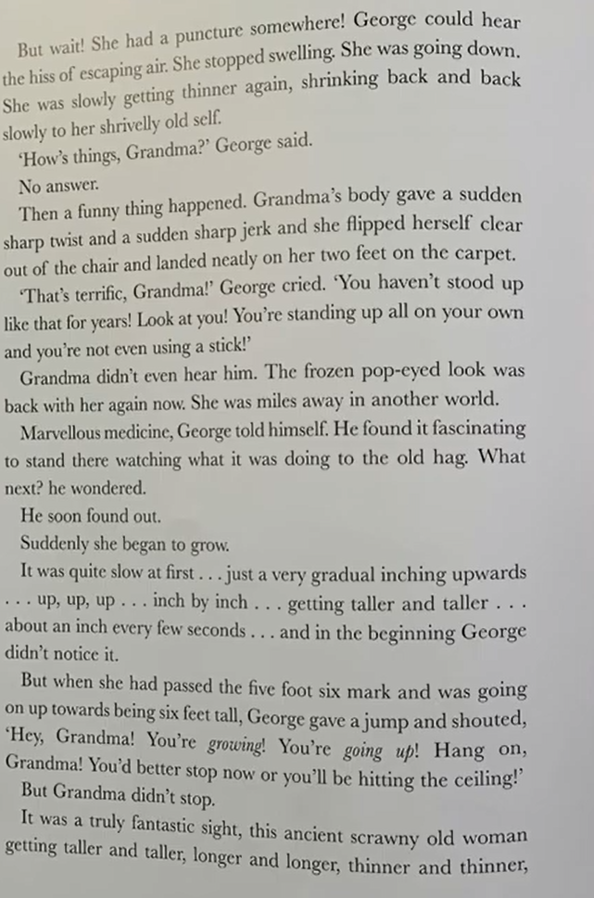

Slide 8
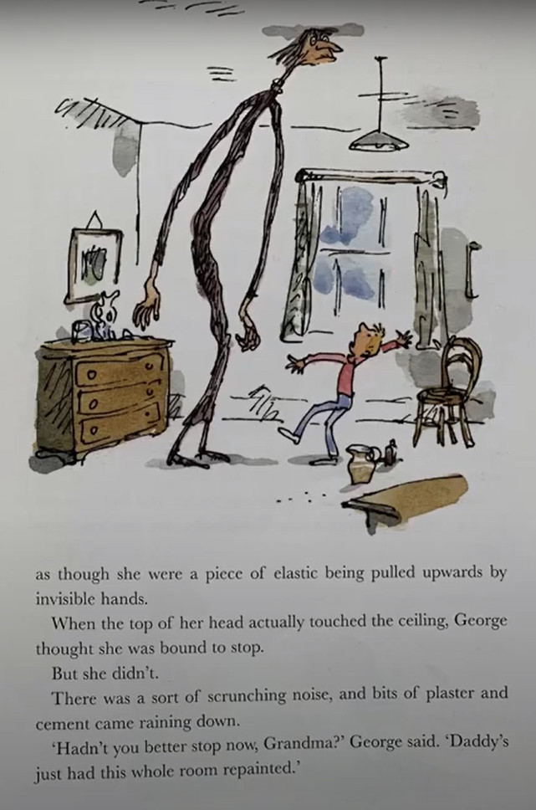
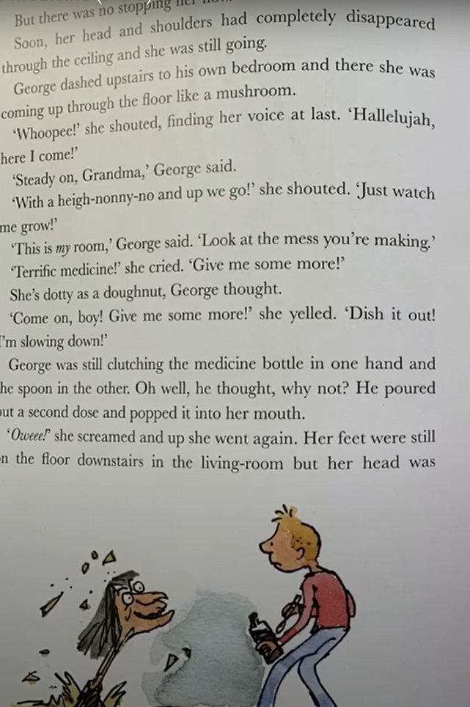
But there was no stopping her now.

Slide 9
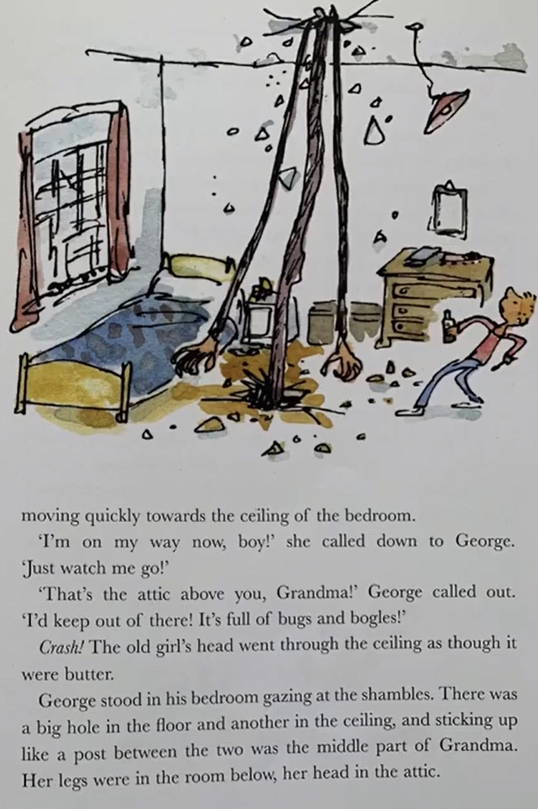
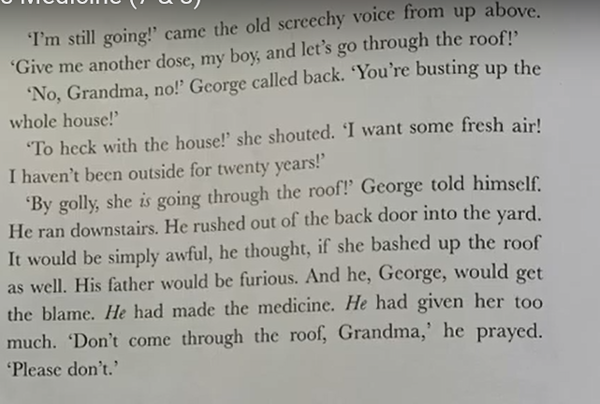

Slide 10
Eeek! I wonder if Grandma will go through the roof!?
Notes:
© Copyright Showeet.com – Free PowerPoint Templates. Photo credits: Pixabay (CC0 Public DomainFree for commercial use No attribution required)

Slide 11
Today, we are going to design our own marvellous medicine!
Before we do…Remember, this is a story.
We do not make
mixtures from things at home and
drink them…especially some of the things
George uses. They could make us very poorly
and it is not safe.

Slide 12
I want you to think of a really grumpy, imaginary adult that you want to fix…
An imaginary adult like George’s grandma!

Slide 13
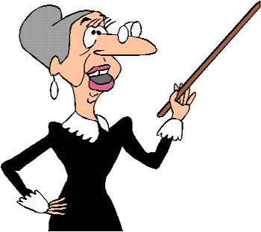
Let’s design them now.
Complete the top of your ‘My Marvellous Medicine’ sheet.
Who are they?
What do they do that isn’t nice?
What do they look like?
Here is mine….
This is Miss Strict.
Miss Strict is a teacher at a primary school in London.
Miss Strict is mean! She calls children names and makes them cry.
She doesn’t let children talk in her class and
if they even move she glues them to the chair!
Miss Strict has bad breath and slightly brown
Teeth from drinking too much coffee.
Miss Strict has lots of long, grey hair and
she wears tiny glasses at the end of her
Nose.
Your character could be:
A teacher
A wicked stepmother
A mean uncle or aunt
A miserable big brother or sister

Slide 14
We are going to design a medicine to fix the problems with our mean, grumpy grown up.
When we choose things to go in the medicine, we need to try and think about what it will do to help them.
For example:
George puts in ‘Nevermore ponking deodorant’ because Grandma is smelly.
He also puts in washing powder because he
says she is a dirty, old woman and it will
clean her.

Slide 15
My turn… What would I put in a medicine for Miss Strict?
Mouthwash – To wash the mean words out of her mouth.
Conditioner – To make her voice smooth and friendly.
Toothpaste – To clean her horrid, brown teeth.
Washing powder – To make her have clean, happy thoughts.
5 cans of pop – To give her fizz and energy (or to make her explode!)
Perfume – To stop her from smelling badly.
Complete the bottom of your ‘My Marvellous Medicine’ sheet.

Slide 16
See you tomorrow for more of George’s Marvellous Medicine!
Notes:
© Copyright Showeet.com – Free PowerPoint Templates. Photo credits: Pixabay (CC0 Public DomainFree for commercial use No attribution required)

