Slide 1
Thursday 23rd April 2020
English – Longer writing task
Notes:
© Copyright Showeet.com – Free PowerPoint Templates. Photo credits: Pixabay (CC0 Public DomainFree for commercial use No attribution required)

Slide 2
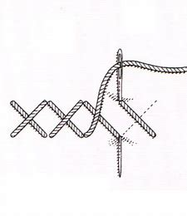
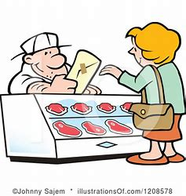
Let’s warm our brains up our brains by recapping this week’s learning.
Spell these words using your Fred Fingers.
Remember our rule… we use tch after a short vowel sound.

Slide 3
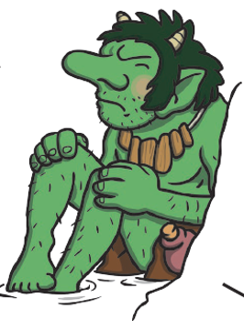
Let’s warm our brains up our brains by recapping this week’s learning.
Explain what an expanded noun phrase is
And give an example about this troll.
Remember our rule… we use tch after a short vowel sound.

Slide 4
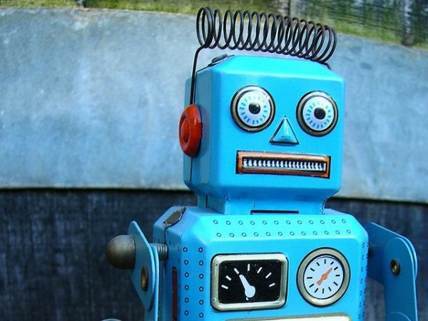
Today, we are focusing on applying our writing skills in a longer piece of writing.
This is today’s writing prompt. Talk together about the
picture. What can you see? What story ideas can
you come up with?
Notes:
© Copyright Showeet.com – Free PowerPoint Templates

Slide 5
Before we write, we need to plan our story.
Remember:
Story beginnings – Have a good opening line.
Introduce characters and settings.
(Just like you did with Dave and the Cave).
2) Story Middles – Something exciting happens! Perhaps
there is a problem to fix!
3) Story Endings - Everything comes back to normal (or does it?)
The problem is solved.
Notes:
© Copyright Showeet.com – Free PowerPoint Templates

Slide 6
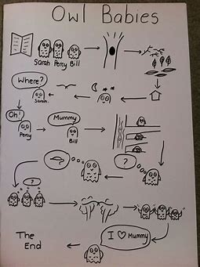
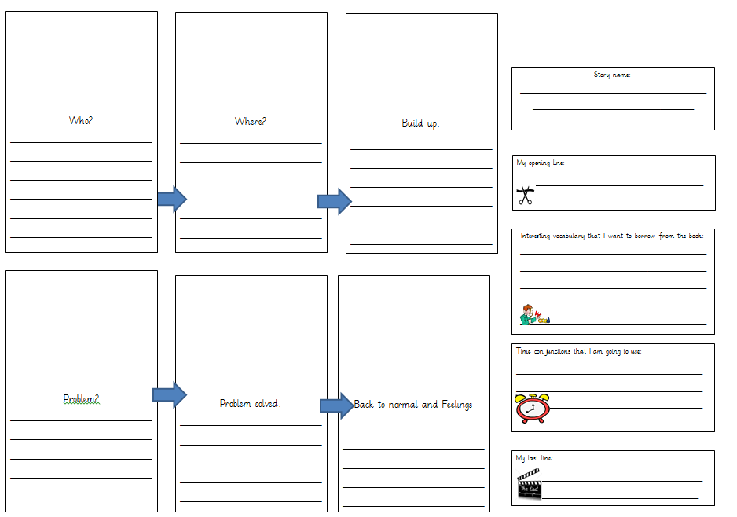
You might choose to plan your story
using Boxing Clever or a story map
like we do in class.

Slide 7
Writing time!
I would split your writing down across at least 2 days or 2 sessions like we do at school so that you don’t get ‘writing tired’.
Remember:
Take your time! There is no rush. The more we rush the
more mistakes we make.
Say each sentence out loud before you write it!
Read each sentence back to check you haven’t
missed any words or letters.

Slide 8
Writing time!
Miss Lacey’s writing wish list
I would like you to include:
Expanded noun phrases
Conjunctions (and, but, because, so)
At least 1 tch spelling word!
(I don’t need to ask for full stops, nice handwriting etc as I expect you to do that anyway! As we learn/recap more skills. I will my list longer or trickier!)

Slide 9
Now, write begin to write your robot story!
When you’ve finished:
Remember to proof read – Read and check for mistakes!
Go through your writing with my wish list. Did you achieve them all?
If you are really proud of your story. Why not turn it into a book with illustrations and become a real author?
Why not have a Storytime where you can read your story to your family?
You can even send it to me if you want to! You could send me pictures or you could type it up on the computer! (Mums and Dads should have my email already)
Notes:
© Copyright Showeet.com – Free PowerPoint Templates

