Slide 1
Tuesday 7th July 2020
Vocabulary

Slide 2
Today we are going to be using our Year 2 writing skills to write our magical ‘helping’ story.

Slide 3
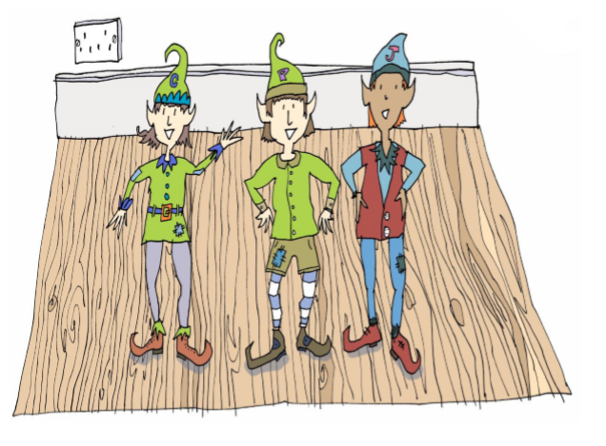
Yesterday, we planned a new
Story where magical friends of
Clary, Jaz and Pepper helped new people.

Slide 4
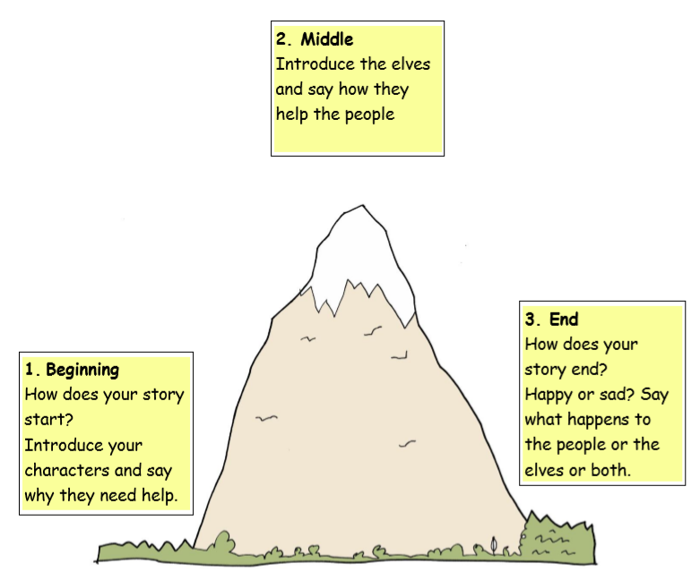
Before we write…
Let’s check our plans from yesterday.
Who are your character helping?
What are they helping them to do?
What are your characters called?
Check your story mountain plan to make sure
that you remember all your ideas.

Slide 5
What are we looking for in Year 2 stories?
A good opening line to draw the reader in.
Interesting vocabulary and different sentence types
(Exclamations, questions, commands)
Punctuation – Full stops, capital letters, exclamation marks, question marks.
Expanded noun phrases.
Past tense all the way through.
Common exception words spelt properly and a good use of phonics
for new words.
Handwriting – As neat and tidy as we can.
Tall giraffe letters reaching high above the others.
Small tortoise letters all the same size.
Dangling Monkey letters with tails under the line.

Slide 6
Now it is time to write your story!
Year 2, I really love it when I get to
read your fantastic stories and see
Your wonderful work! It really cheers
up my day.
If you can, don’t forget to send me a picture
so that I can see all the hard work you’ve put in.
Miss Lacey

