Slide 1
Tuesday 21st April 2020
English –Reading comprehension
Notes:
© Copyright Showeet.com – Free PowerPoint Templates. Photo credits: Pixabay (CC0 Public DomainFree for commercial use No attribution required)

Slide 2
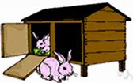
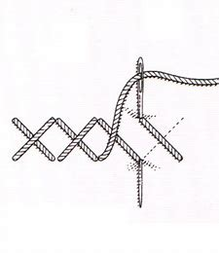
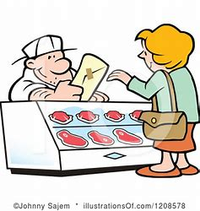
Let’s warm our brains up with a quick quiz about yesterday’s spelling lesson.
Which words are spelt correctly!
hutch or huch
stich or stitch
bucher or butcher
Remember our rule… we use tch after a short vowel sound.

Slide 3
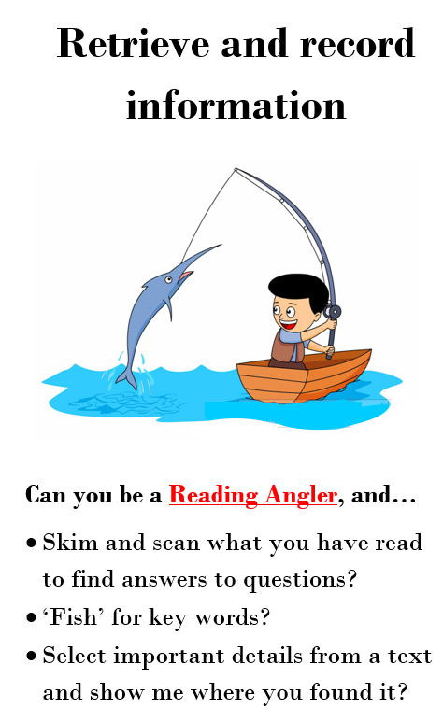
Today, we are focusing on reading comprehension skills.
Today we are focusing on retrieval skills. We use retrieval when the answer is right there in front of us in the text.
This is Reggie. He is our reading character to help us retrieve.
He is a fisherman who fishes the answer straight out.
Notes:
© Copyright Showeet.com – Free PowerPoint Templates

Slide 4
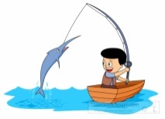
Read this short passage.
Miss Lacey is a teacher in Year Two at Featherstone Primary School. She has two cats called Tilly and Stig.
When she is at home, she loves to read books and grow plants in her garden.
Reggie will help us answer these retrieval questions. Remember, the answer is right there! You should be able to put your finger on it!
What Year group does Miss Lacey teach? She teaches in Year Two.
Notes:
© Copyright Showeet.com – Free PowerPoint Templates

Slide 5
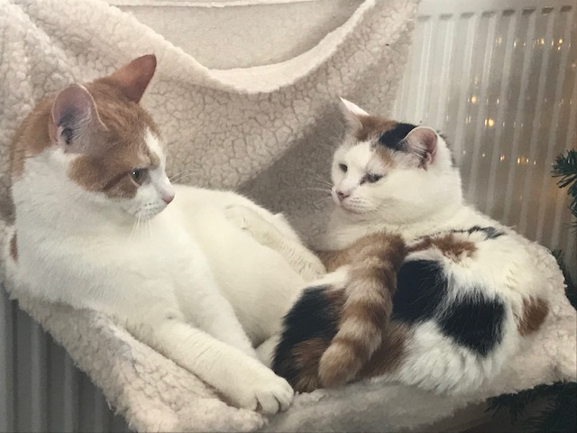
Read this short passage.
Miss Lacey is a teacher in Year Two
at Featherstone Primary School.
She has two cats called Tilly and Stig.
When she is at home, she loves to read books and grow plants in her garden.
Reggie will help us answer these retrieval questions. Remember, the answer is right there! You should be able to put your finger on it!
What are Miss Lacey’s cats called?
Silly and Tig ☒ Millie and Molly ☒ Tilly and Stig ☑ Featherstone and books ☒

Slide 6
Read this short passage.
Miss Lacey is a teacher in Year Two at Featherstone Primary School. She has two cats called Tilly and Stig.
When she is at home, she loves to read books and grow plants in her garden.
Reggie will help us answer these retrieval questions. Remember, the answer is right there! You should be able to put your finger on it!
Tick the statements that are true. She likes to read books. ☑ Miss Lacey is a teacher at Marsh Hill. ☒ She has three cats. ☒ Miss Lacey teaches Year Two. ☑
Yes I do, and I love it! ☺

Slide 7
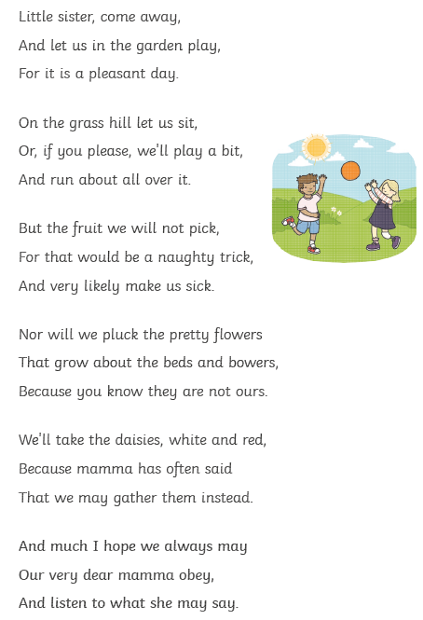
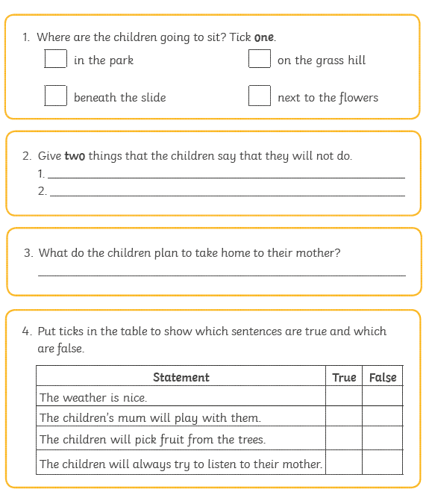
Now, use your retrieval skills to tackle the reading comprehension task.
It should look like this. If you need an adult to help you read, that’s totally okay! ☺ We are practising finding the answers.
If you can’t print, don’t worry, read on the screen and write your answers in your book.
Answers will
be uploaded on
Friday.
Notes:
© Copyright Showeet.com – Free PowerPoint Templates

