Slide 1
Year 2 - Time
Session 2 – 5 mins

Slide 2
Today we are learning to tell the time to the nearest 5 minutes up to half past

Slide 3
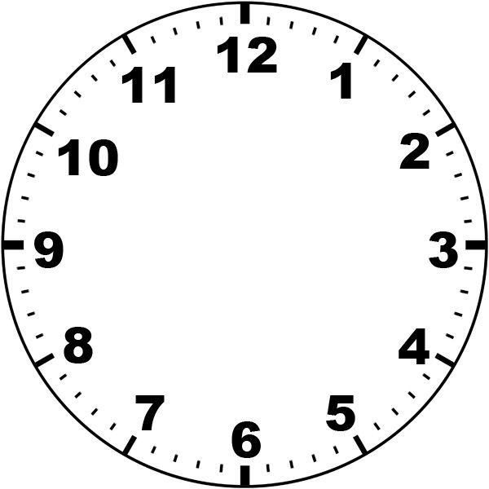
When the minute hand (long hand) is on these numbers:
The 1 represents 5 minutes
The 2 represents 10 minutes
The 3 represents 15 minutes
The 4 represents 20 minutes
The 5 represents 25 minutes
The 6 represents 30 minutes

Slide 4
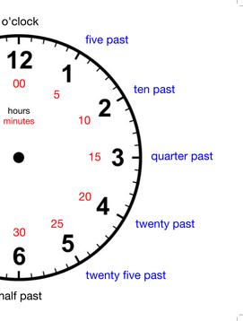

Slide 5
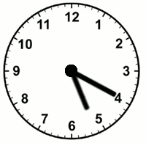
The minute hand (long hand) is pointing on the 4. The 4 represents 20 minutes
The hour hand (short hand) is point on the 5
So the time here is 20 minutes past 5

Slide 6
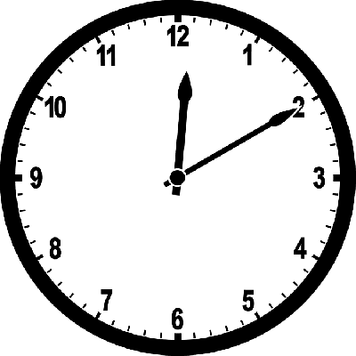
The minute hand (long hand) is pointing on the 2. The 2 represents 10 minutes
The hour hand (short hand) is point on the 12
So the time here is 10 minutes past 12

