Slide 1
Tuesday 30th June 2020
Apostrophes for possession

Slide 2
What does possession mean?
Yesterday, we learnt
about using apostrophes
in contractions.
Today we are using apostrophes to show possession.
If you possess something it belongs to you.

Slide 3
Introduction
Circle all the apostrophes in this sentence.
The apostrophe in rabbit’s shows that the ears belong to the rabbit.
The apostrophe in he’d shows where letters are missing in the contraction.
The rabbit’s ears twitched because he’d heard a noise in the bushes.
© Classroom Secrets Limited 2019

Slide 4
Varied Fluency 1
Circle all the apostrophes.
Match the phrases to the possessive form.
my uncle’s car |  | the car’s tyres
the car’s wheels |  | the car belonging to my uncle
the tyres of the car |  | the wheels of the car
© Classroom Secrets Limited 2019

Slide 5
Varied Fluency 1
Circle all the apostrophes.
Match the phrases to the possessive form.
my uncle’s car |  | the car’s tyres
the car’s wheels |  | the car belonging to my uncle
the tyres of the car |  | the wheels of the car
© Classroom Secrets Limited 2019

Slide 6
Varied Fluency 2
Tick the sentence that uses an apostrophe for possession correctly.
A. The tree’s leaves were golden.
B. The trees leave’s were changing colour.
© Classroom Secrets Limited 2019

Slide 7
Varied Fluency 2
Tick the sentence that uses an apostrophe for possession correctly.
A. The tree’s leaves were golden. |  | ✓
B. The trees leave’s were changing colour.
The leaves belong to the tree. They are the tree’s.
© Classroom Secrets Limited 2019

Slide 8
Varied Fluency 3
Rewrite the sentence using an apostrophe for possession.
The hair belonging to Tess was very long.
© Classroom Secrets Limited 2019

Slide 9
Varied Fluency 3
Rewrite the sentence using an apostrophe for possession.
The hair belonging to Tess was very long.
Tess’s hair was very long.
© Classroom Secrets Limited 2019

Slide 10
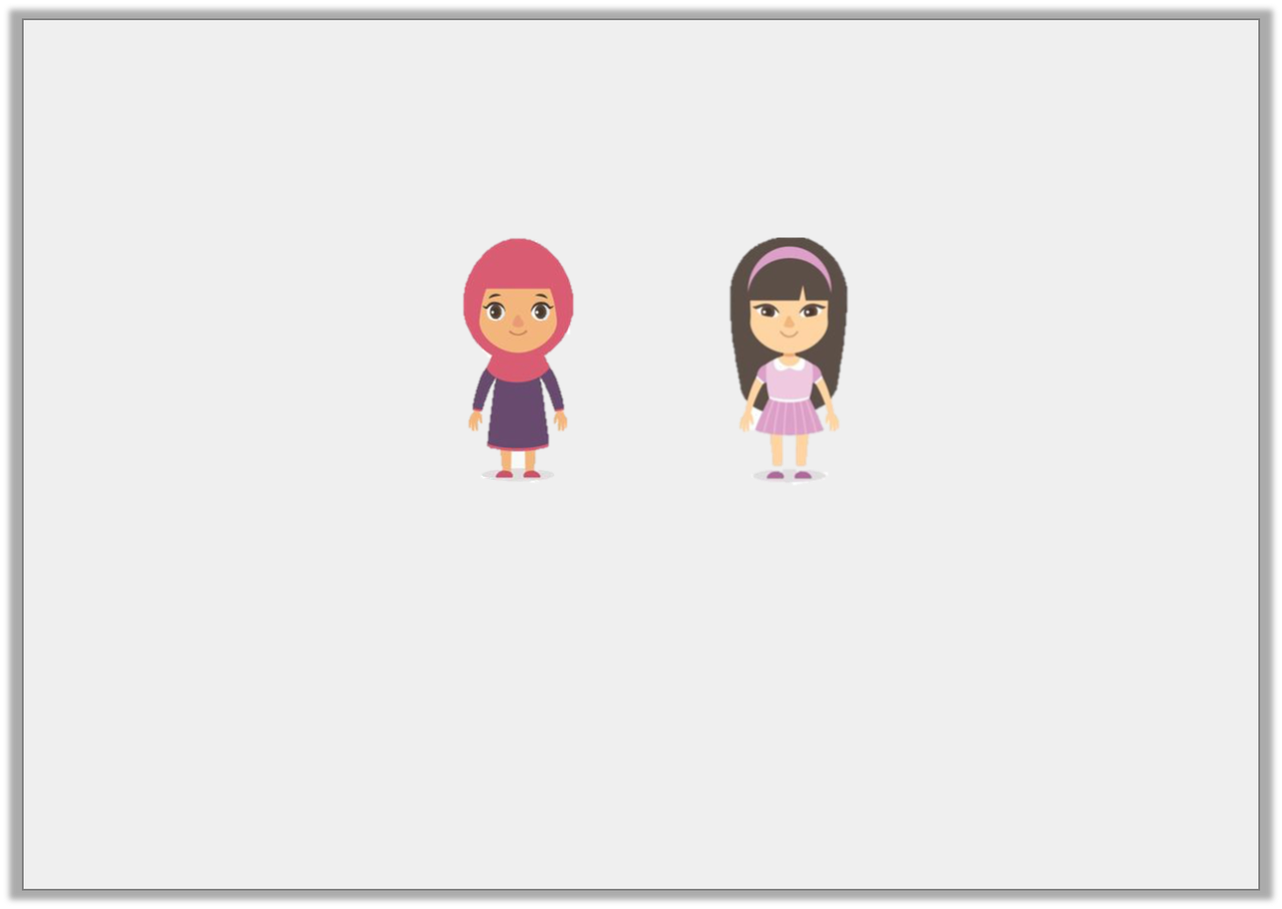
Varied Fluency 4
Use the pictures to complete the sentences.
____________________ dress has long sleeves.
____________________ dress has short sleeves.
Maya
Iris
© Classroom Secrets Limited 2019

Slide 11
Varied Fluency 4
Use the pictures to complete the sentences.
Maya’s dress has long sleeves.
Iris’s dress has short sleeves.
Maya
Iris
© Classroom Secrets Limited 2019

Slide 12
Application 2
Punctuate the sentence below by adding an apostrophe in the correct place.
Dad picked up the babys dummy.
© Classroom Secrets Limited 2019

Slide 13
Application 2
Punctuate the sentence below by adding an apostrophe in the correct place.
Dad picked up the baby’s dummy.
© Classroom Secrets Limited 2019

Slide 14
Reasoning 1
True or false? The apostrophe has been used correctly in the sentence below.
Ben and Sam are Jacob’s friends.
Explain your answer
© Classroom Secrets Limited 2019

Slide 15
Reasoning 1
True or false? The apostrophe has been used correctly in the sentence below.
Ben and Sam are Jacob’s friends.
Explain your answer
This is true because the apostrophe has been used to show that the friends belong to Jacob.
© Classroom Secrets Limited 2019

