Slide 1
Monday 29th June 2020
Contractions and apostophes

Slide 2
What is a contraction?
A contraction is when two words are squeezed together to make one shorter word. e.g. Would not changes to wouldn’t
Do not changes to don’t

Slide 3
Punctuation
As we contract two words together
we remove letters to make the two
Word into one.
Where we take the letters out, we
put in an apostrophe to show that those
Letters are missing.
E.G. Do not Don’t
We have taken out the o in not so we put in an apostrophe to show this.

Slide 4
Year 2 – Spring Block 2 – Apostrophes
Step 1: Recognising Simple Contractions

Slide 5
Introduction
Match the punctuation marks to their labels below.
?
comma
,
question mark
!
full stop
’
exclamation mark
.
apostrophe

Slide 6
Introduction
Match the punctuation marks to their labels below.
?
comma
,
question mark
!
full stop
’
exclamation mark
.
apostrophe

Slide 7
Varied Fluency 1
Circle the contraction in the sentence below.
I think we’ll need to catch the bus.

Slide 8
Varied Fluency 1
Circle the contraction in the sentence below.
I think we’ll need to catch the bus.

Slide 9
Varied Fluency 3
Match the words with their contractions.
is not
she’ll
you have
don’t
do not
you’ve
she will
isn’t

Slide 10
Varied Fluency 3
Match the words with their contractions.
is not
she’ll
you have
don’t
do not
you’ve
she will
isn’t

Slide 11
Varied Fluency 4
Circle the contractions which have been written correctly.
cann’t | shouldn’t
hadn’t | did’nt
are’nt | wasn’t

Slide 12
Varied Fluency 4
Circle the contractions which have been written correctly.
cann’t | shouldn’t
hadn’t | did’nt
are’nt | wasn’t

Slide 13
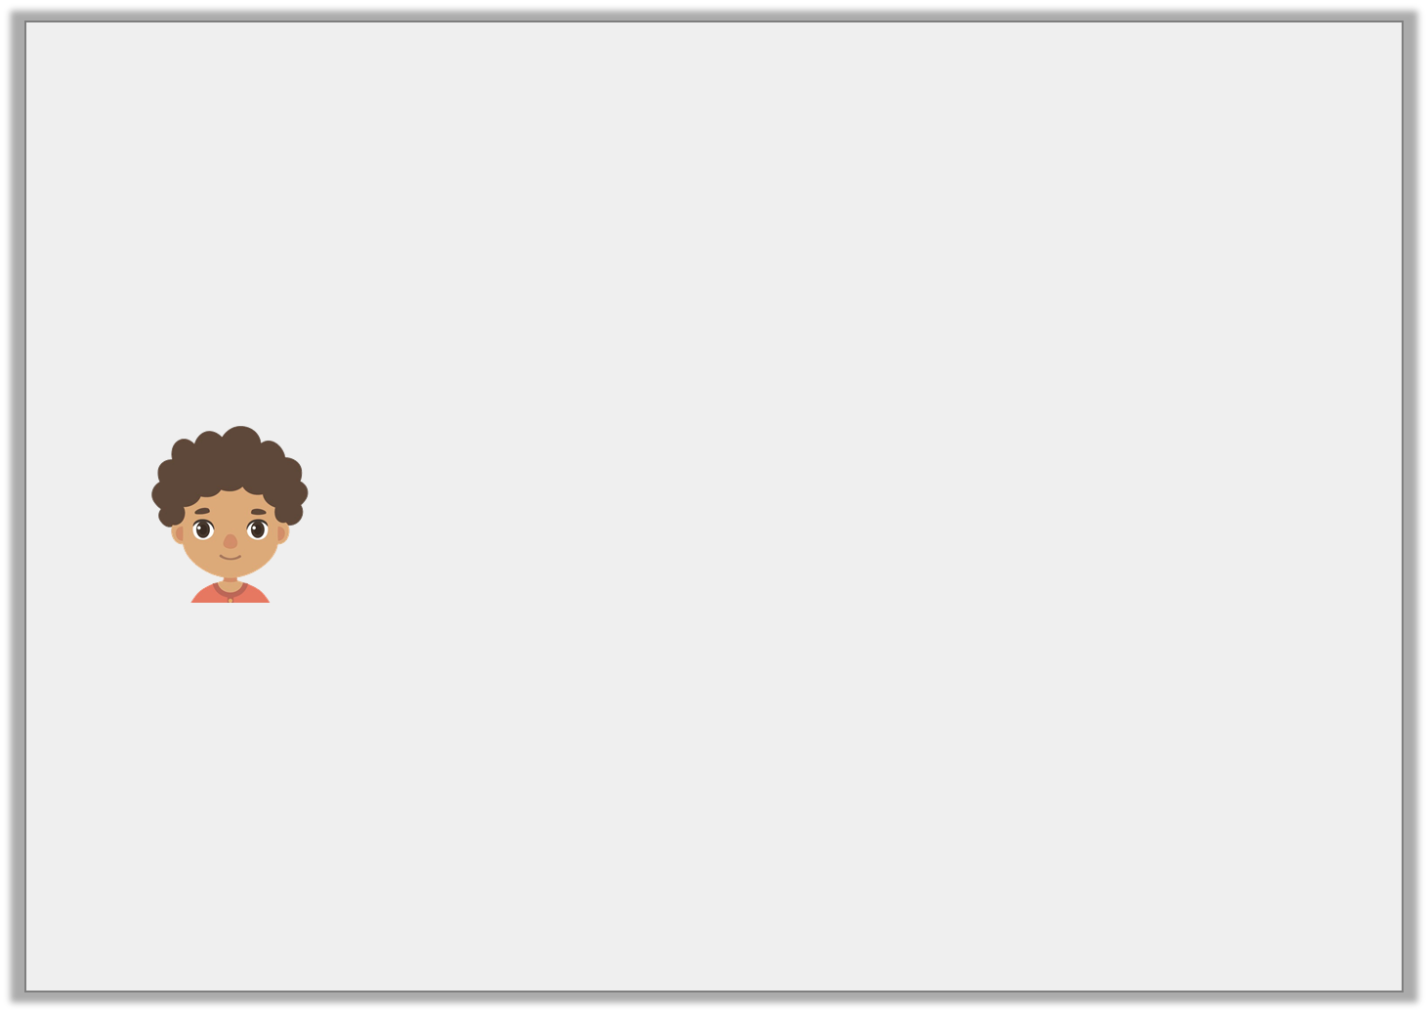
Reasoning 1
Josh has written the sentence below.
He says,
Is he correct?
Explain your reasoning.
After maths, we have got English.
I cannot use any contractions in my sentence.

