Slide 1
Year 1- FRACTIONS
Session 5 – Finding a quarter of a shape

Slide 2
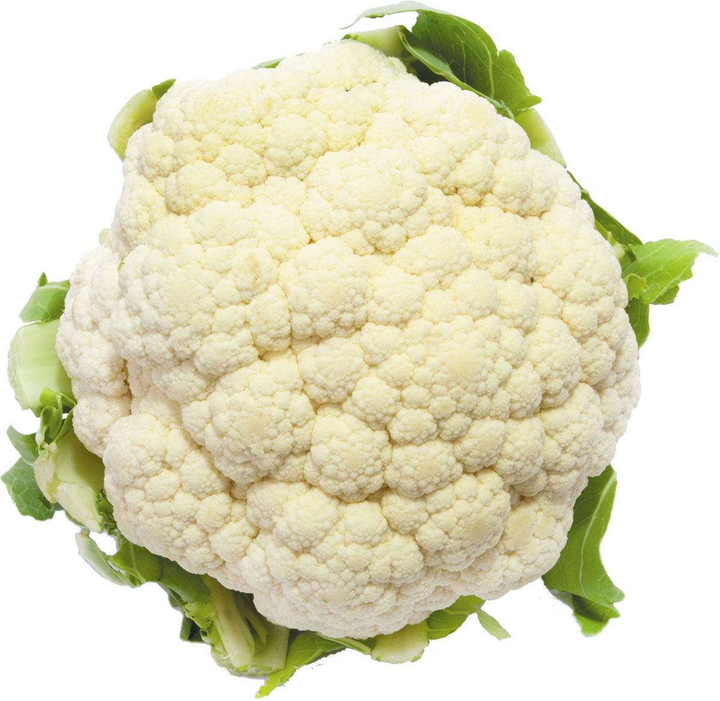
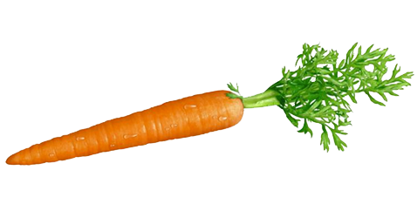
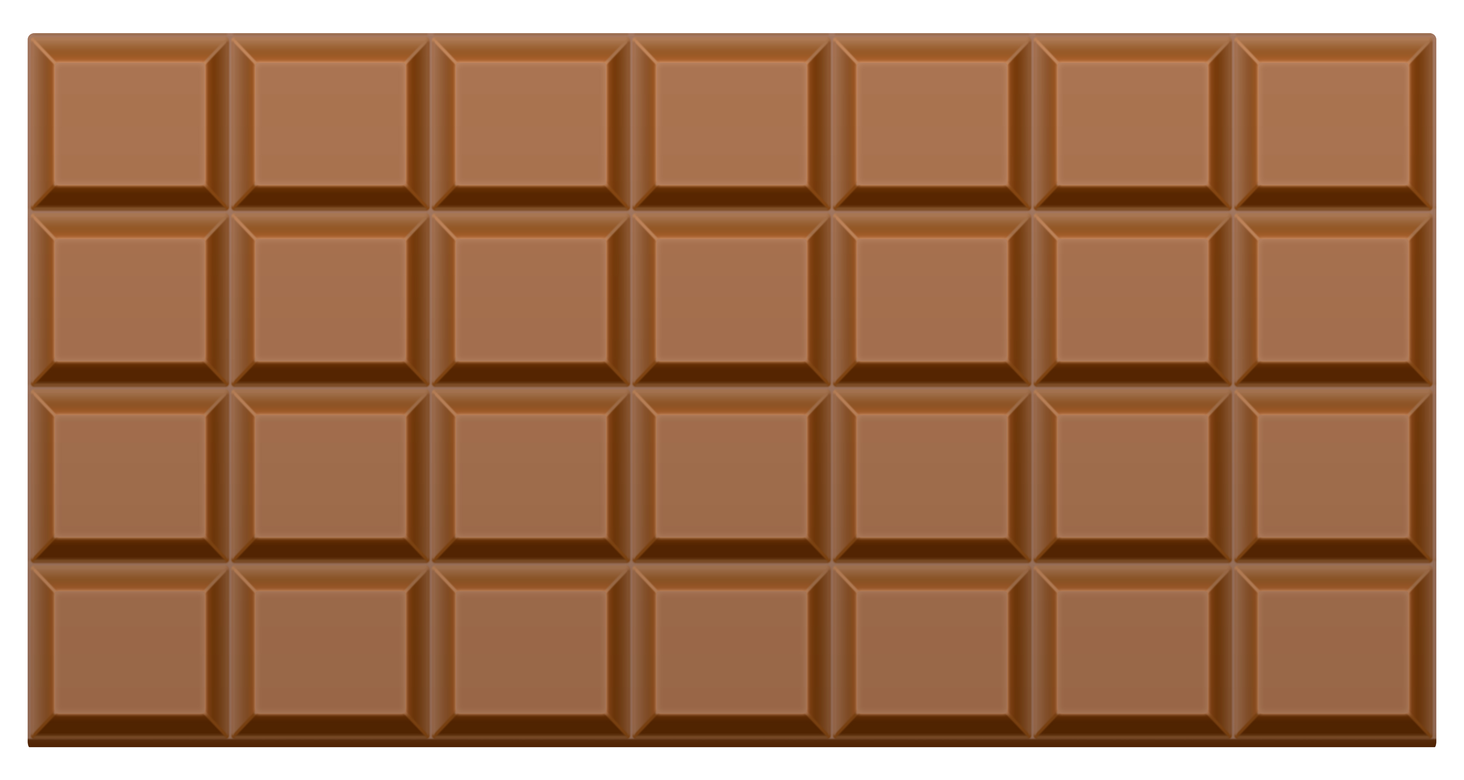
We can also find a quarter of a shape.
The cauliflower and the chocolate have 4 parts that are equal but the carrot only has 2 equal parts. That means the carrot is cut in half not quarters.
Remember…
Whole means all of the object.
Quarters means 4 parts that are exactly the same.
Which objects are cut into quarters?
How do you know?

Slide 3
This is a 2D shape called a rectangle.
How could we find a quarter of the rectangle?
Whole means all of the shape.
Quarters means 4 parts that are exactly the same.
We can find half first.
Then cut each part in half again to make 4 quarters.
We can also fold the shape in half and then in half again to find 1 quarter..
We can draw lines to show the quarters.

Slide 4
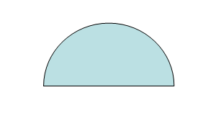
This is a 2D shape called a circle.
How could we find a quarter of the circle?
We can find half first.
Then cut each part in half again to make 4 quarters.
Whole means all of the shape.
Quarters means 4 parts that are exactly the same.
We can also fold the shape in half and then in half again to find 1 quarter.
We can draw lines to show the quarters.

Slide 5
This is a 2D shape called a square.
How could we find a quarter of the square?
We can find half first.
Then cut each part in half again to make 4 quarters.
Whole means all of the shape.
Quarters means 4 parts that are exactly the same.
We can also fold the shape in half and then in half again to find 1 quarter.
We can draw lines to show the quarters.

Slide 6
Do you think we can cut a triangle into quarters?
Why?
We can cut a triangle in half but not quarters.
This is because the 4 parts would be unequal.

