Slide 1
Do you know what a hyphen is?
-
(They’re not dashes)!

Slide 2
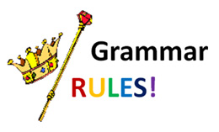
Hyphens
A hyphen is used to join two words together to show that they have a joint meaning or they’re a single object.
In the English language, there are hundreds of words that have hyphens in them.
The easiest way to begin to understand how hyphens work, is to study the word ‘looking.’
Notes:
During this lesson, we will explore several ways in which a hyphen can be used.
Each will be explained, followed by several examples and then an opportunity for children to practice their own.

Slide 3
Hyphens
The word ‘looking’ is an easy, quick way to get hyphens into your writing and can help to start to explain them too.
The kind-looking teacher took the register.
Notes:
Note how if we took away the hyphen, the sentence would become a bit unclear. Is the teacher looking kind? Is that how she is looking around the room? The hyphen makes things a lot clearer!

Slide 4
Hyphens
The mean-looking dog growled as I walked past.

Slide 5
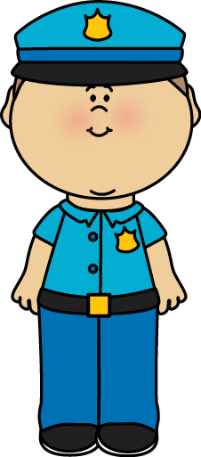
Hyphens
The suspicious-looking man was followed by the police.

Slide 6
Task
Write a sentence which shows your understanding of the hyphen used for ‘looking’.
Repeat with a different example.

Slide 7
Hyphens
During this lesson, we’ll be increasing our understanding of hyphens and how they can sometimes be used to avoid confusion (just like commas can)!

Slide 8
Hyphens
A hyphen is used to join two words together to show that they have a joint meaning or they’re a single object.
Now, we’re going to have a look at some words that would need hyphens in them to show that they’re one object and not several.

Slide 9
Hyphens
The office manager printed the five page document.
Where would the hyphen go?
Notes:
Five-page

Slide 10
Hyphens
“I am really looking forward to my two day break,” said Lily.
Where would the hyphen go?
Notes:
Two-day

Slide 11
Hyphens
The six seater aircraft looked old and unsafe.
Where would the hyphen go?
Notes:
Six-seater

Slide 12
Task
Write a sentence which shows your understanding of the hyphen used to show that there is one object and not several.
Repeat with a different example.

Slide 13
Hyphens
So far, we have covered hyphens:
that are needed before the word ‘looking,’ such as the funny-looking man.
that are needed to show that there is one object and not several, such as four-player game.

Slide 14
Hyphens
A hyphen is used to join two words together to show that they have a joint meaning or they’re a single object.
Next, we’re going to have a look at another really easy way to use hyphens in our work to show that what we’re talking about is one thing!

Slide 15
Hyphens in written numbers
56
Notes:
Model and explain how when you have a two-digit number which is more than 20, and it has a unit value, you would use hyphens.
Fifty-six

Slide 16
Hyphens in written numbers
397
Notes:
Three hundred and ninety-seven

Slide 17
Hyphens in written numbers
1,931
Notes:
One thousand, nine hundred and thirty-one

Slide 18
Hyphens in written numbers
72,463
Notes:
Seventy-two thousand, four hundred and sixty-three
(Two lots of hyphens)

Slide 19
Hyphens
So far, we have covered hyphens:
that are needed before the word ‘looking,’ such as the odd-looking object.
that are needed to show that there is one object and not several, such as ten-sided shape.
that are needed when you are writing a two-digit number > 20, such as thirty-seven.

Slide 20
Hyphens
A hyphen is used to join two words together to show that they have a joint meaning or they’re a single object.
In the English language, there are hundreds of words that have hyphens in them.
Another great way to get them seamlessly into your work is with the word, ‘like.’

Slide 21
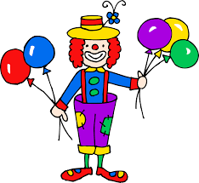
Hyphens
The clown was very child-like in his actions.

Slide 22
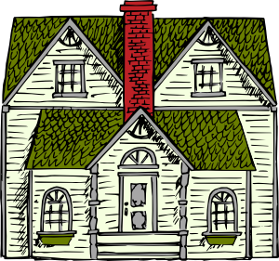
Hyphens
The old building had a mansion-like structure.

Slide 23
Hyphens
The new wallpaper had a shell-like design.

Slide 24
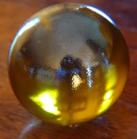
Hyphens
The ball-like object landed at my feet.

Slide 25
Task
Write a sentence which shows your understanding of the hyphen used for ‘like’.
Repeat with a different example.

Slide 26
Hyphens
So far, we have covered hyphens:
that are needed before the word ‘looking,’ such as the good-looking gentleman.
that are needed to show that there is one object and not several, such as three-floor apartment.
that are needed when you are writing a two-digit number > 20, such as seventy-six.
that are needed before the word, ‘like,’ such as a life-like model.

Slide 27
Hyphens
A hyphen is used to join two words together to show that they have a joint meaning or they’re a single object.
In the English language, there are hundreds of words that have hyphens in them.
The hardest job a hyphen has is to avoid ambiguity and make things clear.

Slide 28
Hyphens to avoid ambiguity and make things clear.
Long-haired
Man-eating
Football-crazy
Wrinkly-skinned
Half-grown
Fun-packed
Perfectly-decorated
Partly-eaten
Half-chewed
Fun-loving

Slide 29
Put hyphens in this sentence to make the meaning clear…
In the forest, I saw
three hundred year old trees.

Slide 30
Answer 1
In the forest, I saw
three-hundred-year-old trees.
300
300
300
300
300
300
300
Notes:
Each tree is 300 years old

Slide 31
Answer 2
In the forest, I saw
three hundred-year-old trees.
100
100
100
Notes:
There are 3 trees which are each 100 years old.

Slide 32
Answer 3
In the forest, I saw
three hundred year-old trees.
1
x300!
Notes:
There are 300 trees which are each 1 year old.

Slide 33
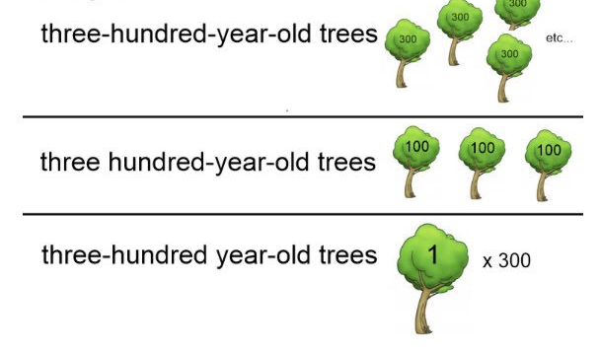
Hyphens are important
Notes:
Really explain and unpick how a hyphen(s) can alter the meaning of a sentence.
They must really make sure the reader has a clear image of what they are referring to.

Slide 34
Your task
We would like you to write a short story (you can choose the context) which includes the following:
A hyphen to show that there is one object and not several
A hyphen to serve a different purpose (a reminder on the next slide)
An expanded noun phrase
Two complex sentences
Make sure you use ambitious vocabulary where appropriate and ensure your sentences and word choices have a purpose.
There are some images on another slide for inspiration if you wish to use them ☺
Notes:
Ensure children have used hyphens appropriately and not for the sake of including one to tick it off - it should serve a purpose.
Encourage children to use a range of sentence types rather than simple sentences throughout ☺

Slide 35
Hyphens
We have covered hyphens:
that are needed before the word ‘looking,’ such as the good-looking gentleman.
that are needed to show that there is one object and not several, such as three-floor apartment.
that are needed when you are writing a two-digit number > 20, such as seventy-six.
that are needed before the word, ‘like,’ such as a life-like model.
that are needed to avoid ambiguity and make things clear.

Slide 36
