Slide 1
Week 9 English 1
Reading

Slide 2
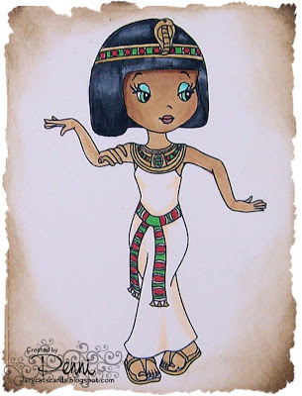
You are going to watch a short video…, one that you will remember from our Egyptian topic!
https://www.youtube.com/watch?v=fWBw9oiZcGQ

Slide 3
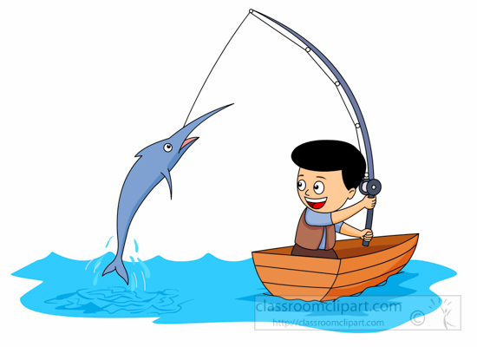
RETRIEVE
Can you find information in the text?
What do certain words mean? (Dictionary)
Look through the text carefully and highlight or underline the words which answer the questions.

Slide 4
INFER
How are the characters feeling?
Why did they do or say that?
What might happen next?
Unlock information from the clues given in the text.

Slide 5
CHOICE
Which words help you understand what is happening?
What techniques has the author used to describe?
How has the author organised or presented the text?
Think carefully about the author’s choice and what they have done to make the text interesting and enjoyable to read.

Slide 6
Retrieve:
What colour is the girl’s hair and costume?
Interpret:
What is this video clip for? What clues are there on the screen which tell you this?
Choice:
What did the director of the clip do to make the pictures/images you see match the song?

